Slide 1
FRMAC Field Team
Field Monitoring Instrumentation
Notes:
Welcome to the Just-in-Time training for FRMAC Field Teams. This training will focus on “Field Monitoring Instrumentation.”
It is assumed that everyone taking this training has some experience with radiological field monitoring equipment such as GM-tubes, Geiger counters, or pancake probes. During this training module, we will introduce you to the instruments that you will use as a member of the FRMAC Field Team. After completing this presentation, you will have an opportunity to handle the instruments and ask questions.

Slide 2
FRMAC
Federal Radiological Monitoring and Assessment Center
Responsible for coordinating all environmental radiological monitoring, sampling, and assessment activities for the response of federal agencies to a major radiological incident.
  Monitoring – the use of detection equipment to determine the levels of radiation in the environment or to determine the level of radioactivity on objects or people.
  Sampling – the collection of representative environmental media to determine the extent of contaminant deposition in soil, water, air, and on vegetation.
  Assessment – evaluation and interpretation of information to develop a basis for making decisions.
Notes:
First, some basic background…FRMAC is the Federal Radiological Monitoring and Assessment Center and is responsible for coordinating all environmental radiological monitoring, sampling, and assessment activities for the response of federal agencies to a major radiological incident. FRMAC works closely with the state, tribal, and local response organizations to ensure smooth integration of their resources with the FRMAC if they so choose to combine resources.
Let’s define these three activities:
<CLICK> Monitoring is the use of detection equipment to determine the levels of radiation in the environment. For example, you may use a survey meter to determine the milliRoentgens per hour (mR/hr) at a location. Another word frequently used for this term is “surveying.” We also monitor, or survey, objects or people to determine the amount of radioactivity that may be contaminating the objects or people. The units may be in counts per minute (cpm) or picoCurie per square centimeter (pCi/cm²).
<CLICK> Sampling is the collection of representative environmental media to determine the extent of contaminant deposition on or in soil, water, air, and vegetation. For example, you may take a soil sample at a location to determine if that area is contaminated with radioactive material.
<CLICK> Assessment is the evaluation and interpretation of information to develop a basis for making decisions. For example, this is the function that analyzes that soil sample or survey measurement and evaluates their relation to the EPA’s Protective Action Guides (or PAGs) for evacuation or relocation.
<CLICK> This training module concentrates on the monitoring aspect of FRMAC.

Slide 3
Training Objectives
Familiarization with standard radiation survey instruments
Performance and documentation of pre-operational checks, including quality control checks
Performance and documentation of surveys
Selection of appropriate survey areas
Notes:
We have four main training objectives today.
First, by the end of today’s training and practicum, you will be familiar with the standard radiation survey instruments that you will use as a part of a FRMAC Field Team.
<CLICK> You will also be able to perform and document the required pre-operational checks, including quality control checks, on the survey instruments you will be using in the field.
<CLICK> Third, you will also be able to perform and document area surveys.
<CLICK> Finally, you will be able to select an appropriate survey area when sent to a location to survey.

Slide 4
FRMAC Monitoring Manual, Volume 2, Radiation Monitoring and Sampling
Chapter 3, “Field Monitoring”
Chapter 7, “Equipment Contamination Surveys”
Appendix A, “Forms and Checklists”
  Daily Instrument QC Checks
  Field Monitoring Log
  FRMAC Field Monitoring Team Assignment, ICS 204-FRMAC
  Team, Instrument, & Equipment Information Log
Notes:
Much of the generic information for this training module comes from the July 2012 FRMAC Monitoring Manual, Volume 2, Radiation Monitoring and Sampling. We will be talking about Chapters 3 and 7 and using the forms listed here from Appendix A.

Slide 5
Radiation and Detector Types
Notes:
Before we jump into talking about the radiation detection equipment to be used in the field, lets quickly cover some basics of radiation.

Slide 6
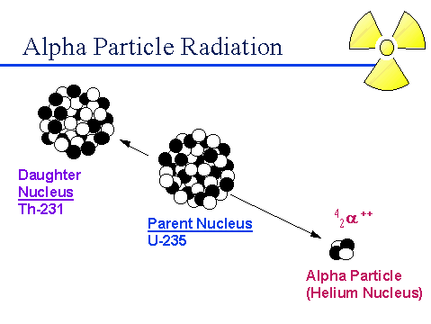
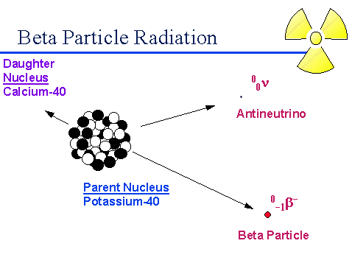
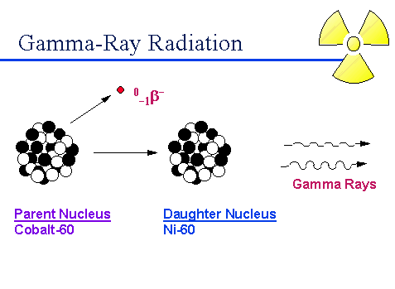
Radioactive Decay – Alpha and Beta Particles,
Gamma-Rays
Notes:
There are three main types of radiation that we are interested in measuring in the field: alpha particles, beta particles, and photons (x-rays or gamma-rays). All three of these types of radiation originate in the nucleus of a radioactive atom and may be emitted when the atom decays.
A few of the heavier elements emit alpha particles that may or many not be accompanied by gamma-rays. An alpha particles is composed of 2 protons and 2 neutrons, like a helium nucleus. The lightest known alpha emitters are the lightest isotopes of tellurium (element 52); uranium, plutonium, and americium all emit alpha particles during their decay.
Most radioactive material that will be encountered as the result of an emergency incident will emit beta particles and gamma radiation. A beta particle is similar to an electron except it is ejected by a nucleus during decay. Gamma-rays are pure energy like x-rays, but with higher energies. There are some radionuclides, such as Strontium-90, that only emit beta particles. Cesium-134, Iodine-131, and Cobalt-60 emit both beta particles and gamma-rays.

Slide 7
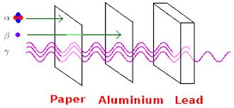
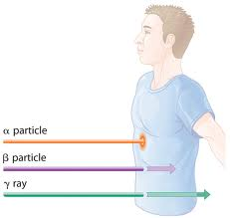
Radiation Penetration Ability
Notes:
As shown in this picture, alpha particles do not travel very far; they can be completely stopped by a few inches of air or a sheet of paper. Alpha particles cannot penetrate the outer layer of skin. Therefore, if the alpha-emitting radionuclide is OUTSIDE of the body, it does not pose a hazard. BUT, alpha-emitting radionuclides pose a serious hazard when inhaled or ingested. Because alpha particles do not travel very far in air, they are difficult to measure directly in the environment.
Beta particles travel further than alpha particles. Beta particles can travel several feet in air and can penetrate human skin to the layer where new skin cells are produced. Therefore, if the beta-emitting radionuclide is deposited on the skin, it may cause skin injury. Beta-emitting radionuclides are also a hazard when inhaled or ingested.
Photon radiation, x-rays and gamma-rays, are very penetrating. They are able to travel great distances in air and can penetrate other materials. Dense materials are needed to stop these types of radiation. They frequently accompany the emission of alpha and beta radiation during radioactive decay. They constitute mainly an external hazard to humans.
All three types of radiation are known as “ionizing radiation.” When ionizing radiation passes through material, it deposits enough energy to break molecular bonds and displace (or remove) electrons from atoms. This electron displacement creates two electrically charged particles (ions), which may cause changes in living cells of plants, animals, and people.

Slide 8
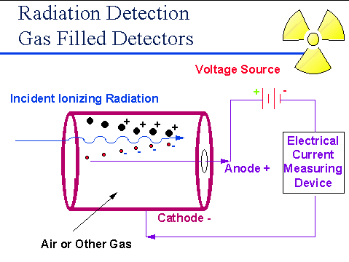
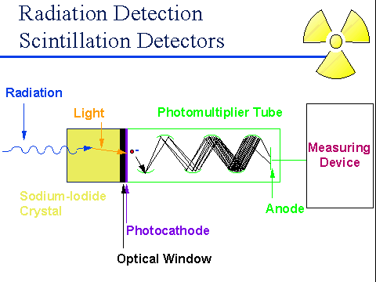
Basic Types of Detectors
Notes:
The ability of these types of radiation to cause ionization in materials allows us to detect the radiation.
Two of the most common types of detectors are gas filled detectors and scintillation detectors.
Gas filled detectors, such as a Geiger-Mueller (GM) tube or probe, are most often used with handheld radiation survey instruments. When a high voltage is applied to the anode, an electrical pulse is created when the radiation interacts with the wall or gas in the tube.
When radiation interacts with a solid crystal in a scintillation detector, it creates a pulse of light (i.e., it scintillates). This pulse of light is converted to an electrical signal by a photomultiplier tube. The pulse of light is proportional to the amount of light and the energy deposited in the crystal. Special plastic or other inert crystal materials may used in place of the sodium iodide crystal shown here.

Slide 9
Canberra Emergency Response Kit
Notes:
At this time, we will discuss the standard radiation survey instruments that will be issued to you as part of a FRMAC Field Team. DOE and FRMAC use the Canberra Emergency Response Kit.

Slide 10
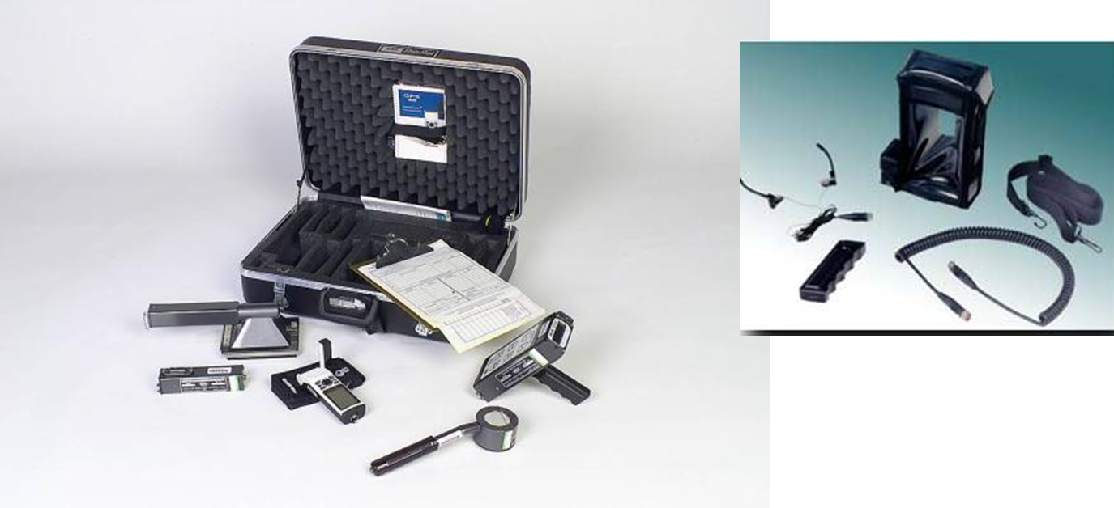
Canberra Emergency Response Kit
Notes:
The Canberra Emergency Response Kit is manufactured by Canberra and includes a multi-function survey meter with two built-in Geiger-Mueller (GM) detectors and a beta window; it also includes three external probes for measuring alpha, beta, and gamma radiation. The kit comes with a hard case that has shaped padding for all the components and connectors.
Prior to actually being dispatched into the field, you will need to perform pre-operational checks, such as making sure all the parts are in the kit and there is no physical damage to any of the equipment. You will also need to perform quality control checks on your instruments, such as determining normal background response and source response or quality control source checks.

Slide 11
Canberra Emergency Response Kit
Introduction, Pre-Operational and Quality Control Checks
Notes:
Instead of just talking about the Canberra Emergency Response Kit and how to do the pre-deployment checks, let’s watch as our Field Team introduces you to the equipment and checks necessary.
{INSTRUCTOR NOTE: Minimize this PPT. Run the video: “Intro to Instrumentation.” The video is ~18 minutes long.}

Slide 12
Questions?
Notes:
<After answering questions, take a short break.>

Slide 13
Performing Monitoring Activities
Notes:
Now that you are familiar with the Canberra Emergency Response Kit survey meter and probes, let’s look at how monitoring is performed for each of our radiation types.
In next four videos, we will see how to monitor for each of the three types of radiation with the ADM-300 survey meter and with each of the three external probes.

Slide 14
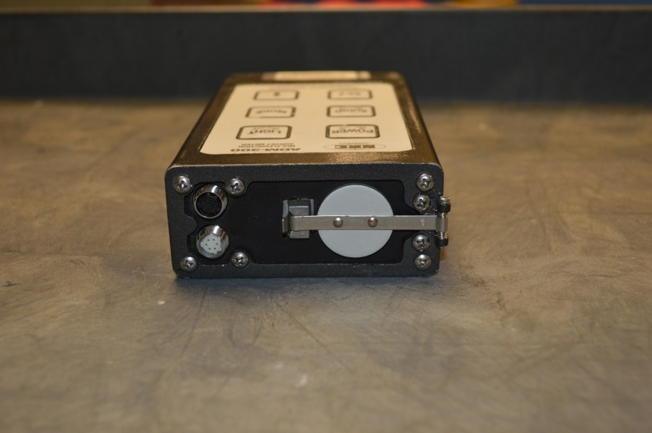
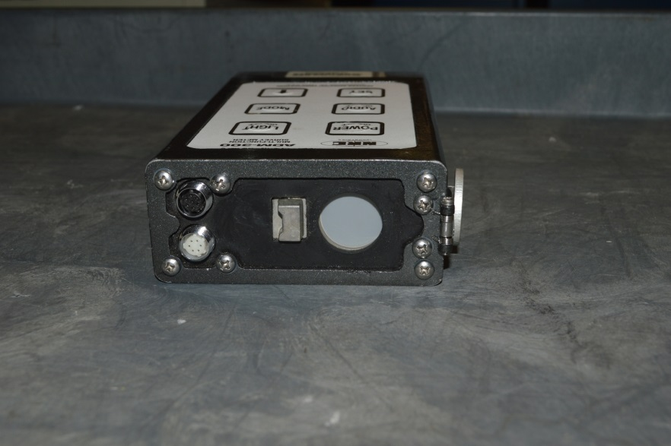
Beta-Gamma Monitoring
ADM-300 Survey Meter
  Internal end-window GM detector
Survey distance
  ½ inch for “ground level” or close monitoring
  ~1 meter (or 3 feet) for area monitoring
Survey rate – 2 to 3 inches/min
Normal survey units (auto-ranging)
  Dose (uR, mR, R)
  Dose rate (uR/h, mR/h, R/h)
Notes:
Beta-gamma monitoring may be performed using the ADM-300 with its internal probes. One probe is an end-window Geiger-Mueller, or GM, detector; the other is a GM detector used for higher levels of radiation. The detector should be within ½ inch of the surface of the object that you are surveying; or, the survey meter may be used to take an area survey – normally taken at ~ 1 meter or 3 feet from the ground (about waist level). The normal survey units when using the ADM-300 are dependent on whether you are measuring dose or dose rate and will indicate either microRoentgens, milliRoentgens, or Roentgens or those dose units per hour. The meter is auto-ranging; therefore, you will need to record the appropriate units. With the beta window open, you also have the ability to DETECT beta particles; however, you cannot quantify the amount of beta radiation. Normally, you will be looking for the difference between the open window and closed window readings to indicate the presence of beta-emitting radionuclides.
As we indicated in the video for “Introduction, Pre-Operational and Quality Control Checks,” the most likely sources of beta and gamma radiation are fission and activation products such as iodine-131 or cesium-137 or activation products such as cobalt-60 or manganese-54.
Accidents likely to result in the release of fission or activation products include nuclear power plant accidents, nuclear weapons detonations, criticality accidents, and accidents involving spent nuclear fuel.

Slide 15
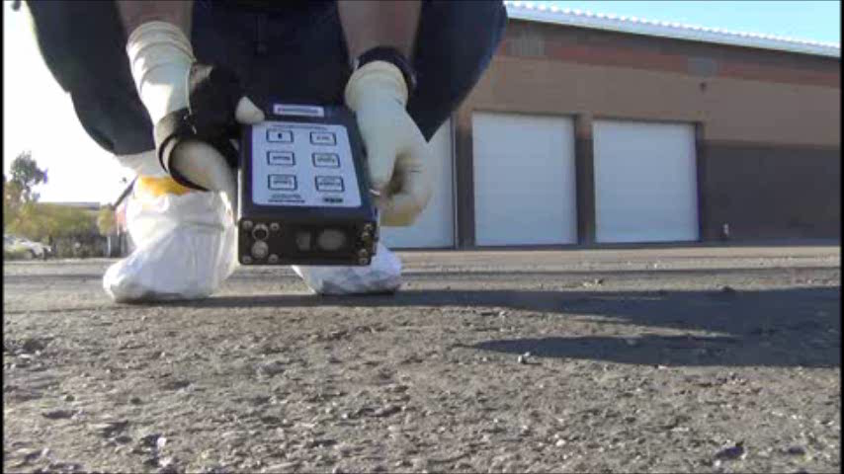
Beta-Gamma Monitoring
Using the ADM-300 Survey Meter Without an External Probe
Notes:
Lets watch as our Field Team demonstrates ground level beta-gamma monitoring.
First, our Survey Technician took a survey with the beta window open; then, he repeated the survey with the beta window closed.
The Technician will repeat these activities with the detector held at about 1 meter, or at waist level, from the ground.

Slide 16
Notes:
As survey measurements are taken, the team records the measurements on the Field Monitoring Log. Here we show you all the measurements taken with the ADM-300 including the closed and open window measurements at waist level and at ground level.

Slide 17
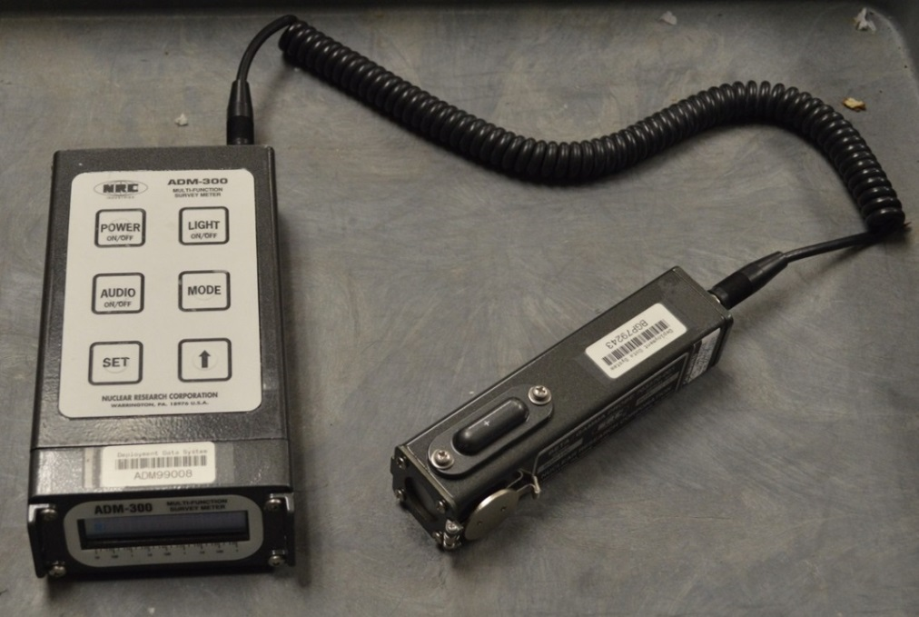
Beta-Gamma Monitoring
BGP-100 Probe
  End-window GM detector
  Identical to the internal ADM-300 detector
Survey distance
  ½ inch for “ground level” or close monitoring
  ~1 meter (or 3 feet) for area monitoring
Survey rate – 2 to 3 inches/min
Normal survey units
  Dose (uR, mR, R)
  Dose rate (uR/h, mR/h, R/h)
Notes:
Beta-gamma monitoring may also be performed using the BGP-100 Beta-Gamma Probe. This probe is an end-window Geiger-Mueller detector identical to the internal detectors of the ADM-300 survey meter. Therefore, the survey distance, rate, and units are the same as for the ADM-300 without an external probe.

Slide 18
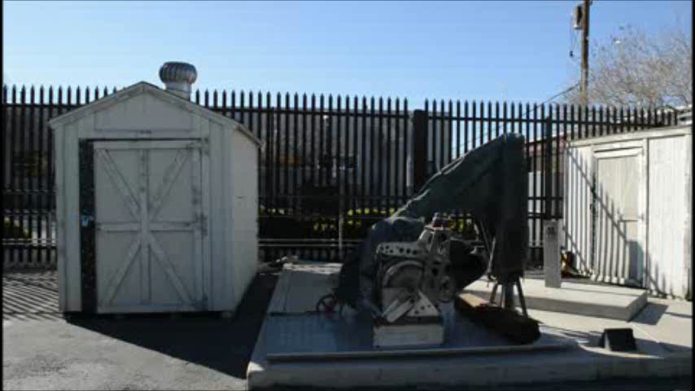
Beta-Gamma Monitoring
Using the ADM-300 Survey Meter and BGP-100 Beta-Gamma Probe
Notes:
Let’s watch our Field Team demonstrate beta-gamma monitoring using the BGP-100 probe.
The advantage to using the separate BGP-100 probe is that it is easier to hold it at waist level and you can also survey equipment as shown in this video.
Also, notice that the technician took an open window survey and then a closed window survey.

Slide 19
Notes:
As each measurement is taken, it is included on the same Field Monitoring Log form. Here, we have added the measurements taken with the BGP-100 probe.

Slide 20
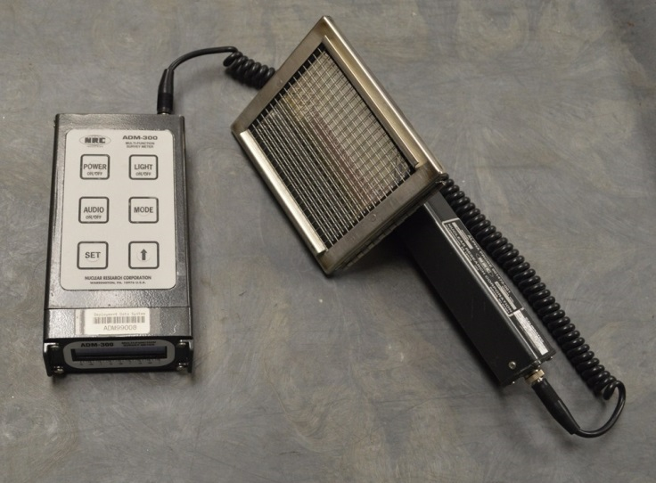
Alpha Contamination Monitoring
AP-100 Alpha Probe
  ZnS scintillator
  100 cm² mylar window
Survey distance – ¼ inch
Survey rate – 2 to 3 inches/min
Normal survey units:
  CPM
  DPMxCMxCM (dpm/100 cm²)
  uCi/MxM (micro-Curie/m²)
Notes:
Alpha contamination monitoring is performed using the AP-100 Alpha Probe. This probe has a Zinc Sulfide scintillator detector and a 100 square centimeter mylar window. Because alpha particles do not travel very far in air, you must be very close – within ¼ inch – of the surface of the object that you are surveying. The normal survey units for alpha monitoring are either counts per minute, disintegrations per minute per 100 square centimeters, or microCuries per square meter. You will be told during your pre-briefing which units to use when performing your surveys.
As we indicated in the video for “Introduction, Pre-Operational and Quality Control Checks,” the most likely sources of alpha radiation are isotopes of uranium, plutonium, americium, and other transuranic elements.
Accidents likely to result in the release of alpha-emitting radionuclides include accidents involving un-irradiated fuel, special nuclear materials, and radio-isotopic thermoelectric generators; as well as radiological dispersion devices.

Slide 21
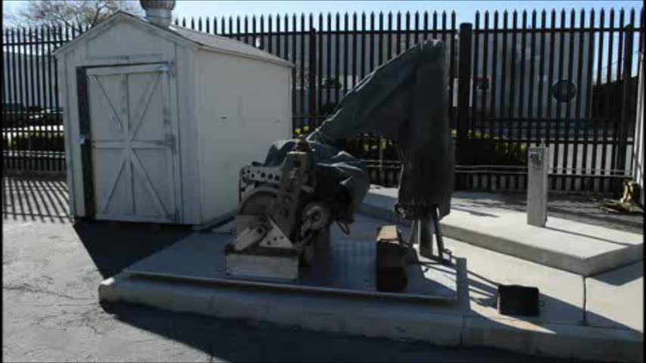
Alpha Monitoring
Using the ADM-300 Survey Meter and AP-100 Alpha Probe
Notes:
Let’s watch as our team demonstrates alpha monitoring of a piece of equipment in the field.

Slide 22
Notes:
Again, we have added the alpha probe measurements to our log.

Slide 23
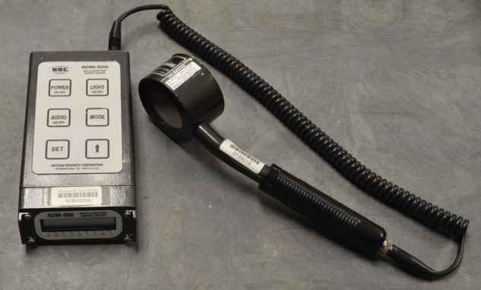
Beta Contamination Monitoring
BP-100 Beta Probe
  Pancake GM probe
  15.5 cm2 thin window
Survey distance – ¼ to ½ inch
Survey rate – 2 to 3 inches/min
Normal survey units:
  CPM beta
  CPM B+G
  uR/h (from internal detector only)
Notes:
Beta contamination monitoring is performed using the BP-100 Beta Probe. This probe has a thin window pancake Geiger-Mueller detector. The detector should be within ¼ to ½ inch of the surface of the object that you are surveying. The normal survey units when using the BP-100 probe are either counts per minute beta, counts per minute beta plus gamma, or microRoentgens per hour which is measured using the internal detector in the ADM survey meter. You will be told during your pre-briefing which units to use when performing your surveys.
As we indicated in the video for “Introduction, Pre-Operational and Quality Control Checks,” the most likely sources of beta radiation are fission and activation products such as iodine-131 or cesium-137 or activation products such as cobalt-60 or manganese-54.
Accidents likely to result in the release of fission or activation products include nuclear power plant accidents, nuclear weapons detonations, criticality accidents, and accidents involving spent nuclear fuel.

Slide 24
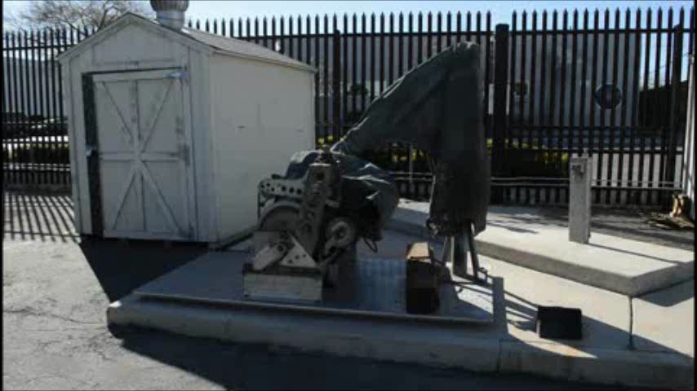
Beta Monitoring
Using the ADM-300 Survey Meter and BP-100 Beta Probe
Notes:
Now, our Field Team will demonstrate beta monitoring on the same piece of equipment as they did the alpha survey on.

Slide 25
Notes:
Finally, the pancake probe measurements are also added to the form.

Slide 26
Questions?

Slide 27
Dispatch and Site Selection
Notes:
Now that you have seen how to perform pre-operational and quality control checks, you will need to prepare for dispatch to your surveying or sampling location. Once at your assigned location, you will have to choose a specific site to perform your surveys or samples.

Slide 28
Dispatch and Site Selection
Notes:
Let’s watch as our Field Team prepare their vehicle, their equipment, and themselves for dispatch. And, then, watch how they choose a specific site to perform their surveys or sampling activities.
{INSTRUCTOR NOTE: Minimize this PPT. Run the video: “Dispatch and Site Selection.” The video is ~14 minutes long.}

Slide 29
Questions?

Slide 30
Recap & Practicum
Notes:
We had four objectives today.
First, we wanted to familiarize you with the standard radiation survey instruments that you will use as a part of a FRMAC Field Team. The type of detection probe you will use is dependent on the type of radiation that you will expect in the field which, in turn, is dependent on the type of event.
We taught you how to perform and document the required pre-operational checks, including quality control checks, on those instruments.
Next, we demonstrated how to perform and document surveys for alpha, beta, or beta-gamma radiation.
Finally, we showed you how to choose an appropriate survey area when you are sent to a particular location.
Now, it is your turn to handle the instruments you will be using in the field!

