Slide 1
FRMAC Field Team
Environmental Sample Collection
Notes:
Welcome to the Just-in-Time training for FRMAC Field Teams. This training will focus on “Environmental Sample Collection.”
It is assumed that everyone taking this training has some experience with radiological field monitoring equipment such as GM-tubes, Geiger counters, or pancake probes. During this training module, we will introduce you to the procedures and equipment that you will use as a member of the FRMAC Field Team to collect environmental samples.
After demonstration of each type of sample collection, you will have an opportunity to handle the equipment and ask questions.

Slide 2
FRMAC
(Federal Radiological Monitoring and Assessment Center)
Responsible for coordinating all environmental radiological monitoring, sampling, and assessment activities for the response of federal agencies to a major radiological incident.
  Monitoring – the use of detection equipment to determine the levels of radiation in the environment or to determine the level of radioactivity on objects or people.
  Sampling – the collection of representative environmental media to determine the extent of contaminant deposition in soil, water, air, and on vegetation.
  Assessment – evaluation and interpretation of information to develop a basis for making decisions.
Notes:
First, some basic background...FRMAC is the Federal Radiological Monitoring and Assessment Center and is responsible for coordinating all environmental radiological monitoring, sampling, and assessment activities for the response of federal agencies to a major radiological incident. FRMAC works closely with the state, tribal, and local response organizations to ensure smooth integration of their resources with the FRMAC if they so choose to combine resources.
Let’s define these three activities:
<CLICK> Monitoring is the use of detection equipment to determine the levels of radiation in the environment. For example, you may use a survey meter to determine the milliRoentgens per hour (mR/hr) or microRoentgens per hour (µR/hr) at a location. Another word frequently used for this term is “surveying.” We also monitor, or survey, objects or people to determine the amount of radioactivity that may be contaminating the objects or people. The units may be in counts per minute (cpm) or picoCurie per square centimeter (pCi/cm²).
<CLICK> Sampling is the collection of representative environmental media to determine the extent of contaminant deposition on or in soil, water, air, and vegetation. For example, you may take a soil sample at a location to determine if that area is contaminated with radioactive material.
<CLICK> Assessment is the evaluation and interpretation of information to develop a basis for making decisions. For example, this is the function that analyzes that soil sample or survey measurement and evaluates their relation to the EPA’s Protective Action Guides (or PAGs) for evacuation or relocation.
<CLICK> This training module concentrates on the sampling aspect of FRMAC.

Slide 3
Training Objectives
Dispatch and site selection
Performance, packaging, and documentation (including chain-of-custody) of sample collection
  Air
  Soil for Ground Deposition
  Smear (Swipe) for Ground Deposition
  Vegetation
  Water
Notes:
We have two main training objectives today. After today’s training, you will understand the activities to be completed prior to dispatch from the assembly area including instrument checks and preparing your vehicle for possibly contaminated materials, and you will be able to select an appropriate sampling area.
<CLICK> And, you will be able to perform, package, and document sample collection for these types of samples.

Slide 4
FRMAC Monitoring Manual, Volume 2, Radiation Monitoring and Sampling
Chapter 4, “Sample Collection”
Chapter 5, “Sample Packaging and Labeling”
Chapter 6, “Sample Control”
Chapter 7, “Equipment Contamination Surveys”
Appendix A, “Forms and Checklists”
  Field Monitoring Log
  FRMAC Field Monitoring Team Assignment, ICS 204-FRMAC
  Sample Control Form & Chain of Custody
  Team, Instrument, & Equipment Information Log
Appendix B, “Operator Aids”
http://www.nv.doe.gov/nationalsecurity/homelandsecurity/frmac/manuals.aspx
Notes:
The information for this training module comes from the July 2012 FRMAC Monitoring Manual, Volume 2, Radiation Monitoring and Sampling. We will be talking about Chapters 4 through 7 and using the forms listed here from Appendix A. Please note that there are Operator Aids in Appendix B; the most up-to-date operator aids are available at the website given here – at this time, these Operator Aids are just for some of the sample collection procedures.

Slide 5
Dispatch and Site Selection
Notes:
The types of samples needed will vary depending on the emergency and the responding organizations. FRMAC, in consultation with the state, tribal, and local responding organizations, will determine the general area where the different types of samples are necessary.
However, there are some common activities that you will need to perform prior to dispatch from the assembly area. In addition, there are some elements of choosing a sample site that are the same no matter which sample type you are collecting.

Slide 6
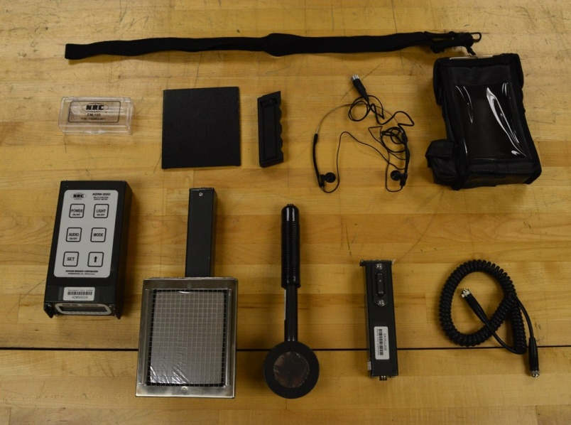
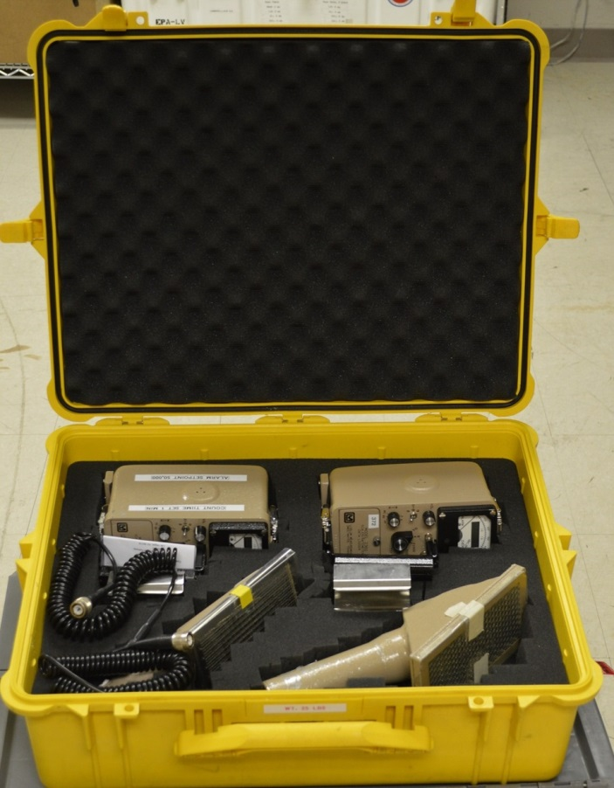
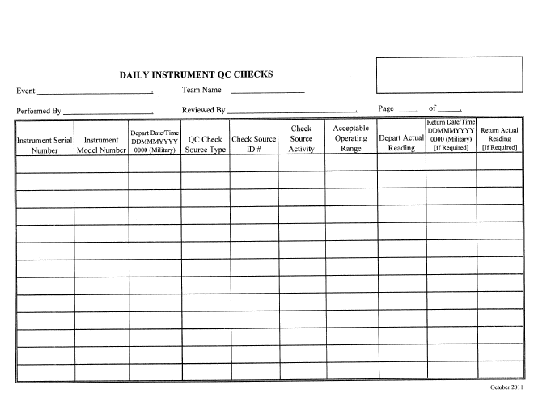
Radiation Survey Instrument
Notes:
Normally, you will be issued the Canberra Emergency Response Kit. This kit, shown here on the left, includes a multi-function survey meter with two build-in Geiger-Mueller (GM) detectors and three external probes. These external probes are for measuring alpha particles, beta particles, and gamma radiation. There are also connectors, a cover, and earphones that you see here.
There are other kits also available; such as the Ludlum kit shown here. We will be showing the Canberra kit in our videos. Specific instructions for the differences between the two manufacturers will be given to you if you are assigned something other than the Canberra kit.
Regardless of the instrument manufacturer, you will need to perform pre-operational and quality control checks on your radiation instruments prior to dispatch.

Slide 7
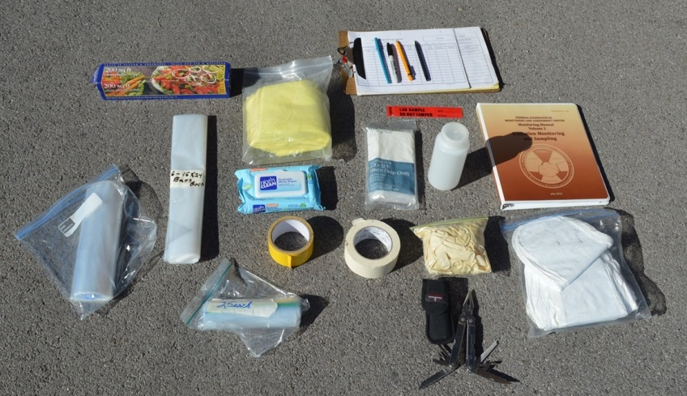
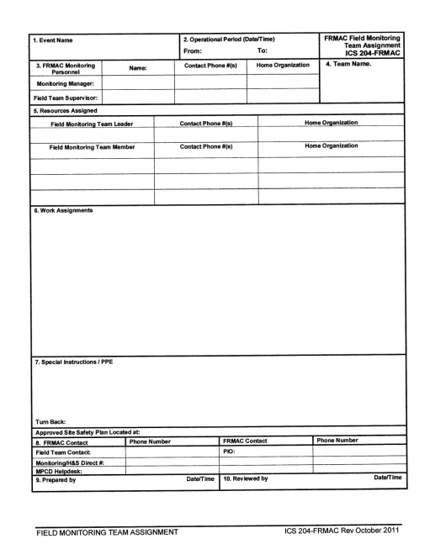
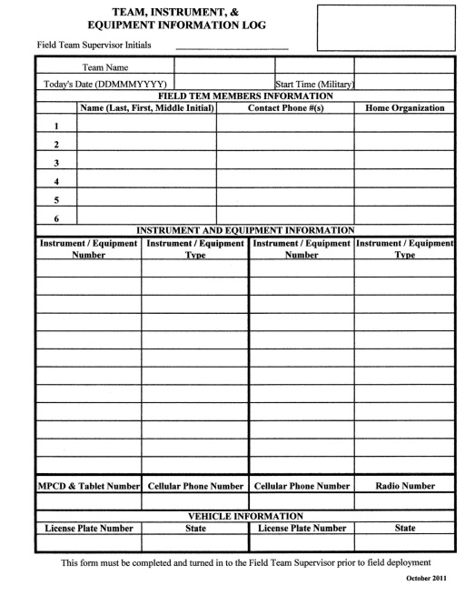
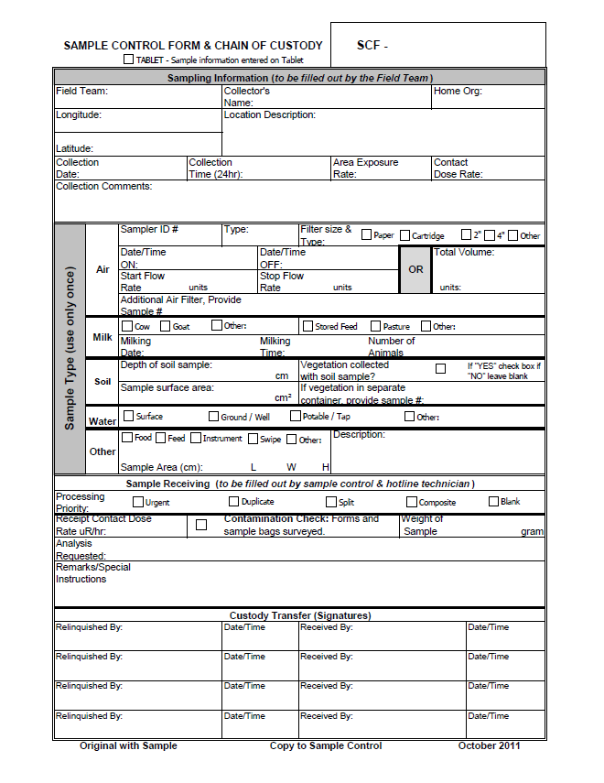
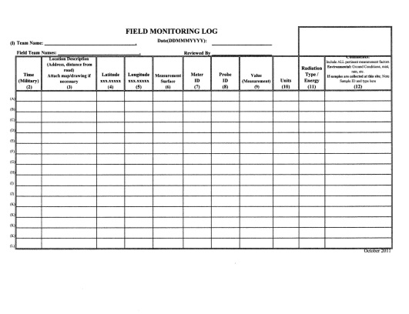
Notes:
You will also be issued some generic supplies and required forms as shown here. Usually, FRMAC will have these supplies packed in a duffle bag for you. The forms may be either paper copies or included on the eFRMAC Tablet.

Slide 8
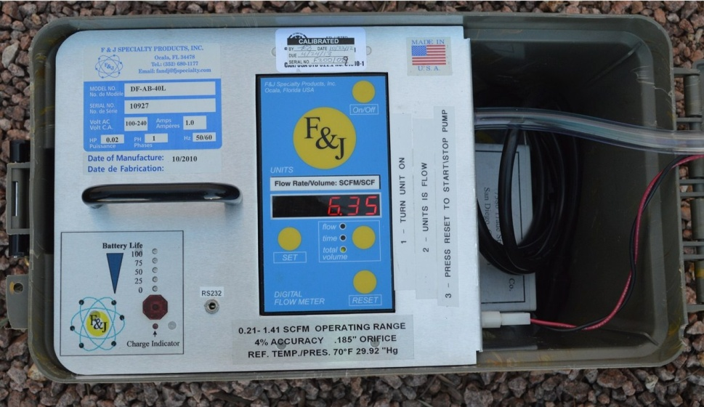
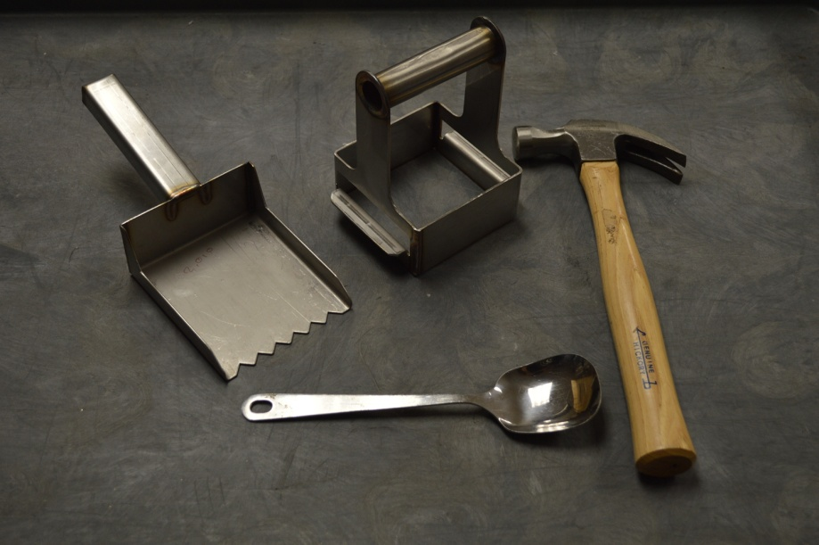
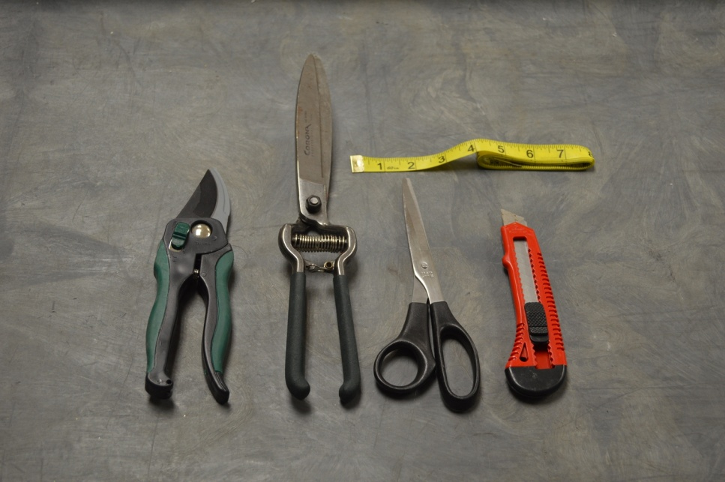
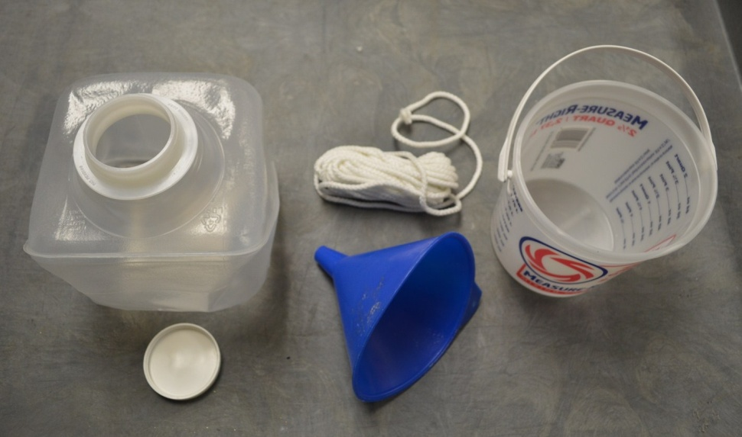
Sample Collection Tools
Notes:
Depending on the type of sample you have been instructed to take, you may have some or all of these sample collection tools. We will discuss the tools in more detail as we cover each sample type.

Slide 9
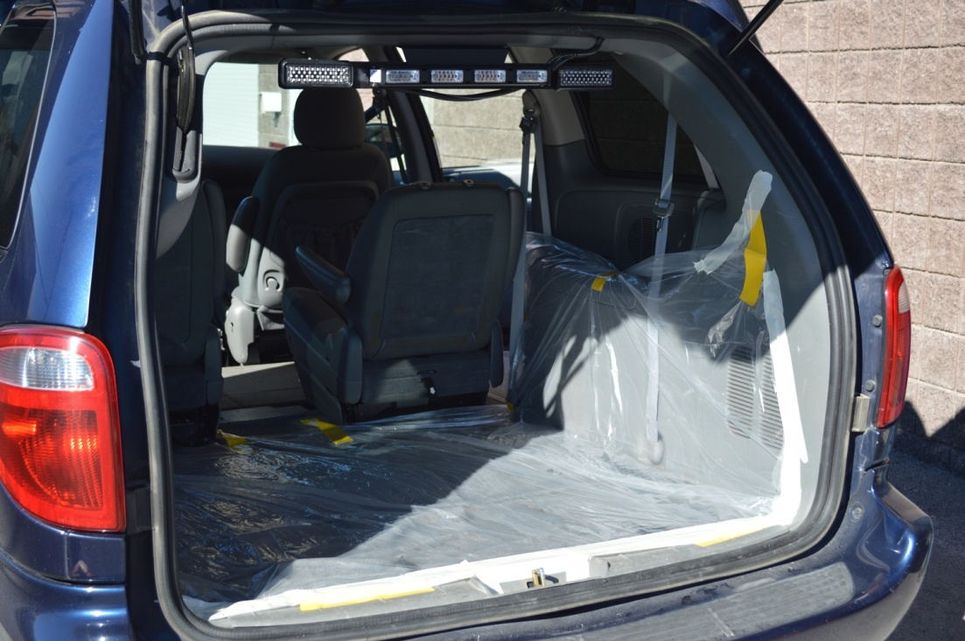
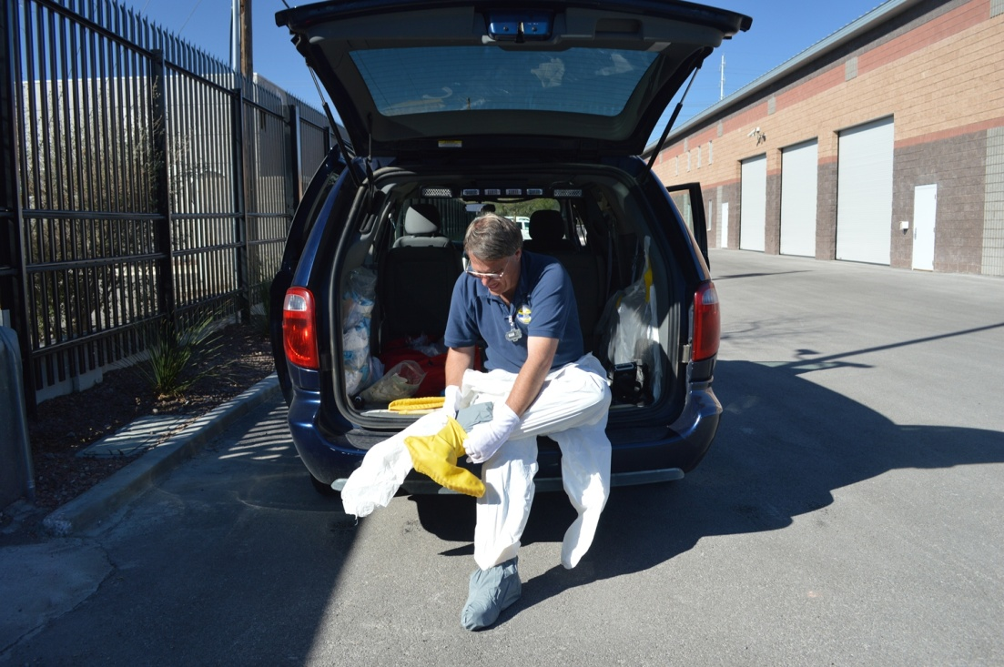
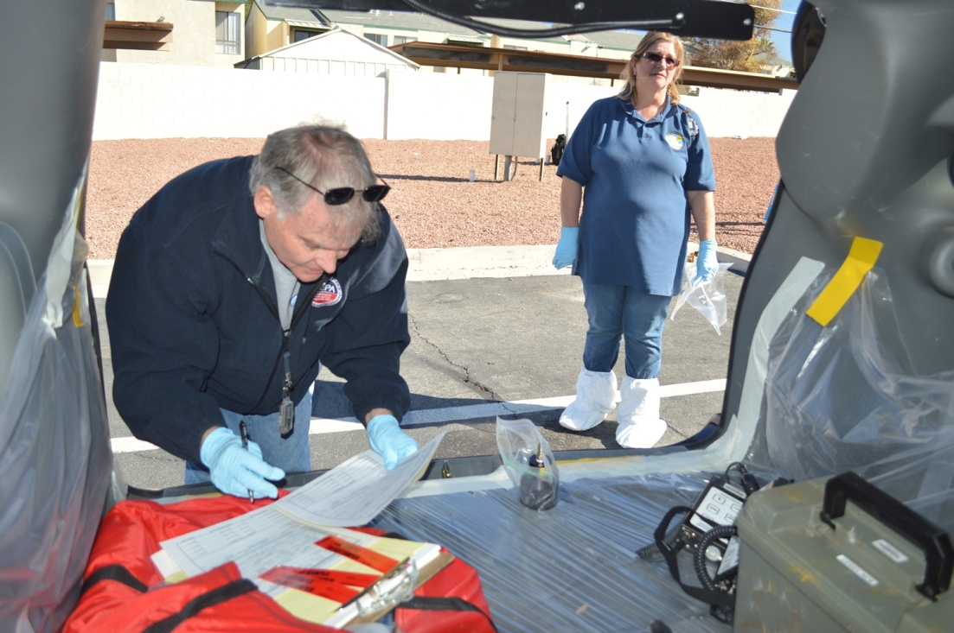
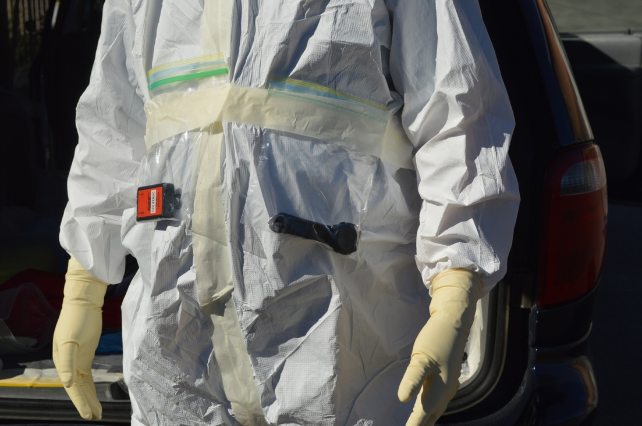
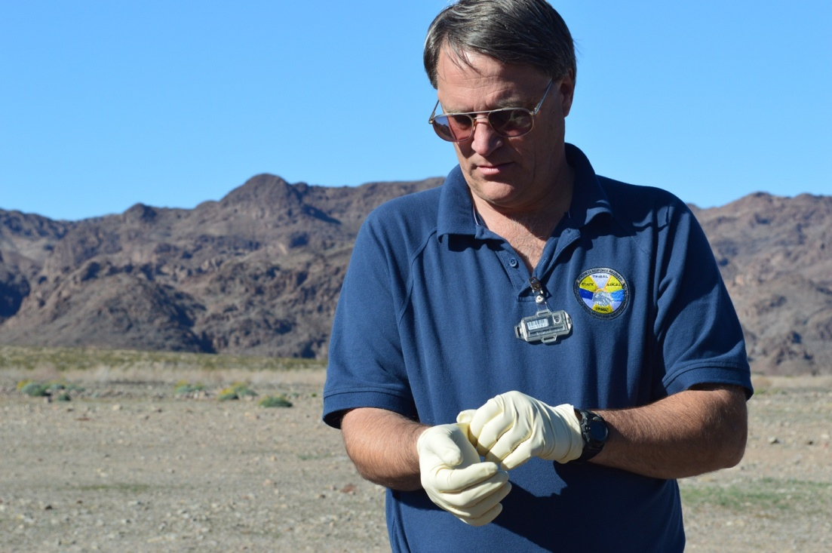
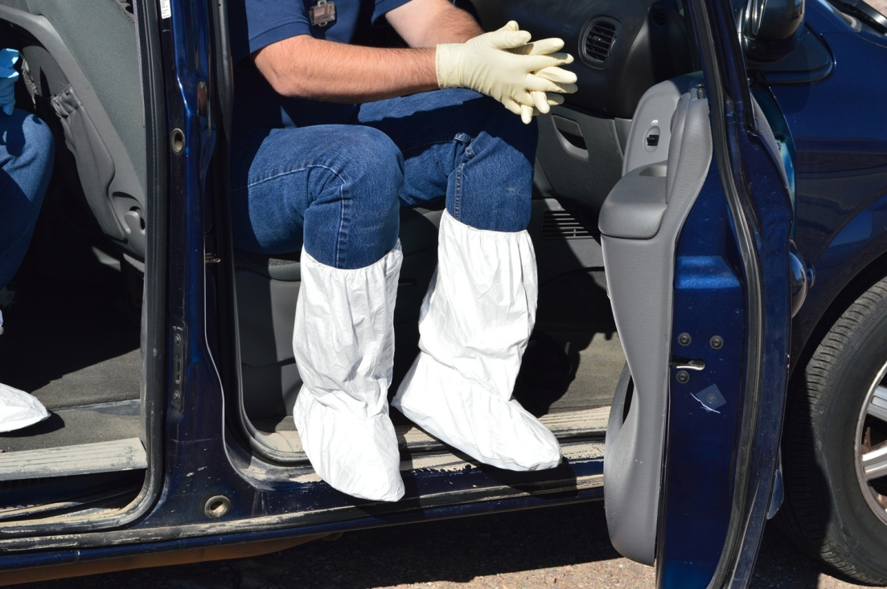
Contamination Control
Notes:
One of the most important things to remember when you are taking environmental samples it to practice good contamination control procedures. This will include setting up your vehicles to minimize the spread of contamination and prevent cross-contamination of samples. You will also need to wear the personal protective equipment, or PPE, as instructed by the Field Team Supervisor during your pre-deployment briefing.
{NOTE TO INSTRUCTOR: Wait for all pictures to load – last picture is of white tyvek suit with masking tape on zipper and holding dosimetry bags to body.}

Slide 10
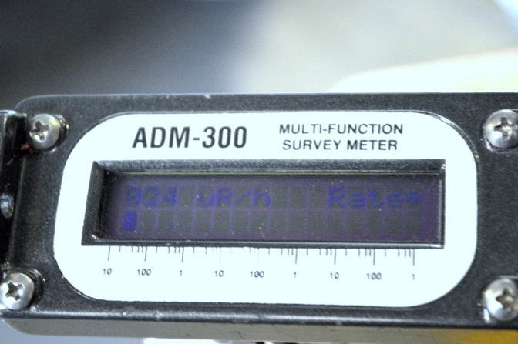
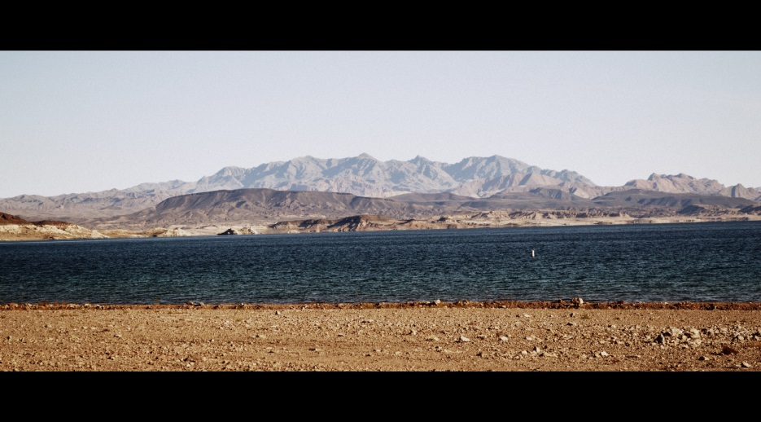

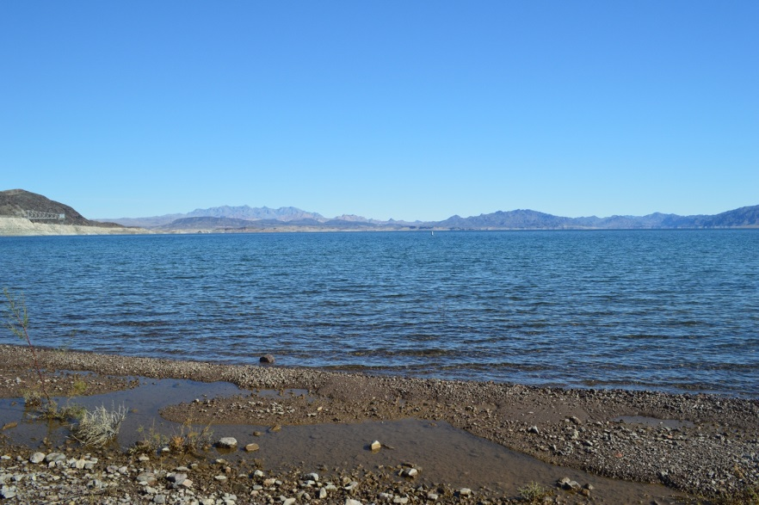
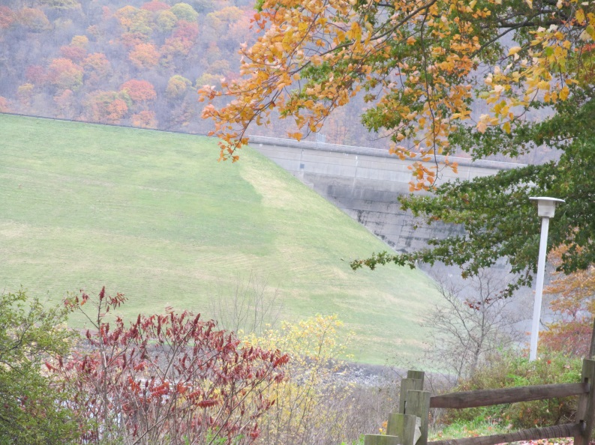
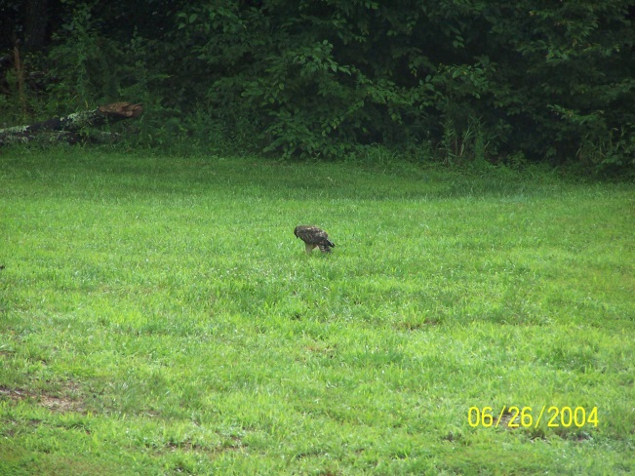
Site Selection
Notes:
While you are en route to your assigned location, your survey instrument should be turned on and placed in a location where you can monitor it for changing exposure rates. It is best to have the audio on so that you can hear increased response since the audio will respond faster than the display.
Once you are at your assigned location, you will have to choose a specific survey or sampling site. In all cases, look for a relatively level, open area.

Slide 11
Dispatch and Site Selection
Notes:
Now that you know what all you will need, let’s look at the pre-deployment activities you will need to perform and how to select an appropriate sampling site…
{INSTRUCTOR NOTE: Minimize this PPT. Run the video: “Dispatch and Site Selection.” The video is ~14 minutes long. This is the same video as in the “Field Monitoring Instrumentation” training presentation. Therefore, if the trainees have just watched this video in that training, this viewing may be skipped.}

Slide 12
Questions?
Notes:
{After answering questions, take a short break}

Slide 13
Performing Sampling Activities
Notes:
There are a number of different environmental media that will need to be sampled following an accidental release of radioactive material. Different sample types are taken at different times in the response based on what information is needed about the release, deposition characteristics, and movement through the biosphere. Each type of sample requires specific sampling equipment.
Remember, sampling activities include the preparation before deployment, choosing a sampling location, collecting the sample, packaging the sample for transport, and completing all documentation.
We will be covering a number of sample types. We have videos that show how to take each type of sample. The videos have been designed to be “stand-alone;” therefore, you will see repeats in each video on some of the common activities.
Now, let’s find out how to take those samples!

Slide 14
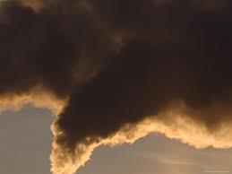
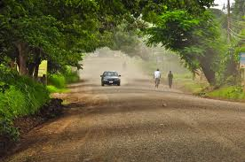
Air Samples
Plume
Re-suspension
Notes:
The first type of sample we will look at today is an air sample. Depending on how soon field teams are dispatched after the event, the air sample could either be of the radioactivity in the released plume or of the re-suspended material from what was deposited on the ground. In most cases, FRMAC will not dispatch teams early enough during an event to be taking air samples in a plume soon after it has been released; however, in cases where the release occurs over a longer period (days or weeks), then it is possible for a team to be “in a plume” to take an air sample. Resuspension of deposited radioactive material may occur at any time; therefore, it is much more likely that these will be the types of air samples taken by FRMAC teams.
NORMALLY, radioactive plumes will not look like this picture – they are not inherently “smoky!”

Slide 15
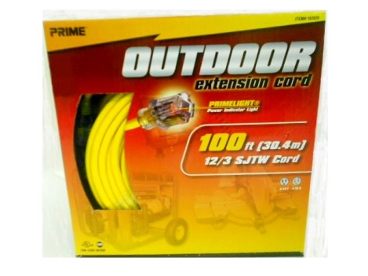
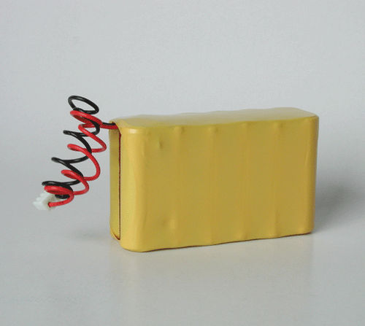
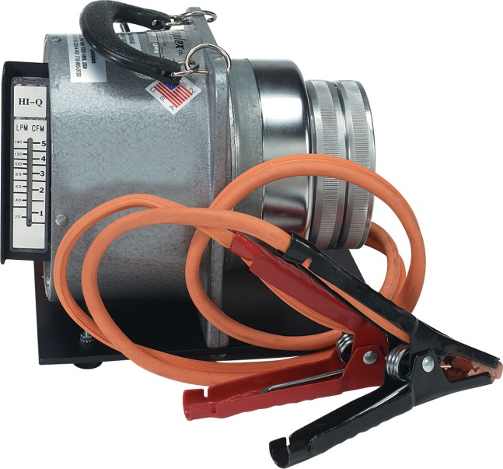
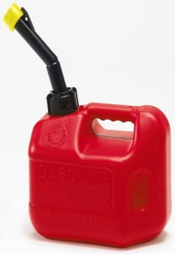
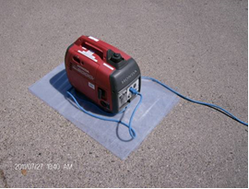
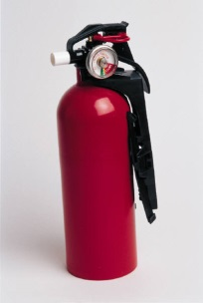
Air Sample Power Options
Notes:
There are a number of power sources that you may use while taking an air sample.
For all power sources, ensure that the pump is “OFF” before connecting the pump to the power source.
The simplest pump to use will be the AC powered pump with an extension cord. Unfortunately, this requires that you have access to AC power. This will work well if you are setting up in the parking lot of a police or fire station; not so good otherwise. AC cords are frequently used for high-volume air samplers that will be collecting a sample for an extended period. When setting up a sampler using an extension cord, you must make sure that the cord is secured so that it does not represent a tripping hazard.
Some pumps have internal batteries that are usually rechargeable. Normally, these are used in low-volume air samplers. The advantage to these types of pumps is that they can be used anywhere. The disadvantage is that they usually have a limited run time before they need to be recharged.
A few air sample pumps have the ability to use a vehicle’s DC power outlet or jumper cables connected directly to the vehicle’s battery. These types of samplers are suitable for a quick grab sample that only takes a few minutes. The vehicle will need to be running while the pump is connected to ensure a steady source of power. If using jumper cables, caution should be used when connecting and disconnecting the cables so that no sparks are created.
The final type of power source is a gas-powered generator. In addition to the generator, you will also need fuel and a fire extinguisher. Because generator exhaust contains poisonous carbon monoxide, generators must be placed outdoors and away from building windows, doorways, or air intake valves. The exhaust system may get hot enough to ignite some material; therefore, keep flammable material away from the generator, and allow the generator to cool before placing it in a vehicle or building. Also, place the generator downwind of the sampler and far enough away so that the sampler does not pick up exhaust from the generator. If you are issued a gasoline powered generator, you will also need a fire extinguisher.

Slide 16
Air Sampling for Radioactive Material
Notes:
Let’s now watch our Field Team take an air sample...
{INSTRUCTOR NOTE: Minimize this PPT. Run the video: “Air Sampling.” The video is ~20 minutes long.}

Slide 17
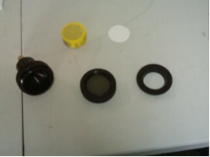
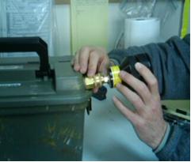
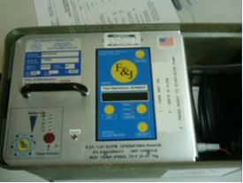
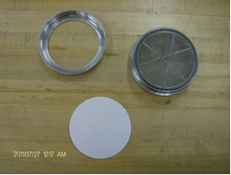
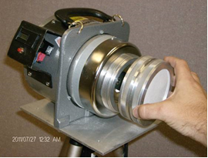
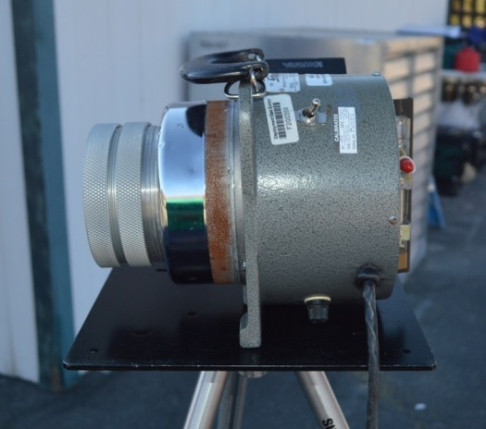
Air Sample Practicum
Notes:
At this time, we will spend a few minutes practicing how to load air sample heads and getting to know the components of the air sample pumps.

Slide 18
Questions?
Notes:
{After answering questions, take a short break}

Slide 19
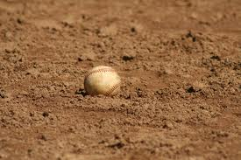
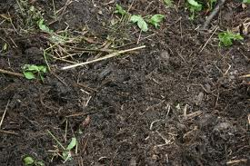
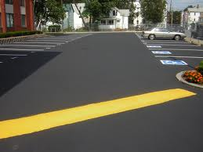
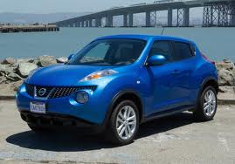
Ground Deposition Samples
Soil
Smear (Swipe)
Notes:
Soil samples are very important to offsite authorities who are responsible for determining whether or not to evacuate or relocate a population or for determining whether the food grown in an area are edible. In the early part of the response (i.e., within the first few days to weeks), FRMAC will take soil samples to determine the ground deposition. These samples are used to decide on evacuation or relocation of a population. We will demonstrate how to take these types of samples. Later in the response (i.e., weeks to months to years after the release), soil samples can also be used to estimate plant uptake; however, the sample depth is different than that used to determine ground deposition. We will not be covering how to sample for plant uptake in our training module today. If these types of samples are required, you will be given separate instructions on how to do them.
Another way to determine ground deposition, especially in urban environments where there is no “open ground” is to take a smear or swipe sample. Smear or swipe samples are taken to determine loose (removable) surface contamination on nonporous fixed items.

Slide 20
Soil for Ground Deposition Sample
Notes:
When taking soil samples, a special sampling frame is required. For normal soil that isn’t too dry or too wet, you may need to dig a trench so that you can pass the trowel under the sampling frame to collect the sample. If the soil is very dry, like sand, or very wet, like mud, then you will need a spoon to scoop the soil up.

Slide 21
Soil Sampling to Determine Ground Deposition
Notes:
Let’s now watch our Field Team collecting a soil sample…
{INSTRUCTOR NOTE: Minimize this PPT. Run the video: “Soil Sampling.” The video is ~15 minutes long.}

Slide 22
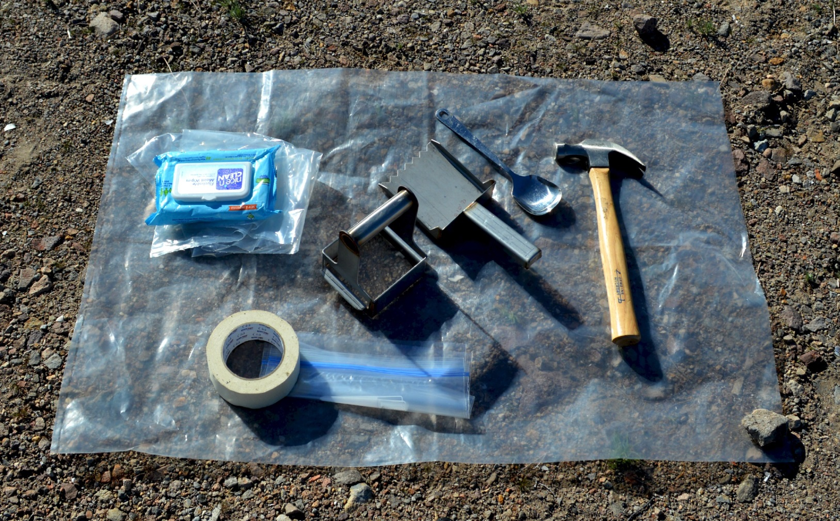
Soil Sample Practicum
Notes:
At this time, lets handle the soil sampling jig and other equipment.

Slide 23
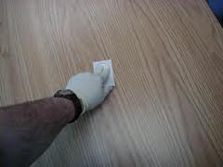

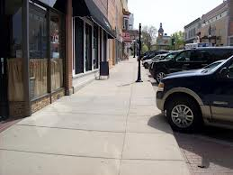
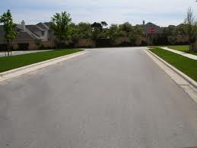
Smear (Swipe) Sample
To determine loose (removable) surface contamination on NONPOROUS fixed items
May be used in place of soil samples in urban environments
Flat, smooth, and stationary objects
Notes:
In some cases, there will NOT be soil available for sampling. For example, there may not be “open” ground and you may need to sample whatever surface is available that has deposition on it. These may include cars (if they were been stationary throughout the deposition time), cement sidewalks, or asphalt roadways.
To take samples of this type, you will need to take a smear or swipe sample. These samples are used to determine the loose, or removable, surface contamination and may be used in place of soil samples in urban environments.

Slide 24
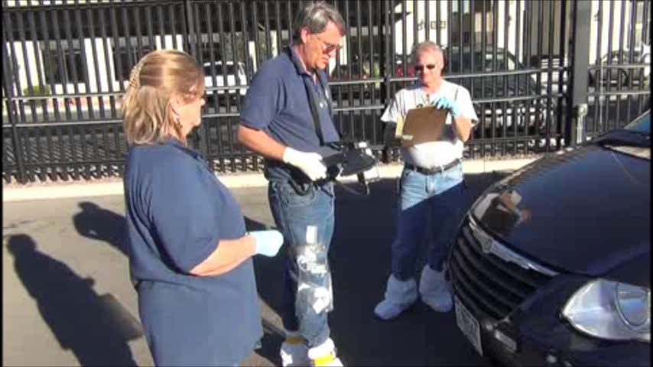
Smear Sampling
Notes:
{NOTE TO INSTRUCTOR: Click on the video and read the following while the video is playing.}
Here, our team is first surveying a vehicle with the ADM-300 gamma/beta internal detector and the AP-100 alpha probe.
Then, they use paper discs to take standard smear samples. The discs may be loose discs or they may be pre-loaded onto protective paper.
A standard smear is 100 square centimeters; about the size of a dollar bill. A large area smear is 1 square foot; a little larger than a letter-sized piece of paper.
When taking a smear sample, hold the smear paper with two gloved fingers and carefully rub the smear paper over the pre-identified area while applying moderate pressure. Be consistent with the pressure if you are performing multiple smears.
Take care not to shake off collected material.
Place the smear in a labeled envelop or bag. Sample control is the same as with soil samples.

Slide 25
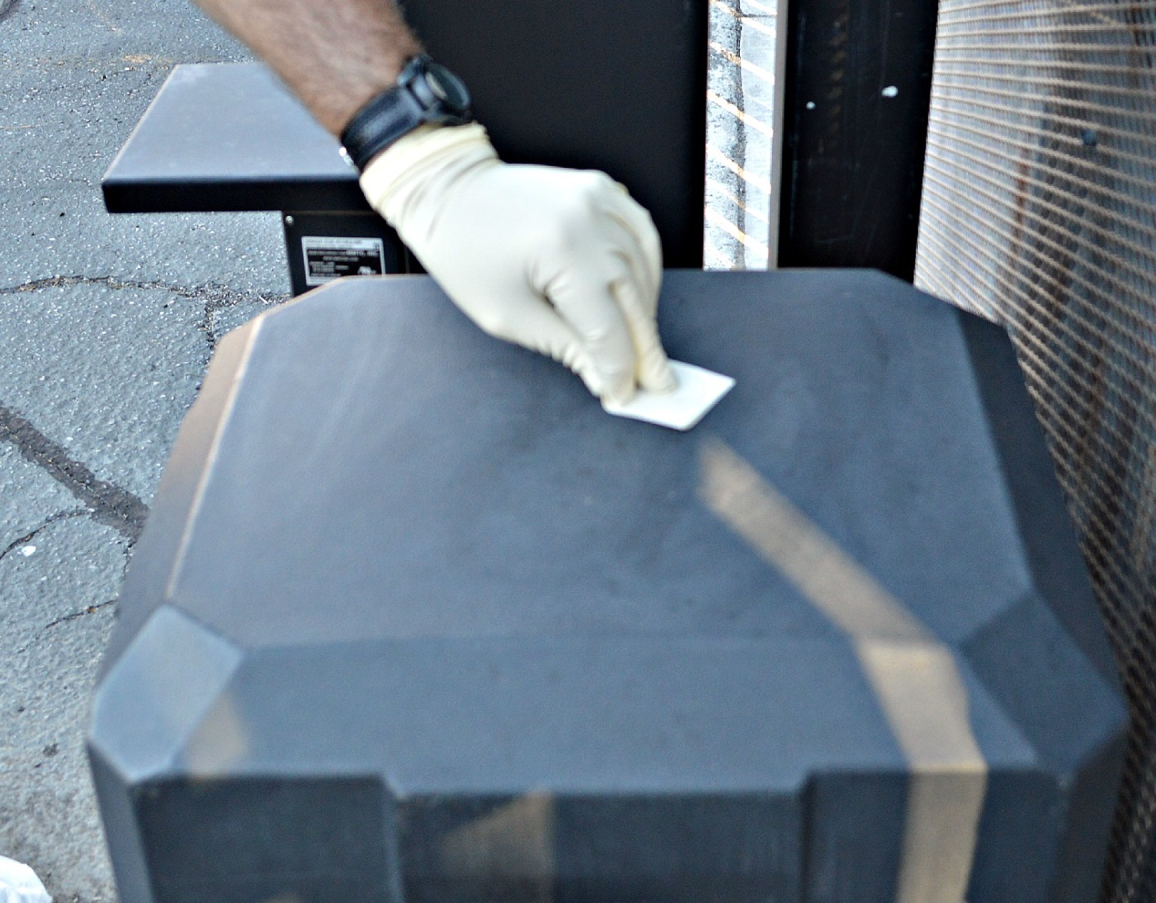
Smear Sample Practicum
Notes:
At this time, let’s take a closer look at the papers used to take smear samples and practice how to package these types of samples.

Slide 26
Questions?
Notes:
{After answering questions, take a short break}

Slide 27


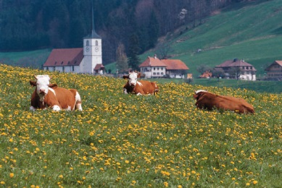
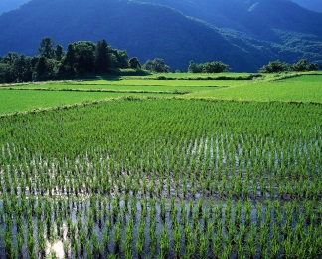
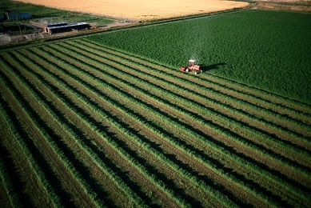

Vegetation Samples
Market ready food (direct ingestion)
Feed crops (indirection ingestion)
Notes:
Vegetation refers to the ground cover that people and animals eat (not your normal backyard grass!).
Market ready foods are those things that humans eat (fruits and vegetables) and are normally collected from farms, roadside stands, or gardens. Market ready samples should be consistent with respect to readiness for harvest; either the crop is already ripe or will be ripe and ready for harvest in the near future.
Feed crops are hays and grains that will be consumed by animals and subsequently man will consume the animals. It also applies to standing grains such as wheat, rye, barley, buckwheat, oats, and soybean that humans may also consume after harvesting, but that will be processed in some way and are not directly consumed by humans in the “field form.”
Samples later in the response may also be taken to determine plant uptake; this may require the collection of other parts of the plants, including the roots. If you need to take these types of samples, you will given special instructions during the field team briefing about what parts of the plants to sample.

Slide 28
Vegetation Sampling
Notes:
Earlier, we made a point of saying that vegetation samples were NOT your normal backyard grass. Unfortunately, the video was taken in Las Vegas in February... food crops are not grown around Las Vegas; therefore, the sample demonstration was done in a backyard. The procedure is the same whether you take a crop sample or grass sample. So...just pretend our Field Team was in a lush pasture instead of a manicured backyard.
Let’s watch our Field Team collect a vegetation sample!
{INSTRUCTOR NOTE: Minimize this PPT. Run the video: “Vegetation Sampling.” The video is ~15 minutes long.}

Slide 29

Vegetation Sample Practicum
Notes:
Now, let’s handle the special equipment needed for taking vegetation samples.

Slide 30
Questions?
Notes:
{After answering questions, take a short break}

Slide 31




Water Samples
Surface Water
Well Water
Notes:
The most important use of water samples is to determine contamination levels in public drinking water. There are two sources of public drinking water: surface water and well water.
Surface water refers to lakes, ponds, streams, rivers, etc. Some water treatment plants obtain their water from surface supplies. Samples of surface water are usually only taken early in a response while the contamination is on the surface of the water.
Well water refers to ground water that is brought to the surface using either submersible or surface pumps; but, it may also refer to the inlet and outlet of water treatment plants. Well water may be taken any time during a response to measure what is in a drinking water supply.

Slide 32
Water Sampling
Notes:
Let’s watch as our Field Team collects surface samples...
{INSTRUCTOR NOTE: Minimize this PPT. Run the video: “Water Sampling.” The video is ~13 minutes long.}

Slide 33





Water Sample from a Tap
Notes:
In addition to sampling surface water as demonstrated in the video, you may be asked to sample water from a well or water treatment plant. Usually, there is a tap that can be used for sample collection from these types of water sources.
Before you collect your sample, you will need to flush the sample line to ensure the sample contains water from the well or treatment plant and not water that was already in the line. To flush the line, turn on the water and let it run for a minute or more. A one minute flush is adequate for a 40 foot deep well. You will need to adjust the flush time for the length of the sampling line.
As you saw in the video, you will need to rinse the sample container and cap will a small amount of water from the water source. Then, you can collect the sample in a bucket and pour it into the sample container using a funnel. After filling the sample container, close and seal the container and then dry it off. Packaging is exactly the same as you saw in the water sampling video.

Slide 34

Water Sample Practicum
Notes:
Let’s now “play” with the water sample equipment and practice packaging a sample.

Slide 35
Questions?

Slide 36








Other Types of Samples
Water
  Rain
  Snow
Milk
  Commercial dairies
  Small farms
In Situ
  Ground deposition
Notes:
There are other types of samples that FRMAC frequently collects for analysis; however, these sample types require specialized equipment and more extensive training. We will not be demonstrating these types of sampling procedures or equipment; but, we did want you to be aware that these kinds of samples may be needed following a radiological release.
Rainwater (NOT puddles or standing water) may be collected to estimate the presence of radioactive material in the atmosphere. If a plume passes over an area where snow is on the ground, then a snow sample may be needed to estimate the amount of deposition from the plume.
Milk samples are necessary to determine the amount of radioactive material in milk for human consumption. Normally, personnel from supporting state or county agencies, the U.S. Department of Agriculture, or the U.S. Department of Public Health will assist the FRMAC Field Team when collecting a milk sample from either a commercial dairy or a small farm. Most states require some form of certification or specialized training to collect milk.
In Situ gamma spectrometry is a rapid method for the assessment of gamma emitting ground surface contamination. Because of the very specialized equipment used for this type of sample, only highly trained FRMAC technicians will perform these measurements.

Slide 37
Recap
Notes:
We had two training objectives today.
We started the training by covering the activities to be completed prior to dispatch from the assembly area including instrument checks and preparing your vehicle for possibly contaminated materials, and we covered how to select an appropriate sampling area.
Then, we showed you how to perform, package, and document sample collection for the most common sample types: air, ground deposition, vegetation, and water.

