Slide 1
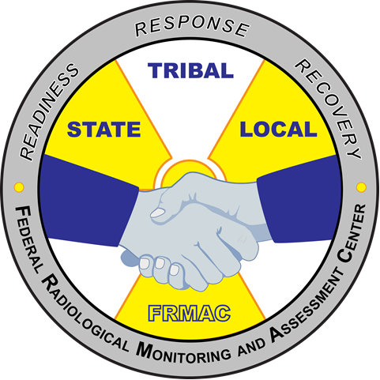
FRMAC Field Monitoring Specialist Training – Introduction
MS-200
Module 1
FRMAC Monitoring Division Training
January 2021
Notes:
This course is required for all FRMAC Field Monitoring Specialists.
New FRMAC Field Monitoring Specialists take this introductory course to familiarize themselves with FRMAC sampling and monitoring equipment, data collection methods, and operations.
This training course introduces FRMAC field equipment and methodologies to new FRMAC Field Monitoring Specialists. Students will learn to use FRMAC monitoring instrumentation and equipment. They will also learn about FRMAC monitoring and sampling procedures and the use of data collection software and be instructed on proper documentation.

Slide 2
MS-200 Content Outline
Module 1: Overview of the FRMAC and Monitoring Division
Recall responsibilities of the Monitoring Division
Review and understand the general structure of the Monitoring Division.
Review roles and responsibilities of the major positions.
Recognize other assets with which Monitoring may be interacting.
Identify the workflow process and role of the ICS-204FRMAC form.
Module 2: Demonstration of FRMAC monitoring and sampling equipment to include eFRMAC data tablets
Monitoring Equipment
Monitoring Techniques

Slide 3
MS-200 Content Outline
Module 3: Overview of FRMAC monitoring and sampling techniques
Sample collection
Air
Soil
Water
Vegetation
Milk/Feed
Sample Receipt
Module 4: Data, Forms, and Documentation
FRMAC forms
Manuals and references

Slide 4
MS-200 Content Outline
Practical: (completed using FRMAC procedures and Operator Aids)
Practice operating FRMAC instruments and equipment.
CMRT HPKIT
Exposure Rate
Contamination Probes
SpecFIDLER
Sample Collection
Air Sampling
Soil Sampling
Insitu Sampling using Detective
Data collection and submit data using MPCD Tablet
Practice field deployment activities.
Notes:
Practical Training may be incorporated into MS-400 “Field Monitoring Specialist – Advanced” when MS-200 is taught virtually.

Slide 5
MS-200 Module 1 Outline
Overview of the FRMAC and Monitoring Division
Recall responsibilities of the Monitoring Division
Review and understand the general structure of the Monitoring Division.
Review roles and responsibilities of the major positions.
Recognize other assets with which Monitoring may be interacting.
Identify the workflow process and role of the ICS-204FRMAC form.
Notes:
This is the beginning of module 1 content.

Slide 6
Role of the Monitoring Division

Slide 7
Role of the Monitoring Division
There are several divisions within FRMAC/CMRT, one being the Monitoring and Sampling Division.
This division is responsible for performing radiological monitoring and sampling operations.
The Monitoring and Sampling Division within the FRMAC/CMRT performs operations in accordance with two manuals:
FRMAC Monitoring and Sampling Manual, Volume 1 (2019)
FRMAC Monitoring Manual, Volume 2 (est. 2021)
https://www.nnss.gov/pages/programs/FRMAC/FRMAC_DocumentsManuals.html
Notes:
The full FRMAC/CMRT division name is the “Monitoring and Sampling Division.” It is also referred to as the “Monitoring Division” or “M&S Division.” The Monitoring Division uses 2 manuals to guide its operations. Volume I is about Monitoring Division Operations. This high level document outlines operations for the division and common strategies to respond to an event. Volume 2 contains more of the technical side for the Monitoring Division. Volume 2 documents the process FRMAC uses to collect measurements and samples and contains operator aids and common field forms.

Slide 8
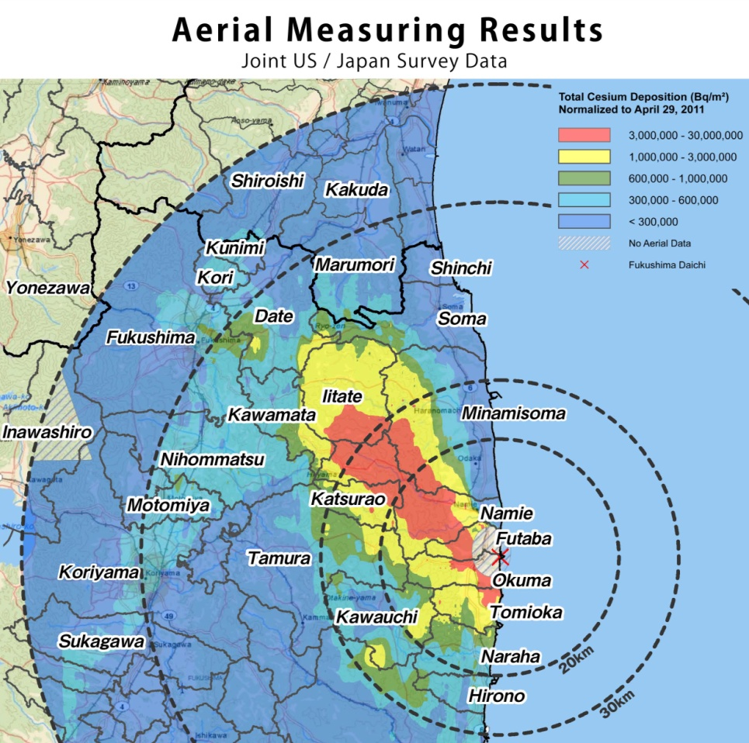
Role of the Monitoring Division
The FRMAC Monitoring Division is primarily responsible for the coordination and direction of:
Aerial measurements to delineate the footprint of radioactive contaminants after they have been released into the environment.
Monitoring radiation levels in the environment.
Notes:
Aerial measurements are performed by the Aerial Measuring System (AMS) asset. AMS joins the Monitoring Division when a FRMAC is established. More information on AMS will be presented later in the presentation.

Slide 9
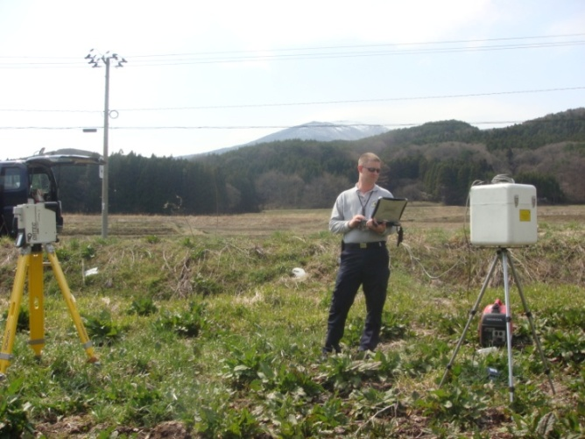
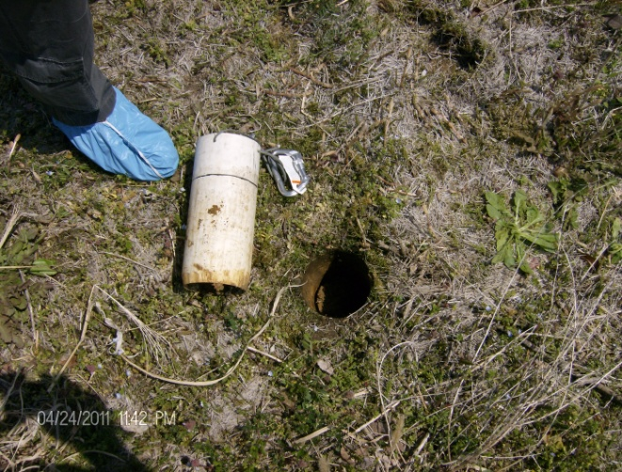
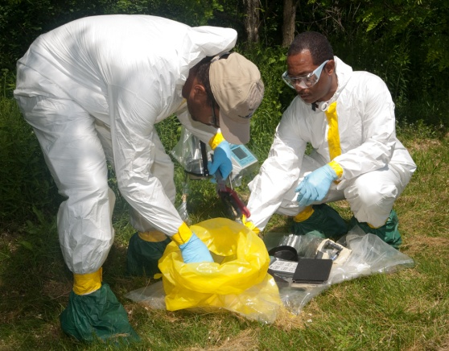
Role of the Monitoring Division
The FRMAC Monitoring Division is primarily responsible for the coordination and direction of:
Sampling to determine the extent of contaminant deposition in soil, water, air, and vegetation.
Preliminary field analyses to quantify soil concentrations or depositions.
Notes:
Monitoring and sampling techniques used during FRMAC operations are specifically selected for use during radiological emergencies where large numbers of measurements and samples must be acquired, analyzed, and interpreted in the shortest amount of time possible. In addition, techniques and procedures are flexible so that they can be used during a variety of different scenarios.

Slide 10
Command Structure for FRMAC Monitoring Division

Slide 11
Monitoring Organization Chart
Monitoring Manager
Deputy Monitoring Manager
Field Team Supervisor
AMS Mission Manager
Field Monitoring Specialist
Specialists (In-Situ, ECAM)
AMS Scientists and Technicians
Rotary and Fixed Wing Crews
Monitoring Staff
AMS Staff
Notes:
There may be more than one Deputy Monitoring Manager, Field Team Supervisor, or AMS Mission Manager as the response demands more personnel. General guidelines for span of control is between 3 and 7 people or teams per person. Field Monitoring Specialists will be scaled in number as necessary and will include employees from other government agencies. It is possible for a Field Team Supervisor to be stationed at a forward monitoring post (which is not located at the FRMAC location), though this does not change the command structure. The same is true for AMS personnel who may reside at their base of operations at an airfield away from the FRMAC location.

Slide 12
Assisting the Health and Safety Division
Some Monitoring Division team members will be assigned to support the Health and Safety (H&S) Division and may perform the following:
Operation of the hotline
Facility surveys
Assistance with H&S functions at checkpoints
Assistance at population assembly areas which require support from the FRMAC
For this reason, the following slide shows the H&S organization chart.
Notes:
Field Monitoring Specialists with experience in contamination control will be used by H&S.

Slide 13
Health & Safety Organization Chart
H&S Manager
Deputy
Dose Analyst/Safety/IH
Hotline Manager
Dosimetry Technician
Site Survey Technician
Hotline Technician
Health and Safety Staff
Monitoring Staff
Monitoring has a responsibility to supply personnel to Health & Safety to staff these areas
Notes:
H&S will need assistance from the Monitoring Division to staff certain positions. These are mainly technician positions with contamination control experience.

Slide 14
Major Roles within FRMAC Monitoring Division

Slide 15
Monitoring Manager and Deputy Roles
Manage operations for the division
Attend/participate in planning meetings
Help create Execution and Implementation Plans
Complete field team instructions (ICS-204FRMAC)
Brief AMS Missions Managers and Field Team Supervisors on objectives and expectations
Review field team data
Relay information up the chain of command
Training: Must complete the FRMAC Monitoring Manager training courses and be approved by a rostering process before being able to take duty. Must complete annual Monitoring Manager training.
Notes:
Roles and responsibilities can be found in the FRMAC Monitoring and Sampling Manual Volume I. During deployment, the Monitoring Manager attends meetings and helps plan field team activities. The Deputy Monitoring Manager would lead field operations.

Slide 16
Field Team Supervisor Roles
Before Team Deployment
Assist in deployment activities
Assist with palletizing deployment equipment
Field team composition
Establish communications with field teams
Ensure necessary equipment available
Brief the ICS-204FRMAC
During Field Deployment
Establish communications
Reroute or change task
Approve data
Training: Must complete the FRMAC Field Team Supervisor training courses and be approved by the monitoring skill set leader before being able to take duty. Must be current on annual Field Team Supervisor training.
Notes:
Roles and responsibilities can be found in the FRMAC Monitoring and Sampling Manual Volume I. The FTS may be assigned to a forward monitoring post. The FTS is the direct contact for field teams during deployment.

Slide 17
Field Monitoring Specialist Roles
Instrument QA/QC before deployment
Ensure tablets and MPCDs are ready
Follow ICS-204FRMAC instructions
Collects/Records measurements and samples
Communicate status to Field Team Supervisor
Help less experienced field team members and/or specialty field teams
Training: Must complete the FRMAC Field Monitoring Specialist training courses.
Notes:
Roles and responsibilities can be found in the FRMAC Monitoring and Sampling Manual Volume I. CMRT Field Monitoring Specialists are from the Nevada National Security Site (NNSS). During a response, the Monitoring Division may acquire more Field Monitoring Specialists from the Radiological Assistance Program (RAP) or other non-DOE agencies such as the Environmental Protection Agency (EPA) or Civil Support Teams (CSTs).

Slide 18
Aerial Measuring System (AMS) Mission Manager/Scientist
Assist the Monitoring Manager with mission planning
Brief AMS staff on objectives
Coordinate flights/ ensure safety of assigned personnel
Communicate flight details and situational awareness to the Monitoring Manager
AMS data product creation/review
Training: Must complete the AMS Mission Manager training courses before being able to take duty. Must maintain proficiency.
Notes:
Due to the complexity of the mission, AMS positions are limited to full time Remote Sensing Laboratory employees. The AMS Mission Manager is the point of contact for the FRMAC Monitoring Manager to plan, coordinate, and track status of AMS missions. In a response that involves multiple flights and agencies, the Monitoring Manager may request an AMS Mission Manager to be stationed at the FRMAC Monitoring Division location to ease the burden of planning, coordinating, and tracking flights.

Slide 19
Associated Assets
Notes:
This section will briefly discuss two assets which will interact with the Monitoring Division: Aerial Measuring System (AMS) and the Consequence Management Home Team (CMHT).

Slide 20
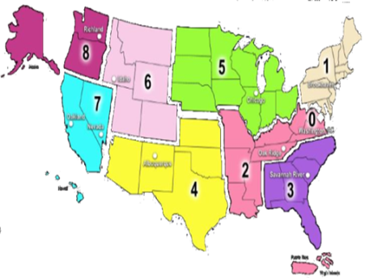
Radiological Assistance Program (RAP) Deployment
RAP is geographically regionalized to support rapid deployment in emergencies
9 Regions located throughout the USA
Mobilized and ready to deploy
within two hours of notification during normal working hours
within four hours of notification during off hours
Arrival upon incident scene will be determined by distance and mode of transportation
Access to ground and air transportation
Notes:
RAP is regionalized into 9 different regions to support rapid deployment to an incident site. These nine regions are centered around existing DOE/NNSA laboratory or sites. Upon notification, RAP will be ready to deploy within two hours during normal duty hours, and within 4 hours during off hours. Arrival upon incident site will be largely determined by distance the team will have to travel. RAP has access to both ground and air transportation. Air transportation normally takes the form of charter aviation that can be ready to be wheels up within the required deployment timeframes.

Slide 21
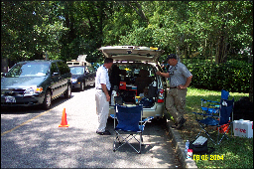
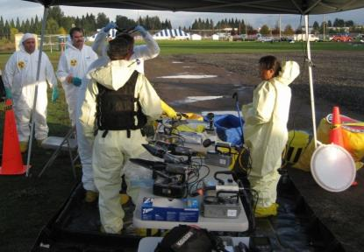
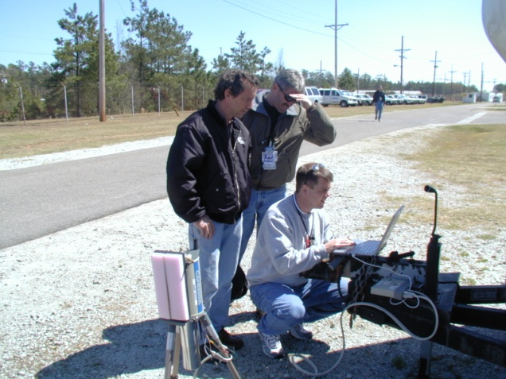
RAP Personnel and Composition
Volunteers from the DOE/NNSA complex
“Standard” RAP Team composition
(1) Federal Team Leader (FTL)
A mission dependent mix of up to 7 Health Physics Support Personnel (HPSPs) & Team Scientists
RAP team configuration and load-out is tailored to response requirements and organizational needs
Notes:
RAP is primarily made up of volunteers from the various DOE/NNSA labs and sites. That means that most of the personnel are not full time emergency responders. They take on RAP as an extra responsibility. During their normal day jobs, they are radiation protection workers and scientists. RAP responders are people who work with radiation everyday. RAP volunteers are given specialized training to ensure that they have the skills and knowledge to support the RAP missions (like search activities and consequence management).
Each RAP region has a minimum of 3 teams. They consist of trained employees from DOE and DOE contractors/facilities. A standard team consists of 9 members; one Team Leader, one Public Information Officer, one Team Captain, one Senior Scientist, and five Health Physics Survey/Support personnel. Additional personnel are available, such as industrial hygienists, transportation specialists, logistics support, etc. Although a standard team consists of 9 members, the RAP response will be tailored to the individual incident. RAP is very flexible; a deployment may only involve two team members or may involve multiple teams.
RAP has expertise in radiological assessment, area monitoring, air sampling, and exposure and contamination control. RAP's capabilities and resources include portable field radiation and contamination monitoring instrumentation (alpha, beta, gamma, and neutron), air sampling equipment, portable gamma spectroscopy systems, decontamination supplies, communications equipment, and personal protective gear.

Slide 22
Radiological Assistance Program (RAP)
RAP personnel will most likely be at the incident before CMRT arrives
RAP will integrate with CMRT
FRMAC field teams will consist of CMRT Field Monitoring Specialists and RAP Health Physics Support Personnel
Same instruments and equipment
Trained to the same monitoring and sampling techniques
Notes:
As the incident progresses and CMRT arrives, RAP personnel will be used in various roles in CMRT. The RAP HPSPs are equivalent to the FRMAC FMS. The incorporation of these teams into Monitoring should be seamless as both positions are trained in similar monitoring techniques and equipment.

Slide 23
Aerial Measuring System (AMS)
AMS is a separate asset from CMRT. They perform search missions as well as radiological characterizations of large areas.
AMS has 2 locations: Nellis Air Force Base (Las Vegas, NV) and Joint Base Andrews (Washington D.C.).
AMS can deploy earlier than CMRT.
When a CMRT/FRMAC is activated, AMS reports under the Monitoring Division.
Notes:
For more information on AMS, go to: https://www.energy.gov/nnsa/aerial-measuring-system-ams
AMS is part of the Monitoring Division when CMRT/FRMAC is activated. As such, AMS Mission Managers receive objectives and directions from the Monitoring Manager. Typically, AMS would be part of the Air Operations Group (if established) within the ICS command structure.

Slide 24
AMS (cont.)
AMS uses NaI radiation detectors (known as RSIs) in their fixed wing or helicopter to characterize large areas.
Field teams will support AMS by taking ground measurements to compare readings
Dose rate (with Pressurized Ion Chamber)
HPGe in-situ measurements
Notes:
AMS fixed wing aircraft is deployed initially to perform surveys. Fixed wings perform large area surveys. Helicopters can fly at a lower altitude and at a slower speed to perform a more comprehensive survey of a particular area. The AMS Mission Manager works with the FRMAC Monitoring Manager to coordinate flights to collect data that will meet Incident Command’s objectives. Field teams will support AMS by surveying the designated AMS calibration line with dose rate surveys (with a pressurized ion chamber) and in situ HPGe measurements (with an ORTEC Detective).

Slide 25
States/locals and other agencies
When a FRMAC is established, then the field teams will consist of personnel from:
CMRT
RAP
States/locals
Other government agencies (EPA, DoD, FDA, USDA, etc.)
Should arrange teams to balance the level of knowledge and experience.
Notes:
Field Team Supervisors will arrange teams to balance each team. A CMRT FMS should expect to be paired with a responder from a different organization/agency.

Slide 26
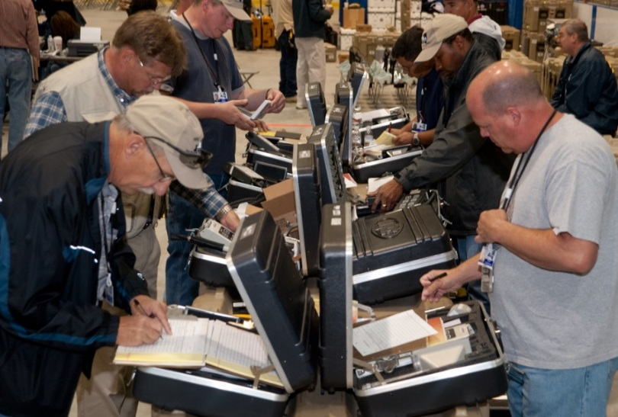
On The Job Training
FRMAC will conduct “On The Job” Training to help unify the Teams Members
Ensure all of the teams are using the same procedures
FRMAC monitoring and sampling “Operator Aids” can be practiced before departure
https://www.nnss.gov/pages/programs/FRMAC/FRMAC_DocumentsManuals.html
Notes:
Collecting measurements and samples in a consistent manner is an important part of performing field work. For this reason, On-the-Job training is performed to ensure that all participating team members from all the various agencies collect samples and measurements in a consistent manner. FRMAC provides “Operator Aids” to help unify the collection methods from the various responding agencies. The FRMAC “Operator Aids” can be found on the FRMAC website: https://www.nnss.gov/pages/programs/FRMAC/FRMAC_DocumentsManuals.html. Operator Aids can be tailored as needed to meet data quality objectives.

Slide 27
Deployment Interactions

Slide 28
Interactions with the public
Since the Monitoring Division goes into the field, it is probable that interactions with the general public may occur.
General Guidelines:
Be courteous
When asked what you are doing, you may answer what the task is, but do not provide any data.
If you do not know the answer to their question, say that you don’t know. Do not make up answers.
Refer the media and public to the Public Information Officer.
Notes:
The Monitoring Division will interact with a very diverse group of people; from the general public to very technical to incident command. We should always be professional and courteous in our interactions. The contact information for a Public Information Officer will be provided so the public may be directed to the proper source of information.

Slide 29
Deployment Interactions for the Field Monitoring Specialist
Receives instructions from the Field Team Supervisor.
Interacts with other field team members (DOE, other federal agency, state/locals)
Mentors field team members that may not have the same level of experience.
Interacts with Lab Analysis Division and Health and Safety personnel

Slide 30
Workflow

Slide 31
Default Guidance
Data is required/expected from the Monitoring Division even before official objectives are set by command.
Initially, the Monitoring Division does not need to wait for state/local objectives to collect data.
Default ICS-234 and ICS-204FRMACs have been created with default objectives and field team instructions.
See Monitoring and Sampling Manual, Volume I (2019), Appendix E-F for the approved guidance.
https://www.nnss.gov/pages/programs/FRMAC/FRMAC_DocumentsManuals.html
Notes:
The mission is to collect radiological data. All the Monitoring Division needs to get started are locations to collect measurements and samples and permission from state/local to enter incident area. Once the CMRT arrives, the Monitoring Division needs to check instruments, form teams, and prepare vehicles for deployment.

Slide 32
Ideal Workflow
Incident Action Plan (IAP)
From Incident Command
Provides overall objectives
Execution Plan
From FRMAC Division Managers
Determines how to accomplish command objectives
ICS-204FRMAC
From Monitoring Manager/Deputy
Instructions for field team to get applicable data to satisfy objectives
IAP
Execution Plan
ICS-204FRMAC
Notes:
When the Incident Command Structure and planning circles are established, then this is the ideal workflow. The Monitoring Manager is involved in the creation of the Execution plan and ICS-204FRMAC forms. The ICS-204FRMAC forms are the field team instructions. A new ICS-204FRMAC form will be generated for each team by the start of the shift. The ICS-204FRMAC forms are written to collect data that will satisfy mission objectives established by Incident Command.

Slide 33
ICS-204FRMAC Field Team Instructions
The execution plan has the generic who, what, where, how, and when.
The ICS-204FRMAC has specific details for each field team.
Field teams are expected to follow the instructions on the ICS-204FRMAC. Deviations should be communicated to the Field Team Supervisor.
Notes:
The ICS-204FRMAC form are known as the “Field Team Instructions.” These instructions are to be followed as best as possible. If some locations are not accessible, find an area nearby that is suitable and inform the Field Team Supervisor. Only collect the measurements and samples that are on the instructions. Communicate any concerns with the FTS.

Slide 34
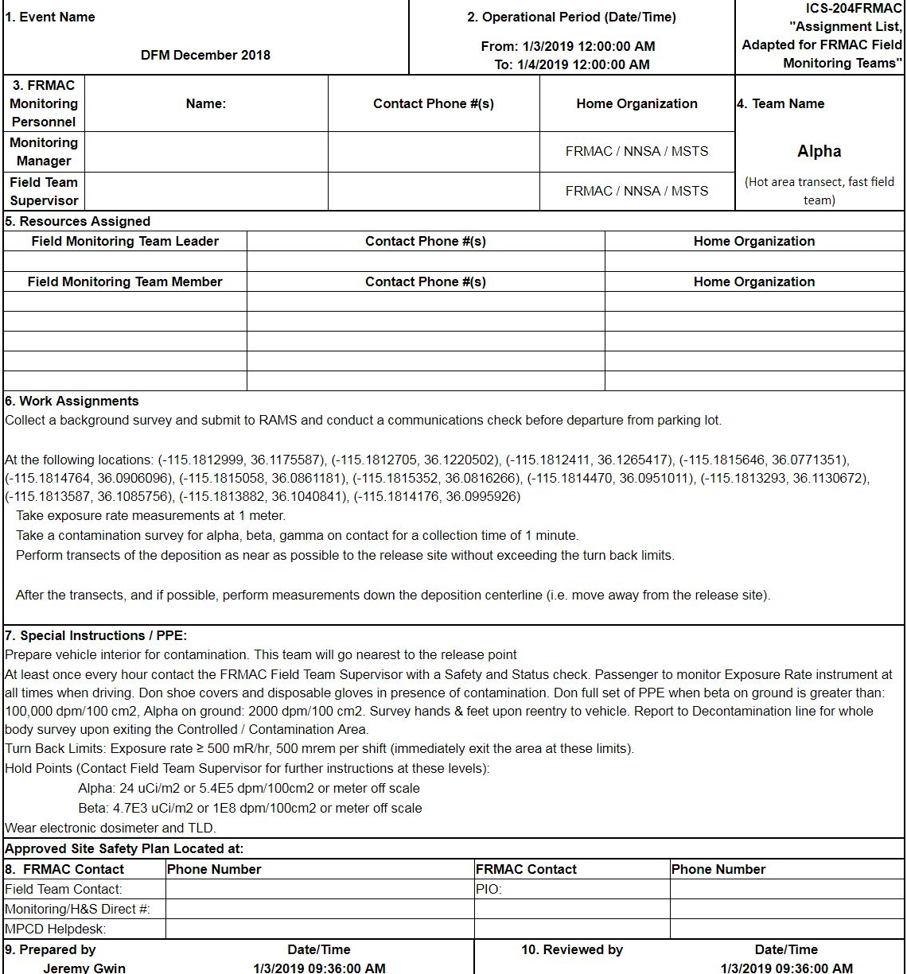
Field Monitoring Team Assignment
Event Name, Operating Shift
Contact Information
Work Assignment
Locations or Survey Spacing
Types of Measurements
Types of Sample to Collect
Example
Special Instructions
Hold Points/Turn back limits
Call back instructions
Notes:
Each FRMAC Field Team will get an ICS-204FRMAC form and a briefing on the content before departure into the field. The ICS-204FRMAC form will contain detailed contact information, locations and requested data, PPE requirements, and turn back levels. Assignments are developed by the FRMAC Monitoring Manager based on ICS objectives and with input from the FRMAC Management Team. Field teams are expected to follow the instructions on the ICS-204FRMAC. Deviations should be communicated to the Field Team Supervisor. ICS-204FRMAC forms are generated and sent to each Field Team using the FRMAC tablets. For those teams without FRMAC tablets, hard copies of the ICS-204FRMAC forms will be available. Those teams without access to the FRMAC tablets will need a device that can direct them to the specific latitude/longitude of the sample locations.

Slide 35
Software Tools

Slide 36
Software Tools
Software tools help our team be more efficient.
Below are some commonly used software products by the FRMAC/CMRT Monitoring Division:
RAMS
RadResponder
AVID
CMC/ DFM Tablets

Slide 37
RAMS
RAMS is the DOE database that stores the monitoring and sampling data for the incident.
Resides on the RSL Portal.
Accounts are needed to access the database and.
Field Team Supervisors and Monitoring Managers are required to have access to RAMS.
https://rslportal.doerer.us/
Notes:
Field Monitoring Specialists do not need access to the RAMS database, however you may need to provide contact information to the Field Team supervisor so he can enter the information into the system. Eventually, RAMS will be discontinued and RadResponder will be the main data collection software.

Slide 38
RadResponder
RadResponder is the FEMA database that stores the monitoring and sampling data for the incident. Many states and locals use it.
Accounts are needed to access the database.
ALL personnel in the Monitoring Division need accounts.
https://www.radresponder.net/
There is also a mobile app for Windows, Apple, and Android devices.
Notes:
RadResponder is a data collection system based on collaboration between Federal Emergency Management Agency (FEMA), Department of Energy (DOE) / National Nuclear Security Administration (NNSA), and the Environmental Protection Agency (EPA), and is provided free of charge to all Federal, state, local, tribal, and territorial response organizations. There is a website and also an app for iOS, Android, and Microsoft devices.
You may have to log into the RadResponder app on the tablet. Download the app on your phone and check it out before you have to use it for real. When you sign up for an account:
In the “Reason for Request” section, type “Member of the FRMAC Monitoring Division”
Select “Join Existing Organization”
Select “DOE FRMAC” as the existing organization.

Slide 39
AVID
AVID is the DOE software that visualizes and analyzes mobile data (aerial, vehicle, or backpack).
Other data, such as the ECAM, is being incorporated into AVID as well.
AVID is a stand alone software that needs to be loaded onto your computer.
All AMS personnel (manager/scientists/and technicians) in the Monitoring Division must have AVID.
Notes:
Currently, CMRT has very limited use with AVID. Other assets (such as AMS and RAP) use AVID to collect and analyze mobile data. So, if you are working with other assets and they mention AVID, you have an idea what it is.

Slide 40
CMC
CMC is software that provides situational awareness for Monitoring Managers and allows them to plan field team activities, interact with teams in the field, and review data.
Resides on the RSL Portal.
MS-260 “CMC Training” is required for Field Team Supervisors and Monitoring Managers
Monitoring Managers and Field Team Supervisors are required to have CMC accounts.
https://rslportal.doerer.us/
Notes:
CMC was developed by RSL specifically for the FRMAC/CMRT Monitoring Division. CMC is a web application that allows Monitoring Managers to create field team instructions. CMC allows for the Monitoring Managers and Field Team Supervisors to chat with the field teams via the tablets, track their progress and location, and review incoming data. Field Monitoring Specialists will not use CMC, but interact with CMC via the field team tablet.

Slide 41
Digital Field Monitoring (DFM) Tablet
Each field team will be given a tablet to use in the field.
The primary method of collecting CMRT data is using the DFM tablet which directly inputs data into RAMS.
The DFM software also allows the field team to receive instructions and chat messages via a CMC interface.
The tablet also has the RadResponder application for those in other agencies that use it for operations.
Notes:
Along with the MPCD, the DFM tablet is a way for field teams to telemeter data to the RAMS or RadResponder database. This allows for data to be reviewed and analyzed quickly. If the telemetering does not work in the field, the tablet buffers the data until a solid connection is made to download the data to the database.

Slide 42
Conclusion

Slide 43
Division Goals
Safety
Safely perform work assignments
Look out for your teammates
Teamwork
Cooperative, coordinated, professional
Integrity
Do your best. The data you collect will ultimately determine actions that affect lives and businesses.
Notes:
Just a couple thoughts from the current FRMAC Monitoring and Sampling Working Group Chair. First off, we want everyone to be safe. Your health and safety is always worth more than a sample of measurement. Watch out for each other. The Monitoring Division is a team with many moving parts. Be respectful to each other, be helpful, and work together. Do your absolute best while collecting data. Follow procedures/instructions and review your work. The data you collect will be used in assessments that have the potential to have dramatic impacts on society (families being relocated, businesses being closed, agriculture being embargoed).

Slide 44
Thank You!
If being a responder is not your full time job, then thank you for volunteering! We look forward to working with you.
Your role is important and vital to the success of the FRMAC.
Feel free to ask questions to current FRMAC responders or the FRMAC Monitoring and Sampling Working Group Chair.
(Jeremy Gwin, email: gwinjs@nv.doe.gov).

Slide 45
Questions?

