Slide 1
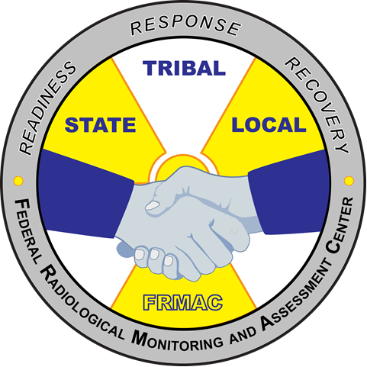
FRMAC Field Monitoring Specialist Training – Introduction
MS-200
Module 3
FRMAC Monitoring Division Training
January 2021

Slide 2
MS-200 Module 3 Outline
Sample collection
  Air
  Ground Deposition/Soil
  Water
  Vegetation
  Milk/feed
Sample Receipt
Notes:
There are videos showing how to collect samples that were made by FRMAC/EPA in 2013 (5 short segments related to air, water, soil, hotline, sample receipt). If desired, show the videos or DVD. Then cover the following slides as a review. If no videos are available, then cover the slides and frequently pause for questions. If equipment is available and weather permitting, then consider doing some portions of the training module as a demonstration or class practical (works well for soil and air samples).

Slide 3
Sampling Techniques

Slide 4
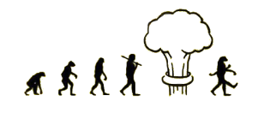
Sampling Evolution
Early Phase
  Focuses on quick results for immediate protective action decisions
    Worker protection
    Public shelter / evacuation
Intermediate Phase
  Focuses on Derived Response Levels (DRL)
    Re-entry decisions
    Examining crop embargo areas
Late Phase
  Focuses on environmental / clean-up levels
Notes:
Radiological emergencies are typically broken into 3 phases. In the USA, the 3 phases of a radiological emergency are named Early, Intermediate, and Late. The international community will call these 3 phases Urgent, Early, and Recovery. Different phases of the response will dictate different measurements and sample sizes.
During the Early Phase (sometimes referred to as the Emergency or Plume Phase), material is still being released into the environment. The duration of this phase is hours to days. For reference, Fukushima’s Early Phase lasted for 2 weeks.
The Intermediate Phase starts when the release has stopped and for several weeks or months afterwards. During this phase, it is time to determine the full extent of the impacted areas.
The Late (sometimes referred to as the Recovery phase) begins after the intermediate phase and lasts for months to years. Full characterization and clean up occur during this phase. EPA would be in charge of the FRMAC at this stage.

Slide 5
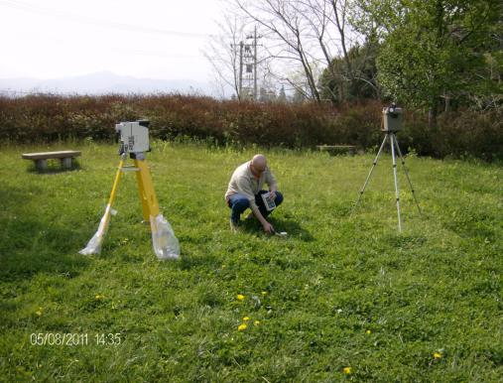
Early Phase – Types of Samples
Air Samples
  Worker Protection
  Plume Tracking
  Re-suspension
Ground Deposition
  Ground deposition sample
  Standard soil sample
  In situ measurements
Notes:
While in the early phase, collecting any type of sample could be requested, however the most crucial samples to be collected to determine public safety would be air samples and ground deposition samples (focused on ground deposition samples and standard soil samples, both of which are discussed later in this presentation). While the isotopic mix could be determined (or partially determined) by an in situ gamma measurement, soil samples are usually preferred so the isotopic mix can be more fully determined in a laboratory. Results from a laboratory may take anywhere between many hours to days to complete depending on the type of analysis requested and work load.

Slide 6
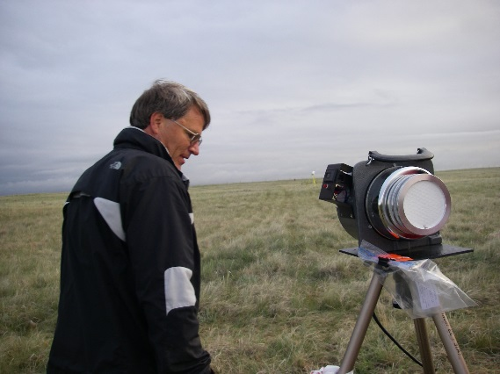
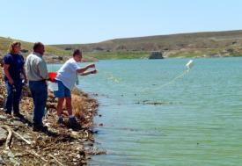
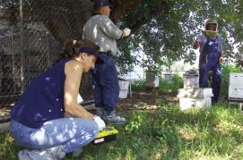
Intermediate & Late Phase
Types of Samples
Air
  Re-suspension
  Monitoring Release Point
Soil
  Migration
  Defining Exclusion Zone
Water
  Drinking - Ingestion Pathways
Vegetation & Other
  Crops - Ingestion Pathways
  Animal - Stored Feed
  Milk - Ingestion Pathways
Notes:
During the intermediate and late phases, all types of samples could be collected. Soil samples will evolve from ground deposition samples, to standard soil samples (samples collect the first inch or 2 of soil), then core samples may be taken after the nuclides have migrated into the soil past the standard soil sample depth. Air samples will continue, but most likely will be low volume air samples with long collection times to measure resuspension. Water samples may be collected during any phase to determine the safety of public drinking water. Vegetation sampling is prevalent in this phase to determine the safety of all food supplies (crops and animals).

Slide 7
When Collecting Samples
Survey the sample location (if possible)
  2.5 cm (1 in.) contamination level
  1 m (waist height) exposure rate
Use clean sampling tools
  rinse and survey prior to use (if necessary)
  use plastic sheets / bag as clean work area
Use gloves when sampling
  change out gloves after each sample
Notes:
These are general guidelines for collecting samples. Performing a basic exposure rate survey and ground contamination survey at the sampling site is for basic health and safety purposes and also the data could be used for correlations by data assessors. Always use clean sampling tools to reduce the risk of cross contamination. After use, decontaminate them (if possible) or ensure there are extra tools in the sampling kit. Wear gloves when sampling. Change gloves after each sample to reduce the risk of cross contaminating samples.

Slide 8
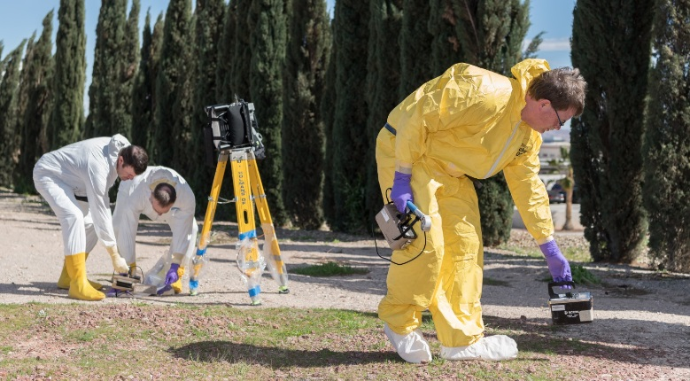
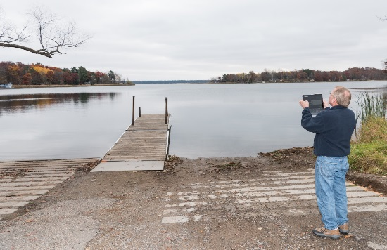
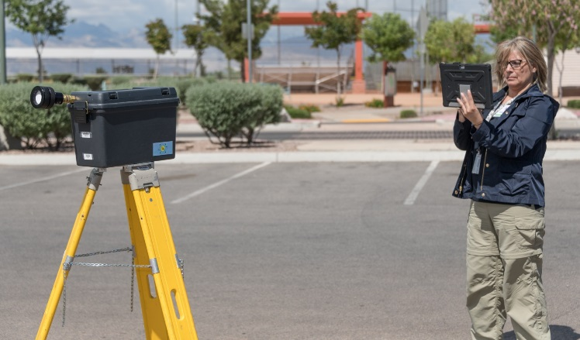
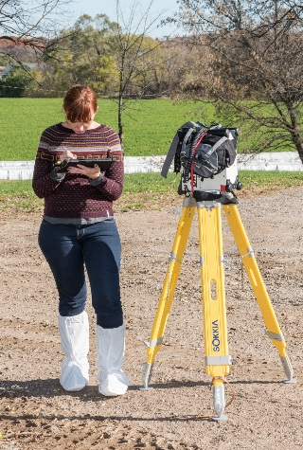
Picture of Sample Area
While collecting a Sample step back and take a picture of the sample area
This helps Assessors understand the area
Submit photo with the sample or measurement
Notes:
Take a picture of the sampling area and submit the photo with the sample or measurements. This helps data assessors to see the area if there are any abnormalities in the results.

Slide 9
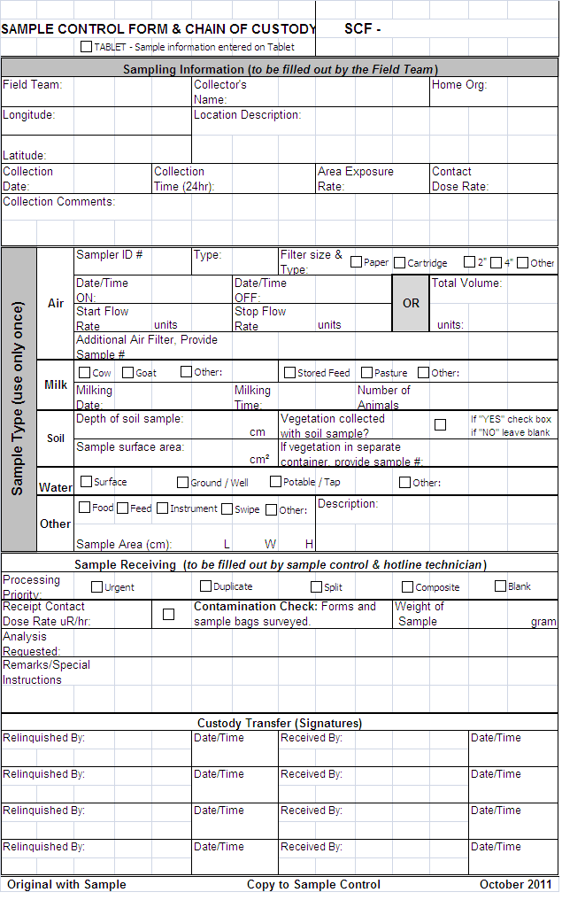
Sample Control Form and Chain of Custody
Example
Unique Sample Control Number for each sample
Team identification information
Location and collection time information as recorded with Radiological reading
Detailed Sample Matrix information sample type, volume, etc. Use only one form per sample media.
Example
Signed Custody Transfer
Notes:
The Sample Control Form is a hardcopy used by field teams. It is the same information you would find in RadResponder. The Sample Control Form could also contain the chain of custody (or the chain of custody could be a separate form). One Sample Control Form is used for each sample collected. This form is completed in the field, transferred with the sample to sample receipt, then signed over to the sample control personnel.
Minimum Information Required
SCF Barcode #
Collection Team ID
Sample Type
Collection Date & Time

Slide 10
Air Sampling

Slide 11
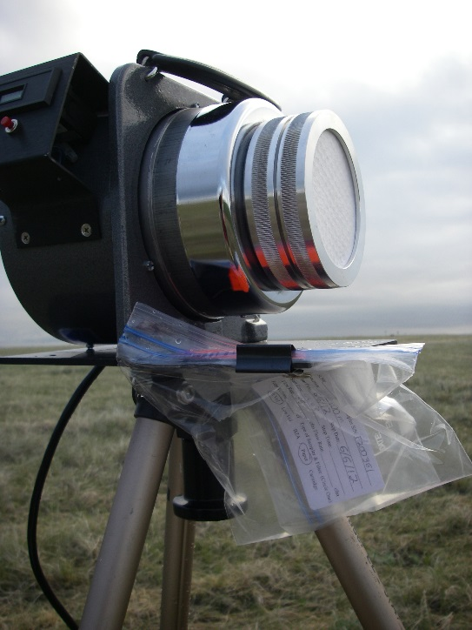
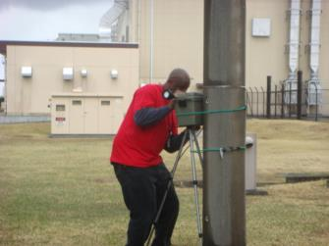
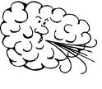
Air Sampling
Plume Tracking
Re-suspension
  public / general population
  emergency workers – hot line, laboratory, etc.
Notes:
Current plans assume that the radioactive release has stopped before FRMAC arrives. Therefore, FRMAC does not expect to perform plume tracking air samples. However, FRMAC does plan on performing environmental level air samples to determine resuspension levels and to support responder health and safety.
Air Sampling Teams should be skilled at taking air samples, in addition to external dose rate and contamination monitoring. They may also require training in field assessment of air samples using portable radiation monitoring instruments prior to placing the sample in a suitable sealed and labeled container.

Slide 12

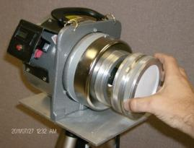
Low Volume Versus High Volume
Low Volume
  0 to 10 CFM approximately
  True breathing rate
  Most commonly used for sampling at Nuclear Power Plant
High Volume
  > 10 CFM
  40 CFM is our standard
  Ideal for Grab Sample
  Large volume of air in a short time
Notes:
Depending on the nuclide(s) and the necessary air volume necessary by the lab to determine activity concentrations, either a low volume or high volume air sampler will be used. High volume air samples are usually collected by field teams to help with responder health and safety. Traditionally, longer low volume air samples are used for environmental samples because the flow rate mimics breathing rates in adults and provides a closer approximation of the activity inhaled by a person. Whatever pump is chosen, the results will provide necessary data for evaluation of inhalation hazards.

Slide 13
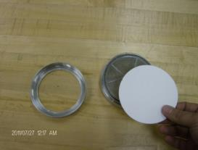
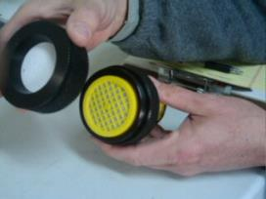
Air Sample Filters
Filter type depends on the contaminant to be measured
High Volume
  Glass fiber filter paper
Low Volume
  high-efficiency filter paper alone or with a charcoal cartridge
Notes:
The type of filter used depends on the contaminant to be measured. Glass fiber or paper filters are used for gross beta + gamma particulate. Cartridges are used with low volume air samples to collect gasses (like radioiodines). The most frequently employed filter in environmental air sampling is the glass fiber filter because it can maintain a low pressure drop even at the high flowrates and large dust loadings associated with environmental air sampling. Charcoal cartridges (TEDA [triethylene di-amine] impregnated carbon filter media) have a high affinity for the adsorption of the various species of iodine. Silver impregnated zeolite cartridges contain a highly efficient inorganic adsorbent for the collection and removal of elemental and organic forms of radioactive iodine.

Slide 14
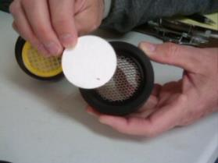
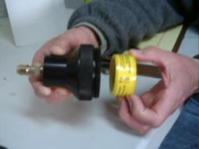
Collect a Low Volume Air Sample
Assemble the Sample Head
Install paper filter.
Install charcoal filter.
Assemble head.
Notes:
There is a FRMAC operator aid available for low and high volume air sampling: https://www.nnss.gov/pages/programs/FRMAC/FRMAC_DocumentsManuals.html
Install the paper filter fuzzy side out. If the front and back of the filter cannot be determined, than place an ink spot on the front of the filter near the edge. Record this in the comments on the Sample Control Form. Install the cartridge. Ensure the Air Flow Arrow is pointing in the correct direction.

Slide 15
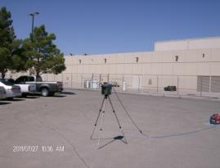
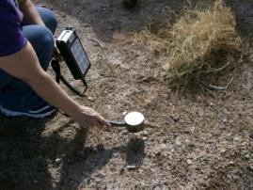
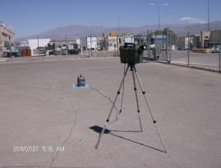
Collect a Low Volume Air Sample
Choose a Location
Locate the pump out in the open away from buildings, trees or other overhead obstructions.
Survey the area (Exposure Rate & Contamination).
Position sample head approximately 1.5 meter off ground, in the direction of the release.
Notes:
The rule of thumb is to locate pump at least two times the height away from the closest obstruction. Perform an exposure rate survey (waist high) and a contamination survey (ground level). Record the measurements. Take a picture of the Air Sample Pump and surrounding area. Submit the photo with the other sample collection information.

Slide 16
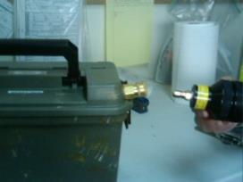
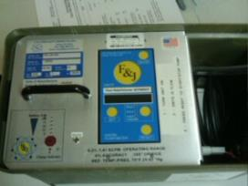
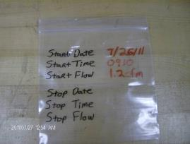
Start the Air Sample
Insert assembled head into air sampler.
Turn Pump ON.
Record Start Date/Time and Flow Rate on bag and paperwork.
Notes:
It is important to record the flow rate and start date/time for the sample to be useful later for data assessment.

Slide 17
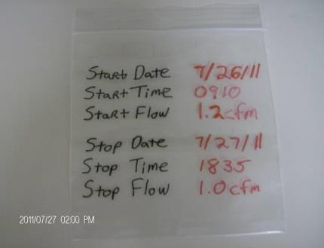
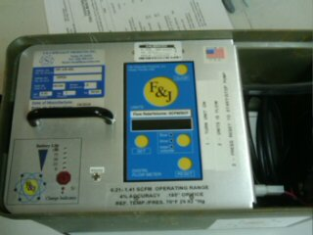
Stop the Air Sample
Record Stop Date, Time & Flow Rate, or Total Volume on bag or paperwork.
Turn Pump OFF.
Notes:
It is important to record the flow rate and stop date/time for the sample to be useful later for data assessment.

Slide 18
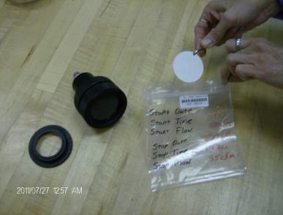
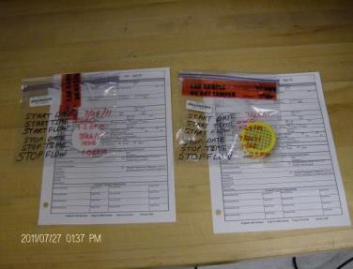
Package the Sample
Using Tweezers, Place Paper and/or Cartridge into separate Sample bags.
Complete a separate Sample Control & Chain of Custody Form for each sample and input into the Tablet.
Notes:
Bag the filter and cartridges separately (each should get its own sample paperwork). Sometimes a filter is folded to fit into a sample bag or to ensure particulates are not lost. If folding a sample filter, fold up and onto itself and then place it into the bag. If background radiation levels permit, survey the sample bag. Record all the information on the sample control form and electronically (i.e. RadResponder or other data collection system).

Slide 19
Ground Deposition Soil Sampling

Slide 20
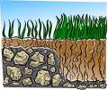
Ground Deposition Sampling
Sample taken are 2 cm deep x 100 cm²
  Looking for ground deposition before the contamination has migrated. Can include:
    Soil, Rocks
    Grass, Leaves & Twigs
A sealable bag is the default standard container
  The sample can be transferred to other containers as needed
Ground deposition and standard soil samples use the same equipment. Difference is the content of each sample.
  We’ll go over how to collect a
  soil sample.
Notes:
FRMAC suggests using a ground deposition sample during the early phase of the response. The ground deposition sample is not the traditional soil sample because it includes twigs, leaves, or vegetation. The ground deposition sample is collected to determine what is on the surface of the ground and top layer of the soil. Ideally, collect a sample with minimum vegetation ( <6 inches of vegetation material). After the early phase, FRMAC suggests collecting the standard soil sample where it is free from everything but soil. Either way, the FRMAC sampling jig is used to collect both types of samples.
In crowded urban locations smear/swipe samples can be used if soil is not present.
There are FRMAC operator aids available for ground deposition samples and standard soil samples: https://www.nnss.gov/pages/programs/FRMAC/FRMAC_DocumentsManuals.html

Slide 21
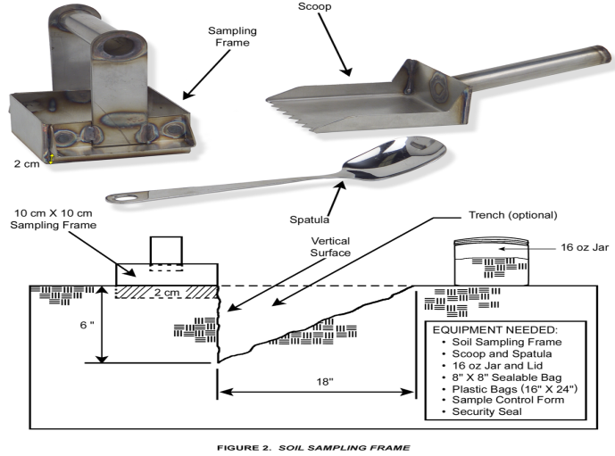
Soil Sample Tools
Notes:
This slide shows the FRMAC soil sampling jig and trowel (used for both ground deposition and standard soil samples). The diagram at the bottom shows a side view of the soil with a the sampling jig on the surface and a trench dug out.

Slide 22
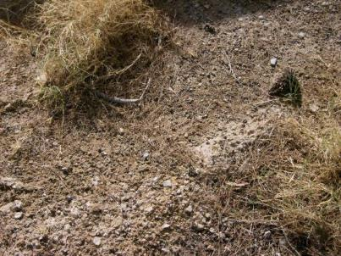
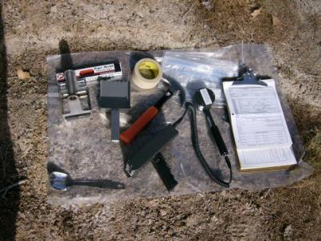
Collect a Soil Sample
Locate the sample out in the open, away from buildings, trees or other overhead obstructions
Gather the needed equipment place in a bag to carry to collection site.
Notes:
Choose a location to collect the ground deposition/standard soil sample in an open area, away from buildings, trees, or other overhead obstructions. Choose a location with as little vegetation as possible. Less than 6 inches high of vegetation is recommended.

Slide 23
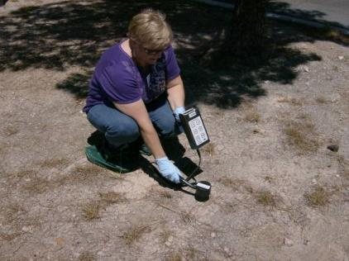
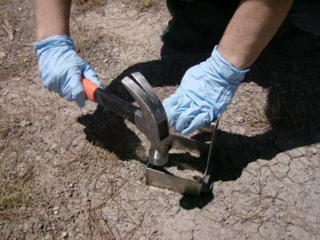
Collect a Soil Sample
Survey the area (Exposure Rate and Contamination).
Push Jig to 2 cm depth. Tap with Hammer if needed.
Notes:
Perform an exposure rate survey (waist high) and contamination survey (ground level). Record the measurements.

Slide 24
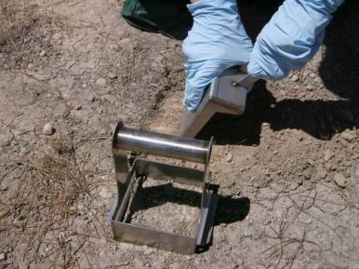
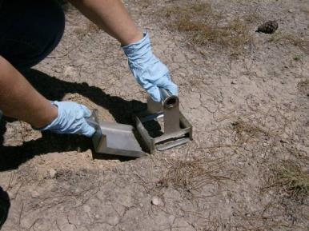
Collect a Soil Sample
Dig trench with trowel, use claw hammer If needed to loosen soil.
Slide Trowel under jig, use hammer if necessary to push trowel under the jig.
Notes:
A ground deposition sample will collect whatever is on the surface (vegetation, debris, etc.). A standard soil sample will only contain soil (the surface debris and vegetation must be removed).

Slide 25
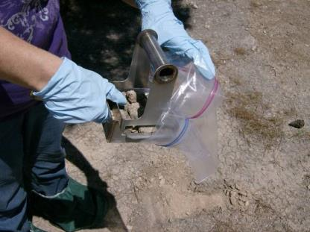
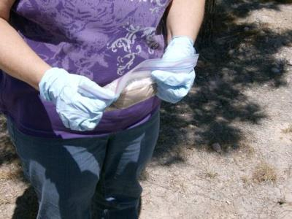
Collect a Soil Sample
Pick up Jig and Trowel with the sample. Pour content into 1 gallon Sealable Bag.
Roll the bag around the sample. Keep the opening away from breathing area.
Notes:
Deposit the sample in the bag. Rolling the top of the bag down will help reduce contamination on the bag. Releasing the air from the bag will help protect the bag from popping or taking up too much space in containers.

Slide 26
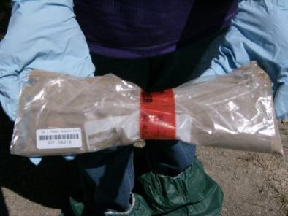
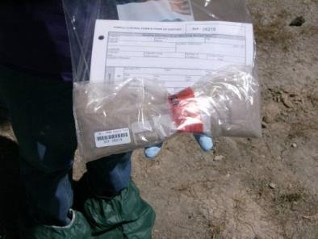
Collect a Soil Sample
Place a Security Seal on the bag.
Complete the Sample Control & Chain of Custody Form and record data.
Notes:
If background permits survey the sample bag. Avoid cross contamination when sampling by changing gloves after collecting each sample.
Record all the information on the sample control form and electronically (i.e. RadResponder or other data collection system).

Slide 27
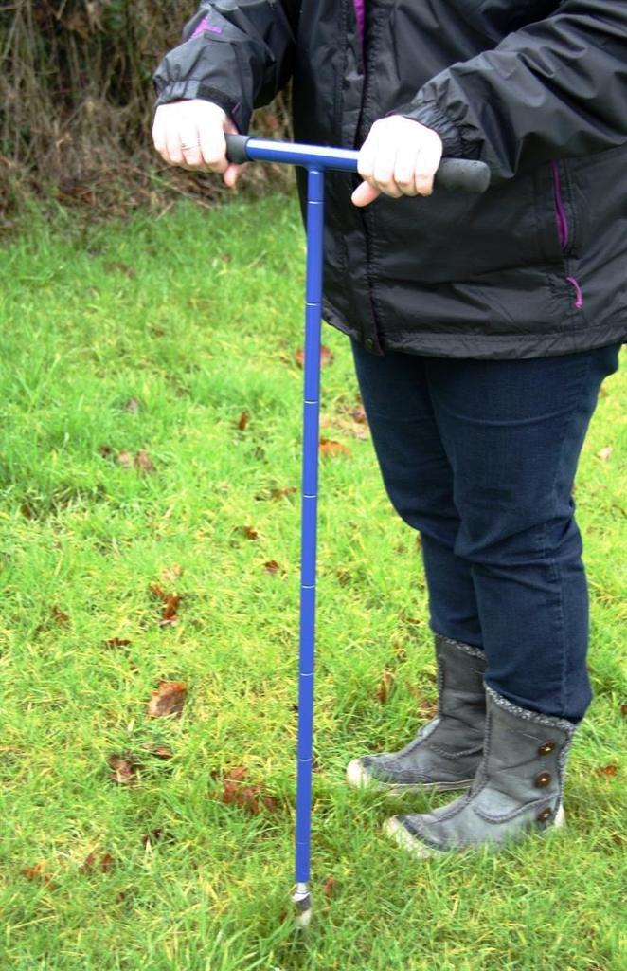
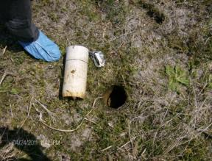
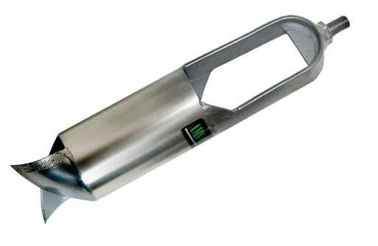
Soil Samples at Depth
In addition to surface deposition, soil depth migration will need to be assessed
Core sampling will depend on special procedures and soil composition and be developed in field.
Notes:
Depths of 5-8 cm typically provide good data for determination of a contamination profile with depth, however soils with high porosity can facilitate a pathway for contamination at deeper depths. FRMAC does not deploy with core soil sampling equipment, however, coordinating agencies could provide equipment. Selection of sampling equipment will depend on the soil type, moisture content, compaction, groundcover, and the size of the required sample. Equipment used to perform core soil samples may include an auger or shovel for bulk samples, and open trenching or split barrel sampler for discreet samples at depth. There is not currently a standard FRMAC method for obtaining core soil samples. As core soil samples could be useful in the latter part of the intermediate phase and the late phase, FRMAC will coordinate with states/locals and other applicable agencies on proper core sampling methodologies based on existing field conditions.

Slide 28
Water Sampling

Slide 29
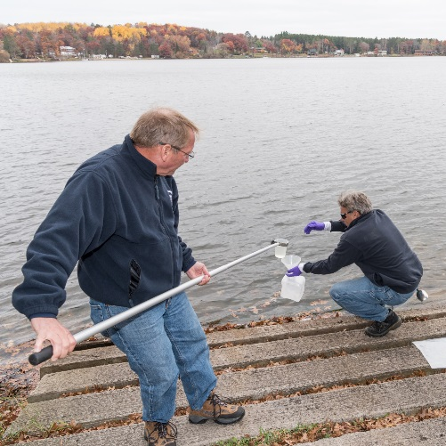
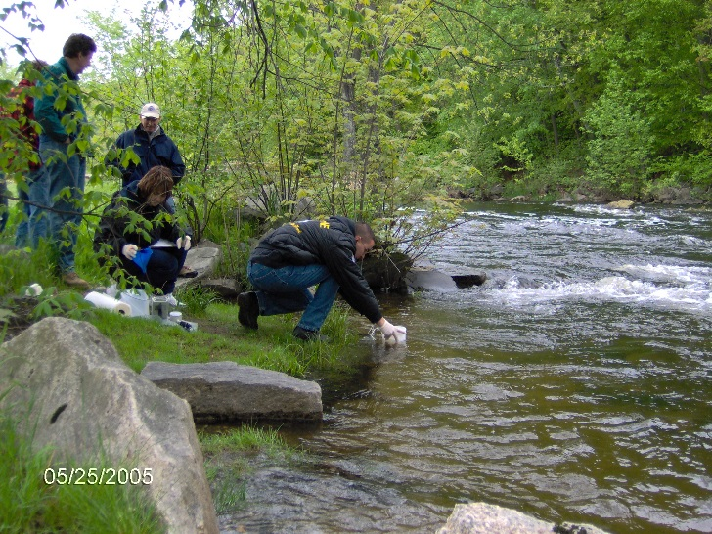
Water Sampling
Early Phase
  Surface
  Rain (standing water)
  Public Drinking
Intermediate and Late
  Wells
  Public Drinking
  Sediments
Notes:
Water sampling is phase dependent, during the early phase, the most important samples would be sources of public drinking water. Water treatment facilities would be a priority and could be easily sampled by local personnel. During the intermediate and late phases, water sampling may focus on lakes and streams to determine the levels of radioactivity in the environment and to determine the impact to agriculture (crops and animals).
There is a FRMAC operator aid available for water sampling (sampling from the tap and also early phase water sampling): https://www.nnss.gov/pages/programs/FRMAC/FRMAC_DocumentsManuals.html

Slide 30
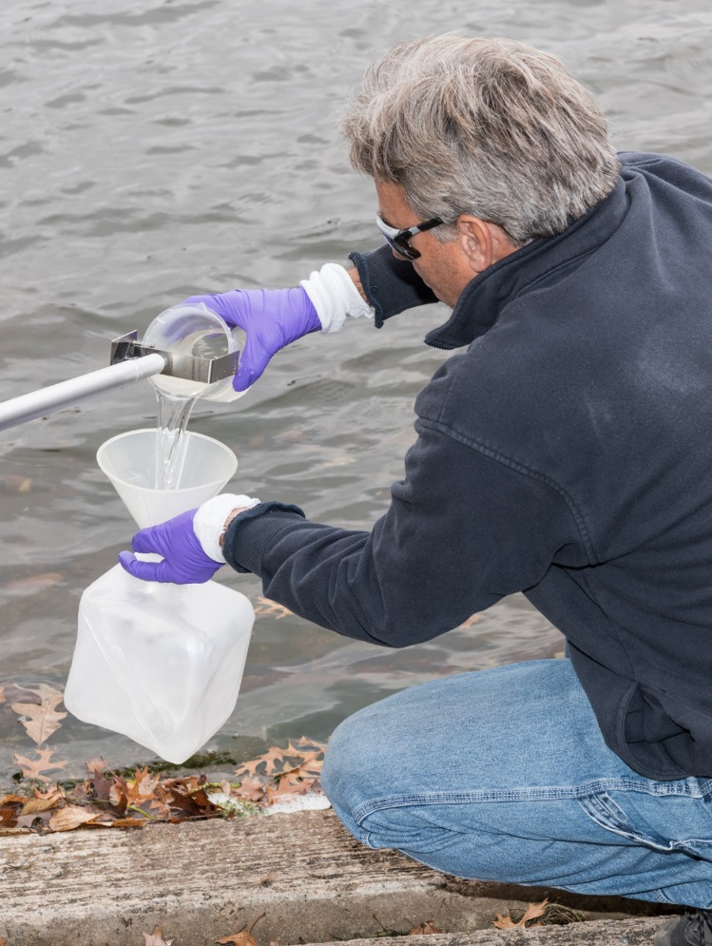
Water Sampling
3.5 liter Cubetainer
Rinse Cubetainer with water
Avoid areas of debris
Notes:
Rinsing the container with deionized or distilled water helps remove any impurities in the container left during manufacturing.

Slide 31
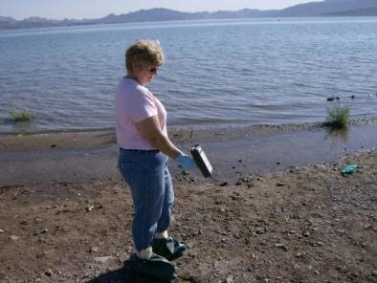
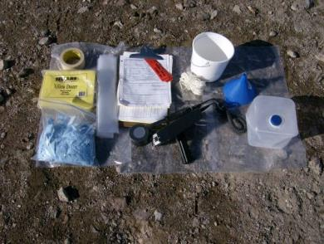
Collect a Water Sample
Survey the nearby area (Exposure Rate and Contamination)
Gather the needed equipment place in a bag to carry to collection site.
Notes:
Choose a location to collect sample. Ensure enough water is available to fill a one-liter cubetainer. Perform an exposure rate survey (waist high) and a contamination survey (ground level) somewhere near the sampling location (on shore).
Choose an area that is open, not sheltered by trees or high brush. There should be little or no current.

Slide 32
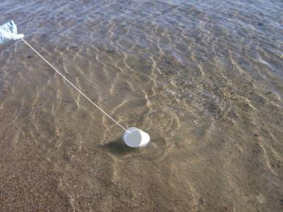

Collect a Water Sample
If needed attach the rope to the bucket.
Collect the surface water.
Using the funnel fill the 3.5 liter container.
Stop 1 inch from the top.
Notes:
Obviously, there are other ways to collect water samples. Use whatever method your agency has approved.

Slide 33


Collect a Water Sample
If needed using an indelible marker, write the SCF Number on the Cubetainer.
Place into a clean plastic bag.
Notes:
Complete the Sample Control and Chain of Custody Form. If background permits, survey the sample bag and record results on the SCF.
Record all the information on the sample control form and electronically (i.e. RadResponder or other data collection system).

Slide 34
Vegetation Sampling

Slide 35



Vegetation Sampling
Early Phase
  samples chosen to match pathway to man
  animal feed and/or grass
  leafy vegetables
  Fruits
Late Phase
  standing crops
  root vegetables
  long-term sampling
Notes:
Early phase is for deposition not plant uptake. This phase focuses on mature produce ready for market and impacts to dairies and ranches (food ready for market). These food items will be of interest through each of the phases.
Intermediate or late phase sampling will focus on immature produce which will determine the viability of using future crops as a food source. These samples have a high economic impact to the affected area.
Discuss complexity of a Vegetation Sample
Crop Types - What are consumed by Man vs. Animal Feed
Time of Year – What is Market Ready or will be soon?
How will you analyze the sample – Fish, Meat, Watermelon?
Procedures for plant uptake samples will be developed based on the following considerations and inputs as to why are you collecting this sample:
State, A Team, Assessment: Determines the PAG (Protective Action Guide) and release criteria for this crop.
Lab Analysis: Determines the size/quantity of the sample to meet the laboratory’s minimum detectable activity and count times.
Monitoring & Sampling: Will train teams to collect appropriate samples.

Slide 36


Collect a Vegetation Sample
Gather the needed equipment place in a bag to carry to collection site.
Locate the sample out in the open, away from buildings, trees or other overhead obstructions.
Notes:
Use plastic sheeting or a large bag to place sampling equipment on the ground. Choose a sample location in an open area, away from buildings, trees, or other overhead obstructions.

Slide 37


Collect a Vegetation Sample
Survey the area (Exposure Rate and Contamination).
Only collect the edible portions of the plant. Clip pieces 16 cm or less. Stop before the bag is bulging and will not seal.
Notes:
Perform an exposure rate survey (waist high) and a contamination survey (ground level) and record the results. Only collect the edible portions of the plant for early phase vegetation sampling. Clip pieces 6 inches or less (to fit in the bag). Stop before the bag is bulging and will not seal.
The current FRMAC Monitoring & Sampling Manual Volume 2 was updated to:
Fill a 1 gallon sealable bag with the sample,
Measure Length x Width x Height of the collected area
Weigh the sample.
After laboratory analysis, the results can then be interpreted in activity per sample, activity per weight, or activity per area.

Slide 38


Collect a Vegetation Sample
Measure the length, width, and depth of the sample collected
Complete the Sample Control and Chain-of-Custody form and record information.
Notes:
Measure the area of the collected sample. Weigh the sample either in the field or at the Sample Control line.
Place a sample control barcode and Security Seal on the bag. Complete the Sample Control and Chain of Custody Form. If background permits, survey the sample bag. Record all the information on the sample control form and electronically (i.e. RadResponder or other data collection system).

Slide 39
Milk and Feed Sampling

Slide 40



Milk and Feed Sampling
Dairy locations
  Farms
  Transfer stations
  Processing plants
Feed sample
  Stored feed
  Open range
Notes:
Personnel from supporting state or county agencies, the U.S. Department of Agriculture, or the U.S. Department of Health and Human Services will normally be present to assist Field Monitoring Teams. Current lists of dairy farms, milk receiving and transfer stations, and processing plants should be maintained by state agriculture agencies. Representatives from the county or state Department of Agriculture, U.S. Department of Agriculture, or the U.S. Department of Health and Human Services may be assigned to assist in the planning, liaison, and/or collection efforts. Most states require some form of certification or specialized training to collect milk. FRMAC field teams may assist the milk collector with radiation safety during the sample collection process.

Slide 41
Milk Sampling
Integration with state and local responders is invaluable
Duplicate sampling is preferred rather than splitting samples
Chain of custody is maintained for all samples
Notes:
State or Federal Agricultural personnel are invaluable in locating, coordinating, and collecting samples.
Use bar code label or indelible ink pen to record sample control number on sample collection container. Collect one sample of at least 1 Gallon (3.5 Liter). Sufficient volume is needed for laboratory analysis. Collect raw or whole milk (cream mixed into the milk) whenever possible. The Field Team instructions should advise if preservative is to be added to the sample, if the sample is to be chilled, when to collect two samples or special milk samples, and the general area in which to collect them. Record all the information on the sample control form and electronically (i.e. RadResponder or other data collection system).

Slide 42
Sample Receipt

Slide 43
Sample Receipt / Hotline
PORTAL
MONITOR
SAMPLE AND
EQUIPMENT
STORAGE
STEP OFF PAD –
FIELD TEAM EXIT
Decon
Shower
HOTLINE
VEHICLE HOLD FOR SURVEY
AND DECON BEFORE EXIT
FROM CONTAMINATION AREA
EQUIPMENT DROP-OFF,
SURVEY & DECON
SAMPLE DROP-OFF
& SURVEY
SAMPLE
DROP OFF
X X X X X X X X X
X CONTAMINATION AREA X
RETURN TO FIELD
VEHICLE PARKING
ENTRANCE –
WAIT FOR
INSTRUCTIONS
Notes:
In the field, samples should be placed inside a sealable plastic bag to prevent spread of contamination. The sample control form and chain of custody should be kept with the sample (preferably in a sealable plastic bag where the paperwork will be contamination free). Radioactive waste will be collected in a plastic bag(s) while in the field. The bag should be readily identified (by either color or label/marking) by each team member as the radioactive waste collection bag. Radioactive waste will be stored in the field team vehicle during the operational shift.
When field team activities are complete, the samples, paperwork, and radioactive waste is brought to the Contamination Control Line (otherwise known as the hotline) and placed in the designated areas. Hotline personnel will survey the field team members, equipment, and vehicle to locate and limit the spread of contamination. Review the “FRMAC Health and Safety Manual” for complete directions on hotline activities. If the team is to return to the field, a routine survey is not taken of the vehicle. Field team personnel should be surveyed if exiting the vehicle. If the Field Monitoring Team is not returning to the field, personnel should follow the directions of the hotline technician. The field team will proceed through the hotline by dropping off samples, equipment, any contaminated trash, and then go through the process of doffing PPE and exiting the area.

Slide 44

Sample Receipt – Contamination Control
  Consider all samples and paperwork to be contaminated until surveyed
  Remove all outer bags to retrieve the sample and paperwork
  Complete a contamination survey (Fixed and Removable)
  Complete a contact dose rate of the sample
Notes:
Personnel (both field monitoring teams and sample control) should consider all samples and paperwork to be contaminated until they are surveyed. Remove all outer bags to get to the sample and corresponding paperwork. Perform an exposure rate survey on the sample and record the results on the sample control form (if not previously done). Perform contamination surveys (swipes and surveys) on the paperwork and sample bag/container. As the sample receipt area has the potential to be easily contaminated, technicians should survey the sample receipt work area periodically for contamination.

Slide 45


Sample Receipt – Contamination Control
If contaminated, decontaminate or double-bag the container, as appropriate.
If paperwork is contaminated, transfer the information to a clean Sample Control form.
Notes:
The hotline is placed in a low background area so sample containers and bags can be surveyed for any contamination above regulatory limits. If the paperwork is contaminated, Sample Control personnel can copy the paperwork onto a clean form. If sample containers are found to be contaminated above the release limits, the containers can be double bagged to prevent the spread of contamination.

Slide 46

Sample Receipt & Inspection
Check for evidence of breakage or leakage
Check for paperwork discrepancies
  Correct sample type
  Dates/times
  Incomplete data entries
Check for sample acceptability by laboratory
  Dose rates and contamination values are below laboratory limit
Notes:
Sample control personnel will check the samples and paperwork for any discrepancies. Sample control forms must be completed. Be aware that some samples may be too radioactive for laboratories. Sample Control personnel may need to store the sample away from counting equipment due to high radiological readings.

Slide 47


Sample Receipt & Inspection
Sample Control personnel will document any observed non-conformances
Field Monitoring personnel must sign the Chain of Custody to transfer custody
Sample Control personnel will:
  Accept the sample by signing the Chain of Custody
  Log the sample into the Sample Control Logbook.
Notes:
The field team should not leave until Sample Control personnel have completed their review of the paperwork and have taken control of the samples on the chain of custody form.

Slide 48

Questions?
Where can I dump this?

