Slide 1

Consequence Management Center (CMC) Training
MS-260
FRMAC Monitoring Division Training
September 2020
Notes:
This course is required by all FRMAC Monitoring Managers and Field Team Supervisors. The course will provide an overview of the Consequence Management Center (CMC) software used by the FRMAC Monitoring Division.
This course was designed to be instructor led or self study. The slides were designed to guide the student through the various functions of CMC. It is expected that the student already have access to CMC and are able to follow along with the slides while using CMC.
As CMC is updated, the slides will be updated to reflect current functionality.

Slide 2
Module Overview
This presentation will cover the following topics:
  CMC Overview
  CMC Login and Controls
  Reviewing Data in CMC
  CMC Tools
  Dispatching Teams in CMC
  Advanced Options in CMC
Notes:
This course is provided to the FRMAC Monitoring Managers and Field Team Supervisors to become familiar with the CMC software tool. CMC is an application specifically designed to assist the FRMAC/CMRT's Monitoring Manager and Field Team Supervisor to quickly and efficiently create field team activities for an event. This course may be led by an instructor or be taken as a self-study course.

Slide 3
CMC Overview

Slide 4
What is CMC?
CMC is a new application specifically designed to assist the Consequence Management Response Team’s Monitoring Manager and Field Team Supervisor to quickly and efficiently create field team activities for an event.
By combining multiple tasks into one application, CMC allows the Monitoring Division to multitask without the need to change websites or programs.

Slide 5
CMC Functionality
CMC functionality highlights are as follows:
  Plan field team sample locations and routes
  Complete field team instructions
  Save and archive sample locations, team instructions, and routes
  Send instructions and sample locations to the field team tablets
  View the real time location of each field team
  View the locations and status of monitoring and sampling data
  Approve or reject monitoring and sampling data in RAMS
  Chat with field teams in real time via the tablets
  View overall status of the monitoring division for the event

Slide 6
CMC Overview
It is the expectation of the FRMAC Monitoring Division that CMC will be used for future drills and events.
CMC is currently functional on the RSL Portal.
Further funding would be required to develop additional functionality as requested by CM/RAP feedback and to fix identified bugs.
If you have any comments, desire a new feature, or identify bugs, please contact Jeremy Gwin at gwinjs@nv.doe.gov or the current FRMAC Monitoring and Sampling Working Group Chair.

Slide 7
How to Use CMC
The following slides are a tutorial on how to use the various aspects of CMC.

Slide 8
Login and Controls

Slide 9
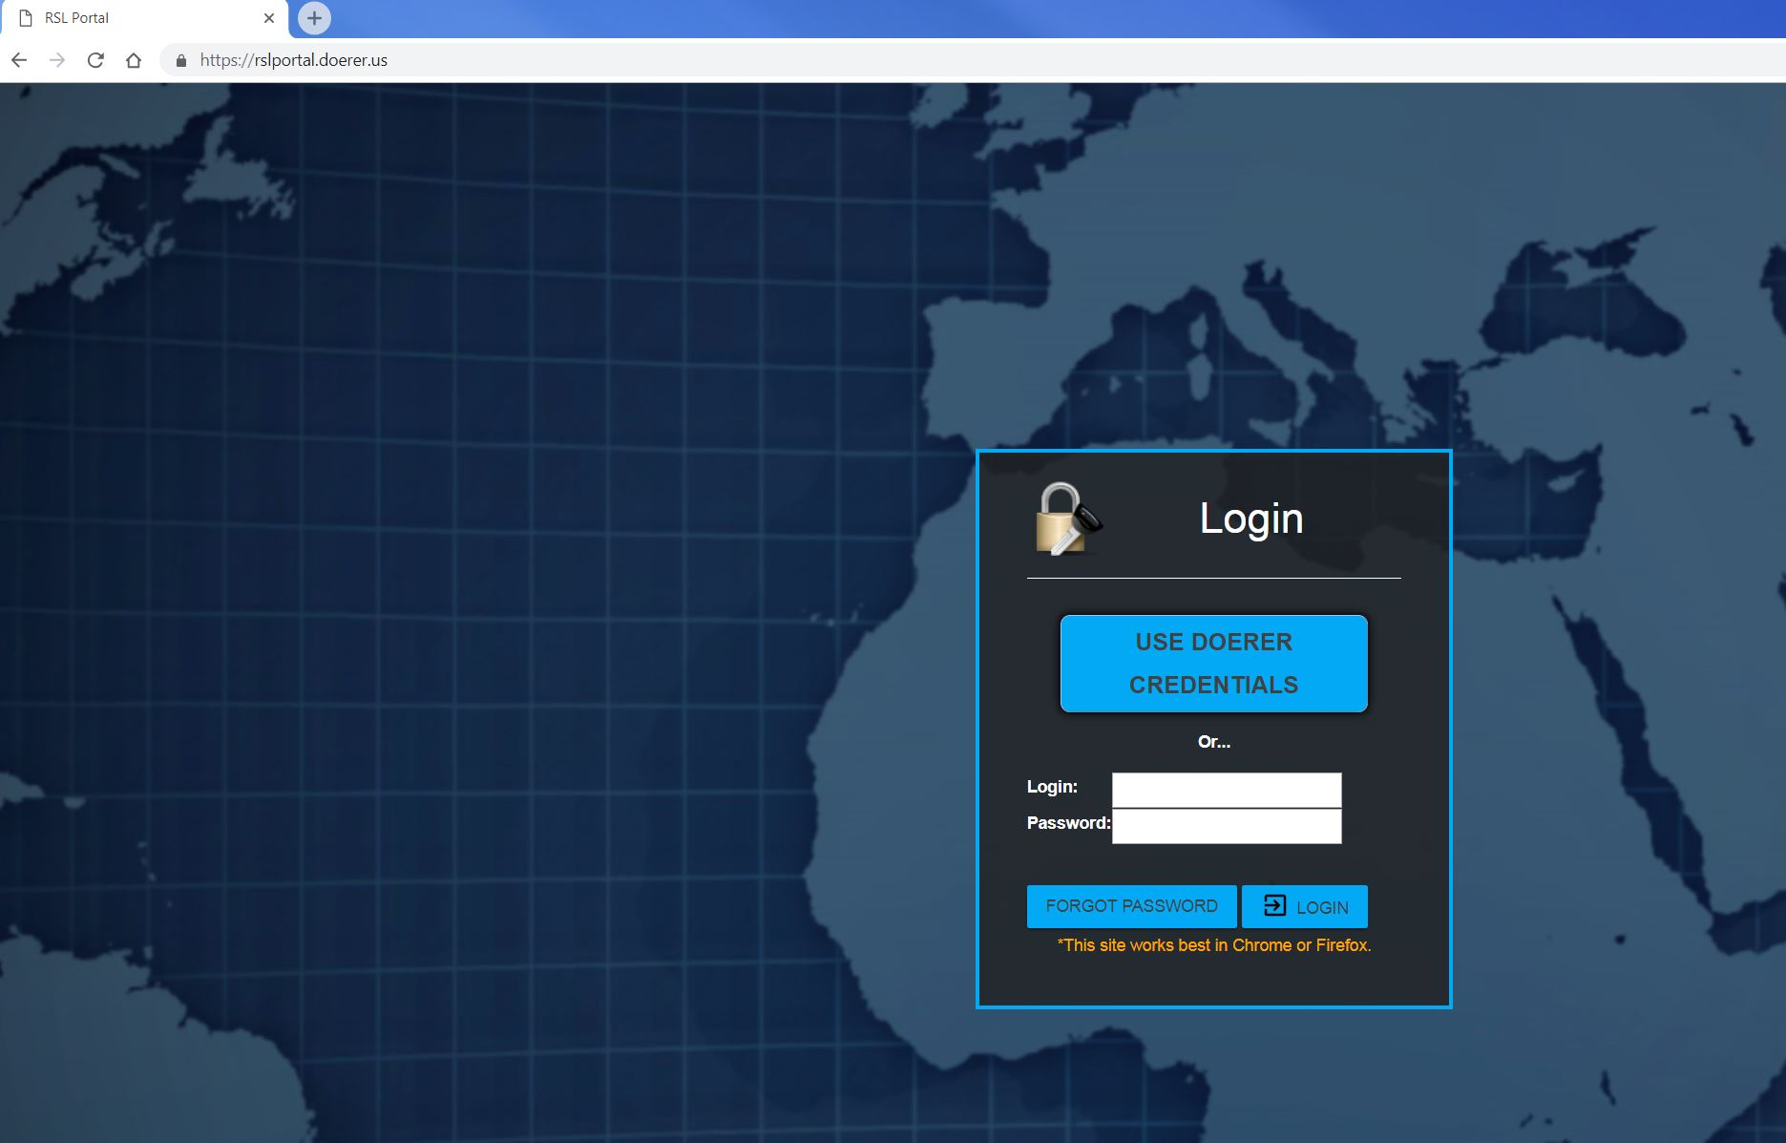
Go to the RSL Portal and log in (https://rslportal.doerer.us)

Slide 10
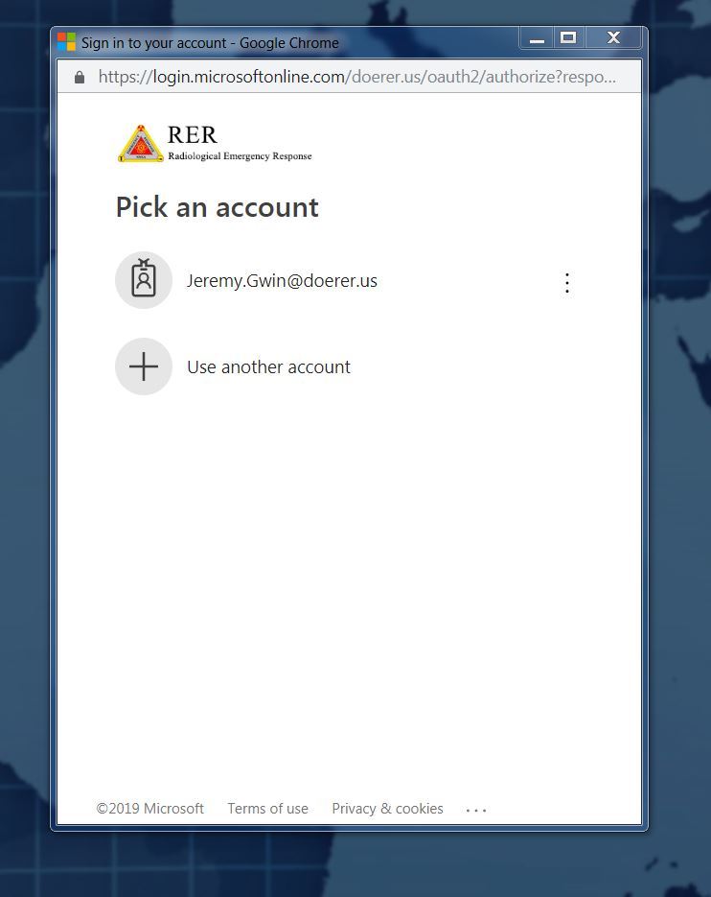
Login to the RSL Portal
Via Shire log in
Via SMC log in with a paper pass

Slide 11
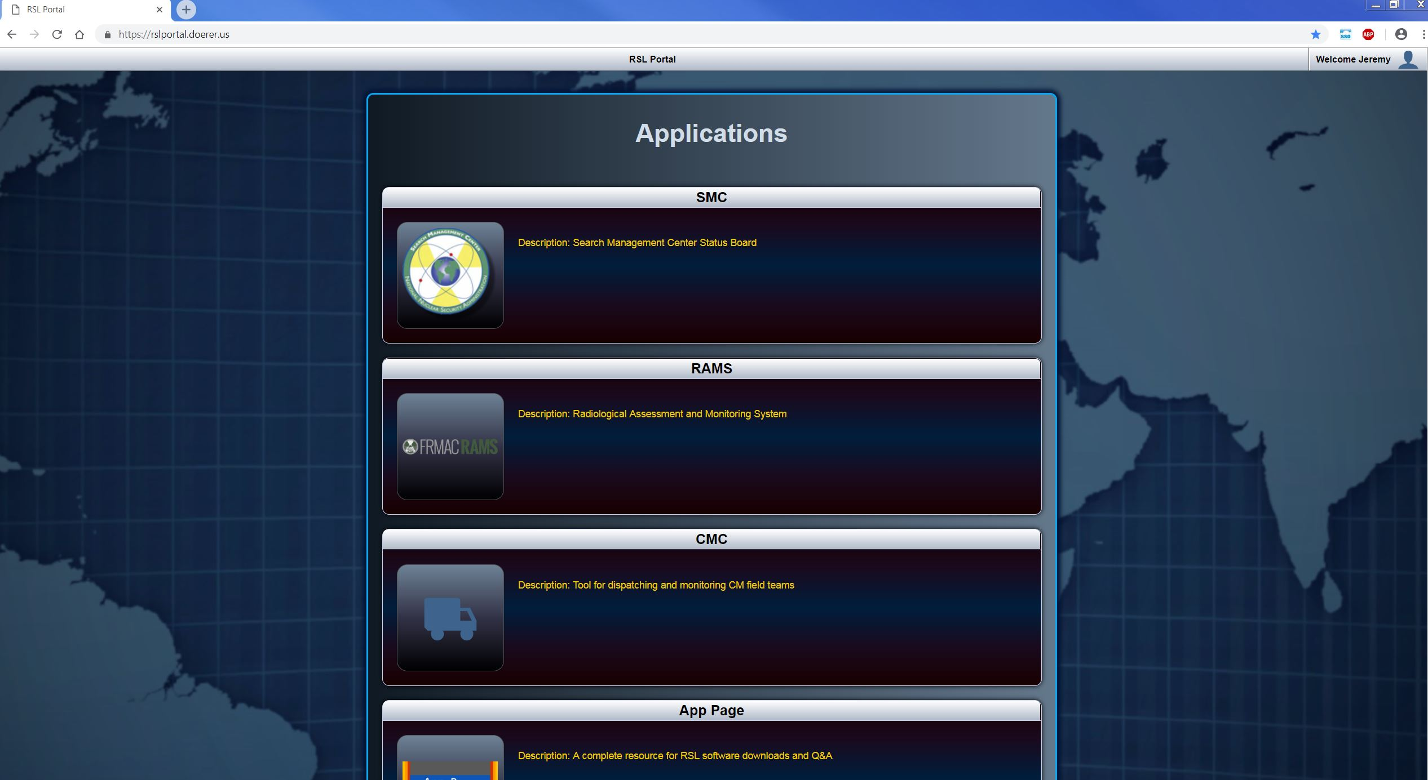
RSL Portal Page

Slide 12
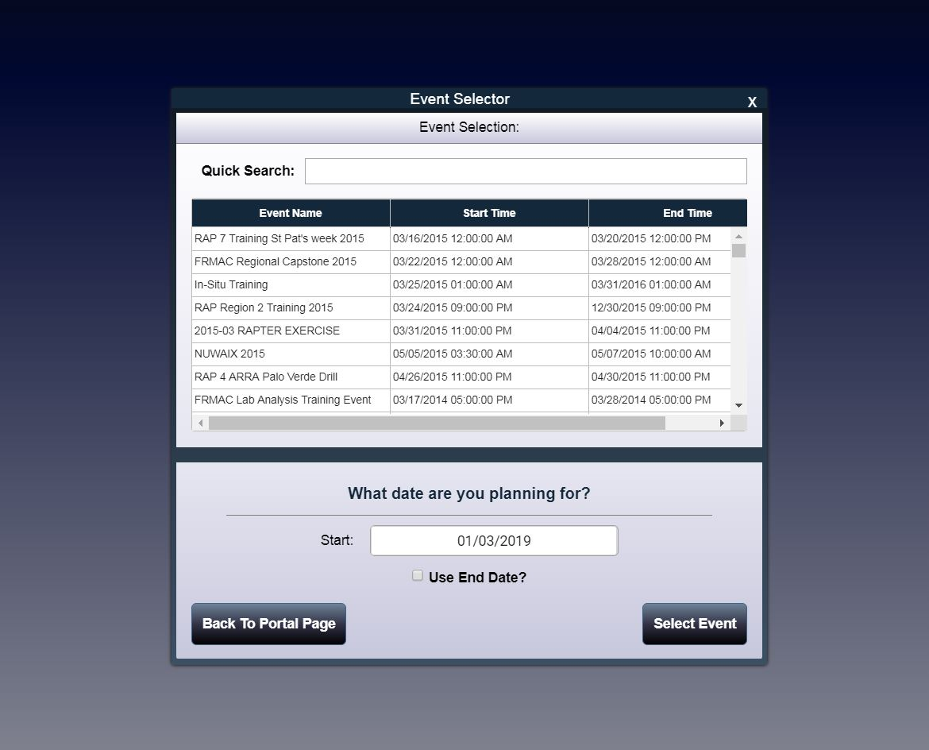
CMC Event Selector
Select an active event in RAMS
  Quick Search for event name
Select the date for which you will be planning field team activities. Default is the current date.
Click “Select Event” to continue.
Caution on the next slide!

Slide 13
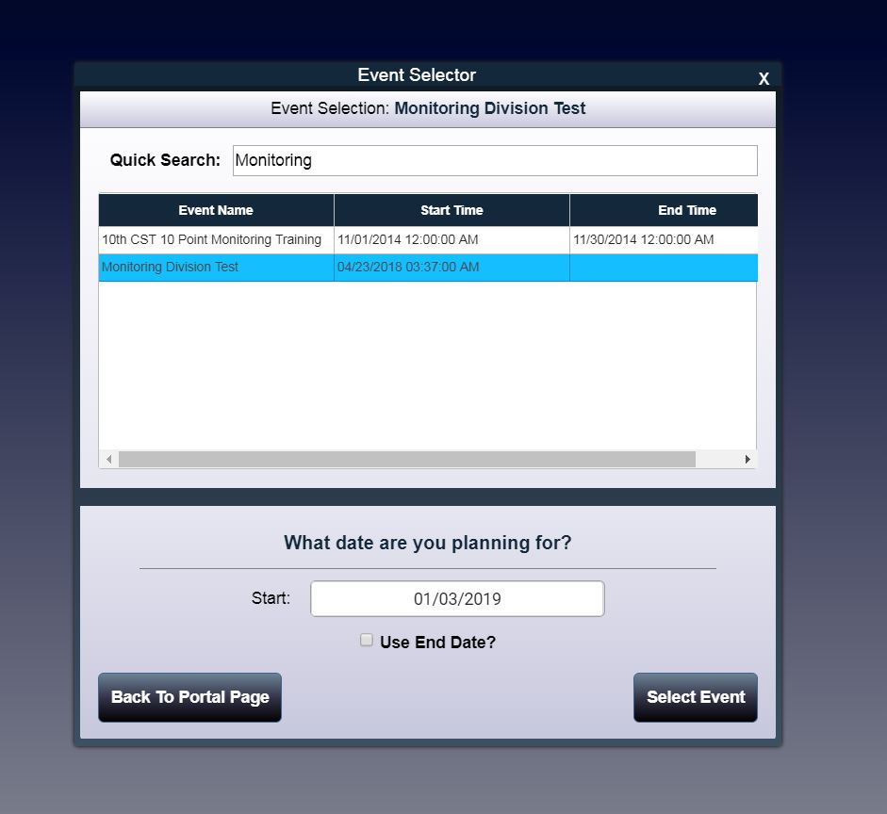
CAUTION!!!
To test or practice using CMC, use the event
“Monitoring Division Test!”
The events are tied to the active RAMS database, so do not overwrite any event.

Slide 14
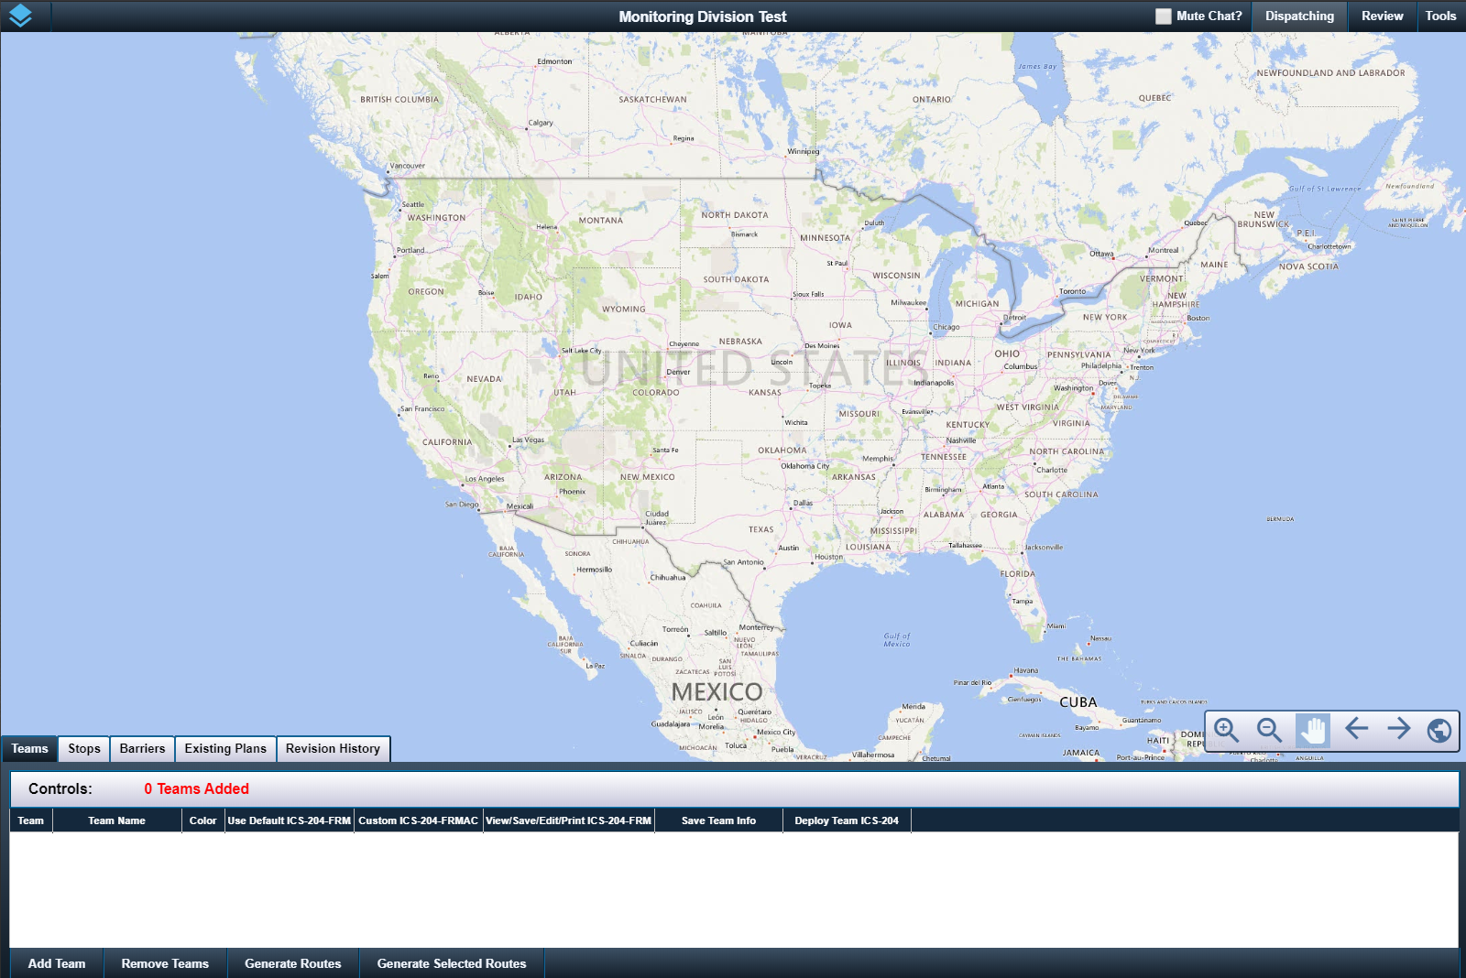
CMC Main Screen
Interesting Things are Here

Slide 15
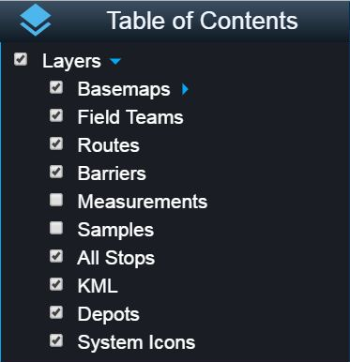
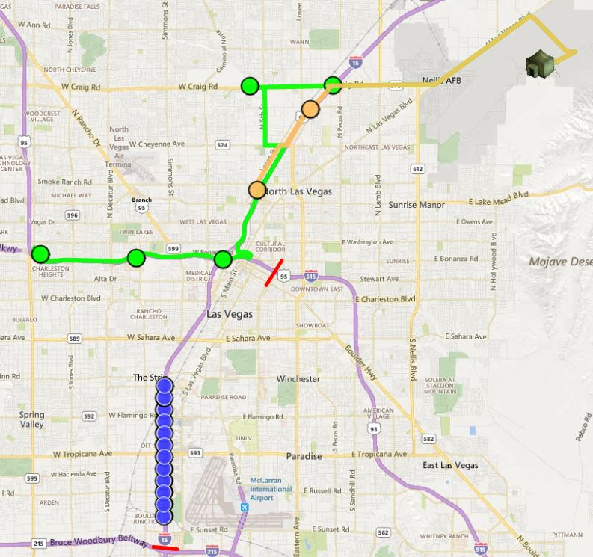
Table of Contents – Top Left Corner
Click the icon to expand the table of contents
Able to toggle on or off layers:
basemaps (street, satellite, or hybrid)
Field Teams (routes, stops, or system icons)
Routes (all routes)
Barriers (all barriers)
Collected samples and/or measurements
All Stops (all sampling locations)
Kmls (choose individual kmls)
Depots (location of team departure)
System Icons (mobile icons)

Slide 16

General Controls - Top Right Corner
Every time a new chat occurs, it is accompanied by an audible alert. Click “Mute Chat?” if it drives you crazy.
Click “Dispatching” to start the process to dispatch teams or view what has been done so far.
Click “Review” to review and approve data collected by the field teams. Approving or rejecting data in CMC will update the “Monitoring Status” in RAMS without having to go to RAMS.
Click “Tools” for various things.
Dispatching, Review, and Tools each have a section in this training module.

Slide 17
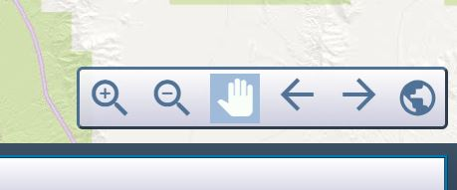
Navigation - Bottom Right Corner
Zoom in or out of map (magnifying glass)
Pan around map (hand icon)
Previous or Forward extent (left or right arrows)
Full world map (globe icon)

Slide 18
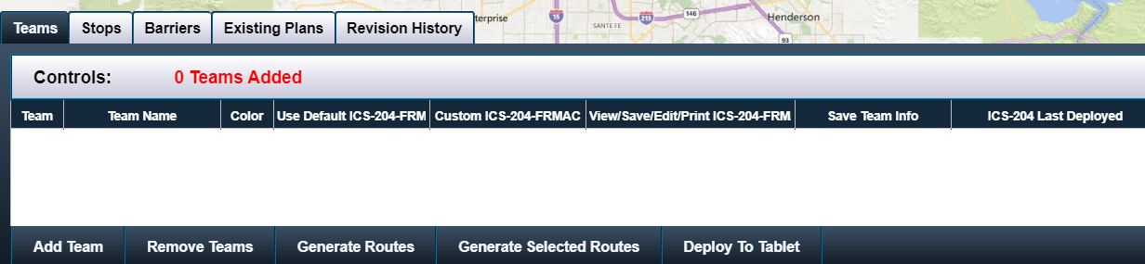
Dispatching Controls - Bottom Left of Screen
Only persons with “Operator” permissions will be able to view and use dispatching controls. By default, this permission is held by all CMRT Monitoring Managers and Field Team Supervisors. Others may be granted permission on a case by case basis.
Notes:
October 2019 Update: Permissions were added to CMC. “Admins” and “Operators” will be able to use the dispatching function. If a user has permissions set to “Viewer,” the dispatching controls will not be displayed along with some ancillary controls.

Slide 19
Review Data

Slide 20
Review Data
Click “Review” to review and approve data collected by the field teams.
Approving or rejecting data in CMC will update the “Monitoring Status” in RAMS without having to go to RAMS.

Slide 21
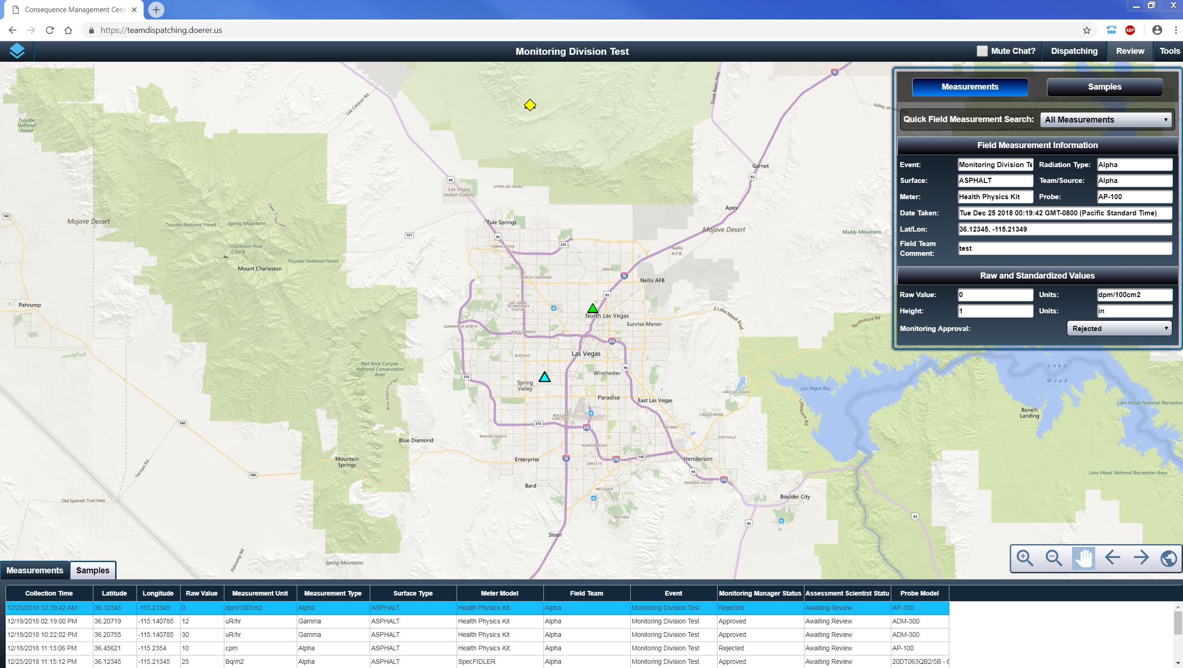
After clicking “Review” this screen appears
Click to expand or collapse information
Click to view the measurement or sample tables.

Slide 22
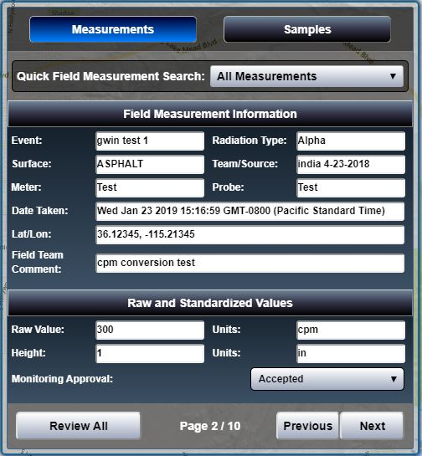
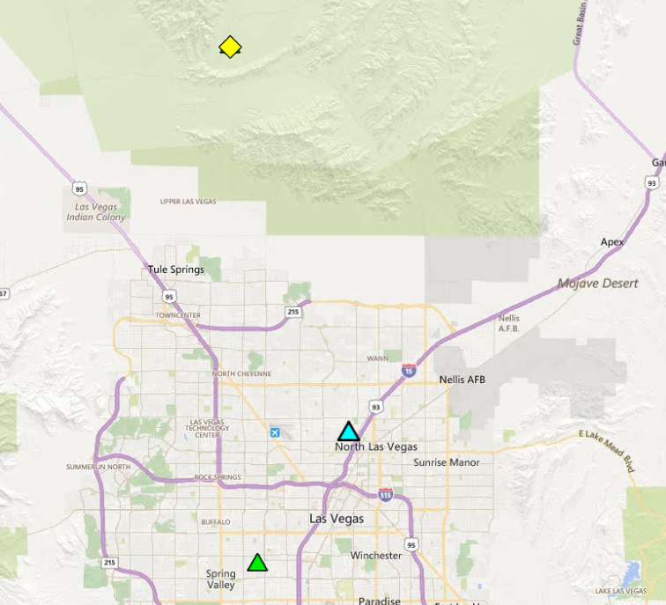

Review Data
To review data and update the monitoring status in RAMS, under “Monitoring Approval,” select “Rejected” or “Accepted” or “Not Reviewed.”
Able to review “Measurements” and “Samples”
Field measurement information will auto populate when you click on a measurement/sample icon in the map
If multiple measurements are selected, press the “Next” or “Previous” button to review the next selected measurement.

Slide 23
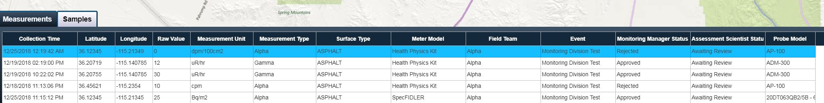
Review Data
Also able to review data in a table form at the bottom of the screen.
Selecting one row will populate the information box in the top right corner.

Slide 24
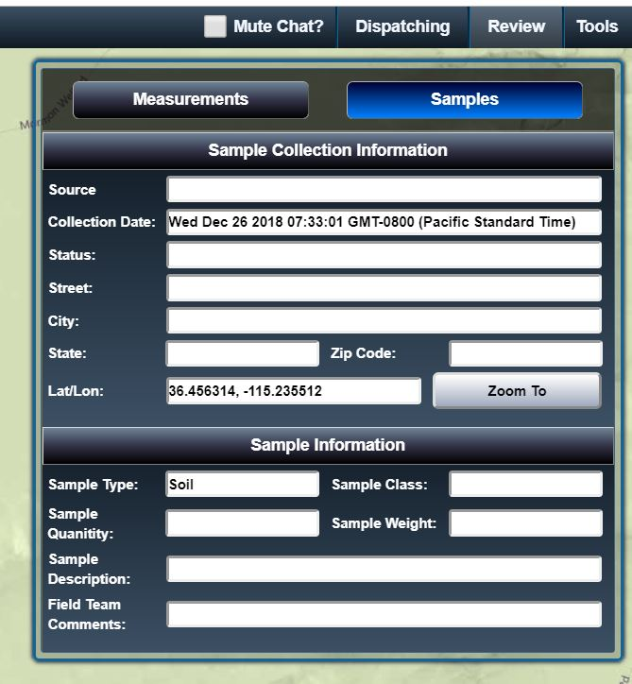

Review Data
Able to review sample information by clicking the “Samples” button in the information box.
There is no monitoring approval of sample data.

Slide 25
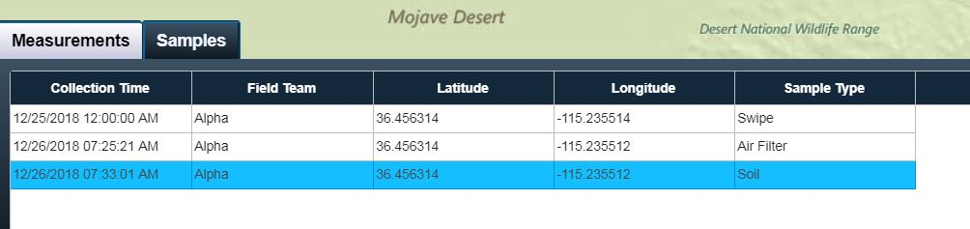
Review Data
View sample information in tabular form by clicking the “Samples” tab on the bottom of the screen.
There is no monitoring approval of sample data.

Slide 26
Tools

Slide 27
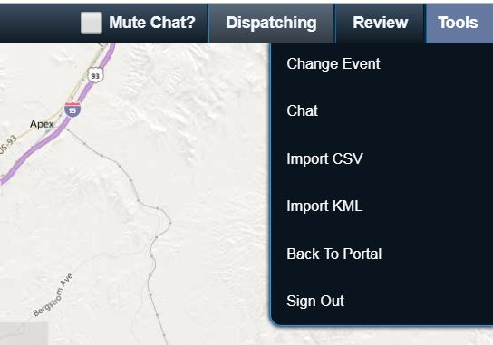

Click “Tools”
“Change Event”
  You can change RAMS events
“Chat”
  Allows you to chat to field teams via the tablet or others on CMC
“Import CSV”
  Import a csv as “Stops” (aka locations)
“Import KML”
  Imports a kml or kmz file (NARAC contours etc.)
“Back to Portal” and “Sign Out”
  Logs you out of CMC

Slide 28
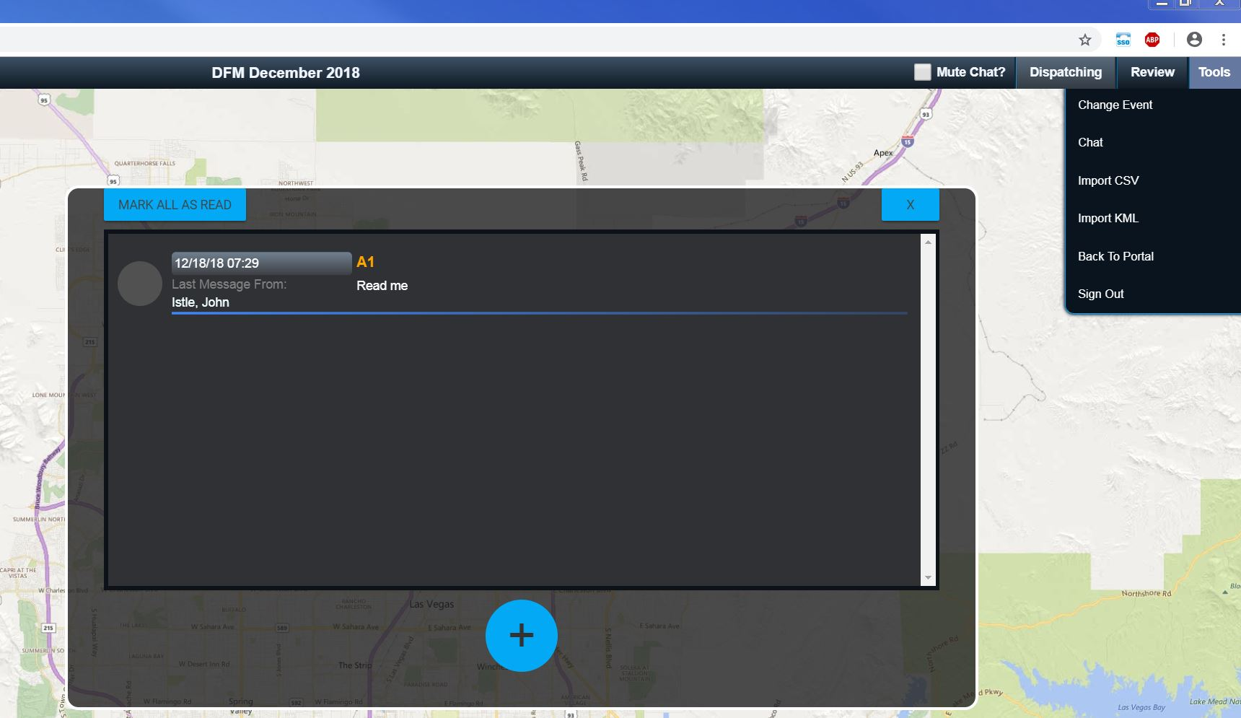
Click “Chat”

Slide 29
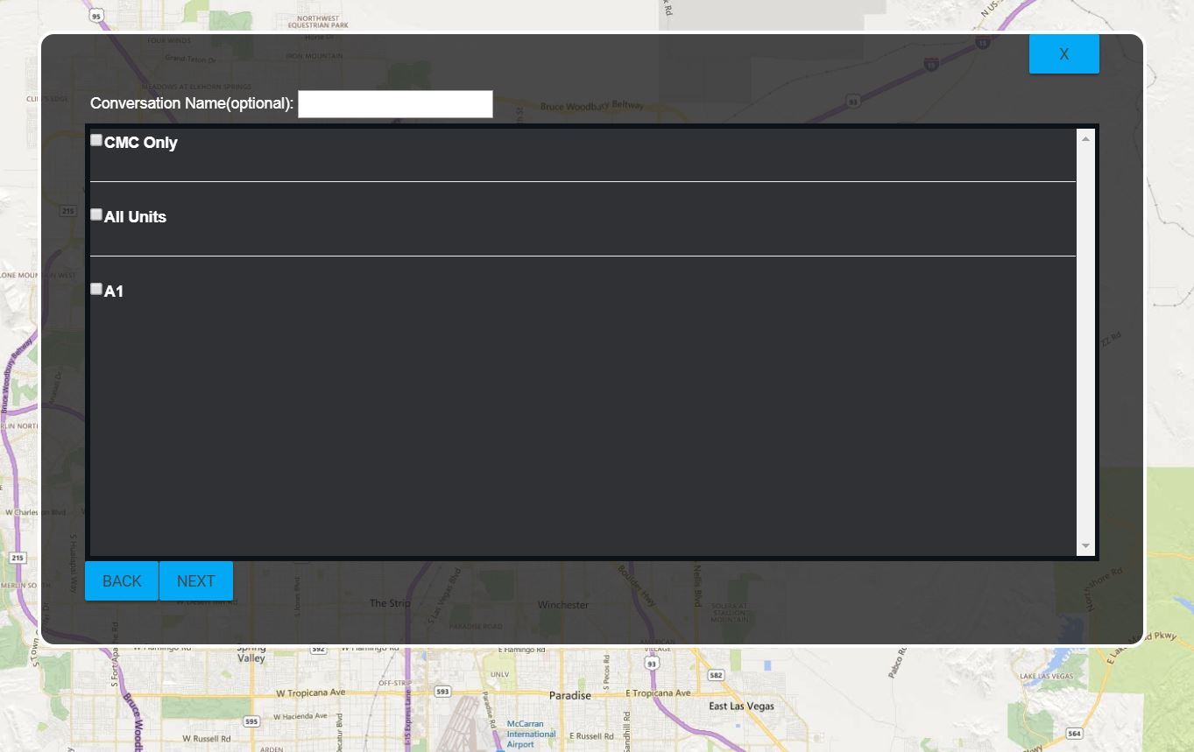

Chat
Click
Select who you want to chat with.
In this example, we can chat with:
  CMC Only - whoever is on CMC
  All Units – All field team tablets
  “A1” – a specific field team.
Click “Next”

Slide 30
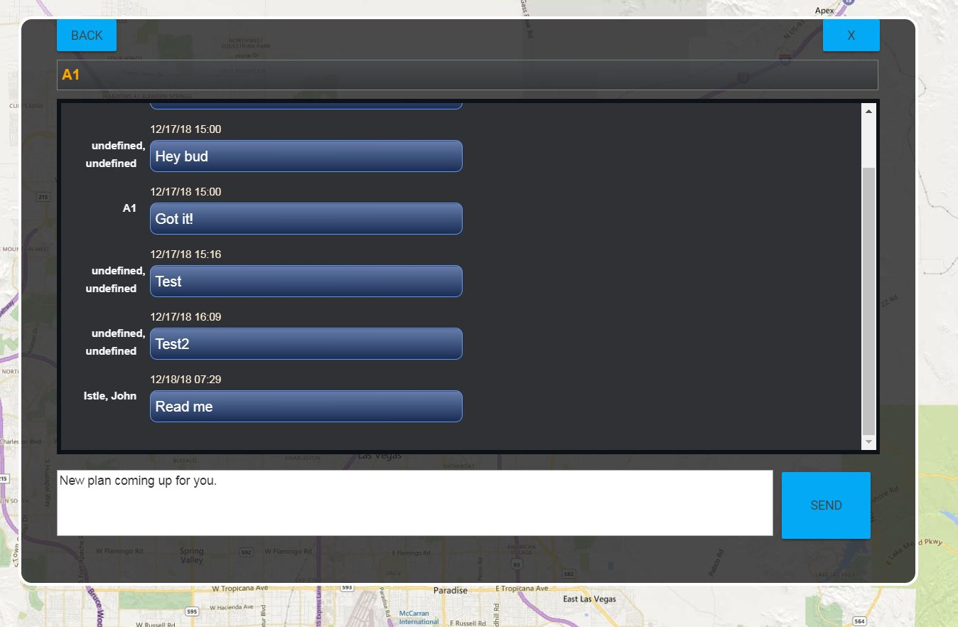
Chat
Like a text message, type in your message and click “Send.”
Click “Back” to go to the previous screen
Click “X” to exit chat.

Slide 31
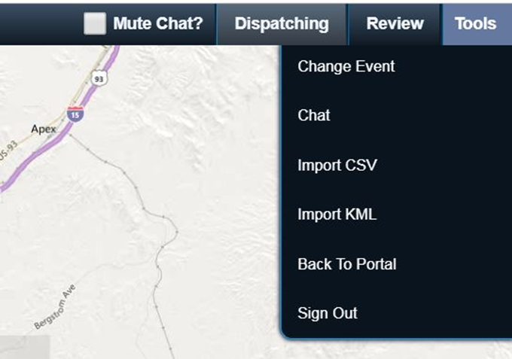
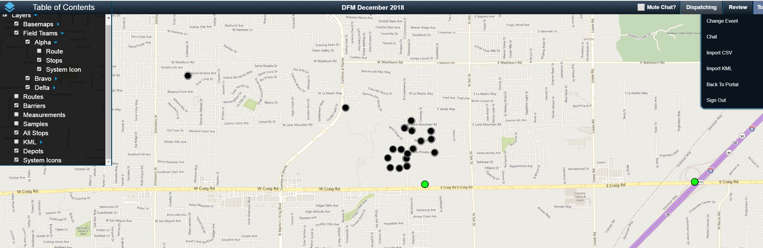
Import CSV
Import a csv (must contain a latitude and longitude) to create field team sample/measurement locations (aka “stops”).
Toggle the stops on and off in the table of contents under “All Stops.”

Slide 32
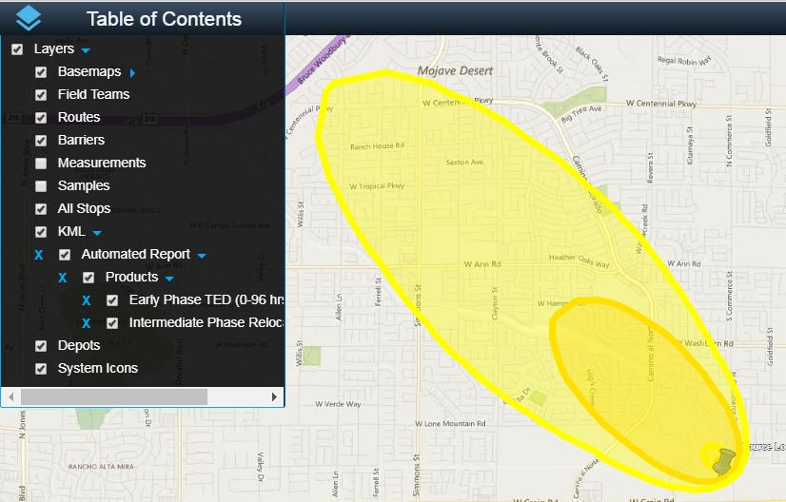
Import KML
Import multiple kml/kmz files.
Toggle the KML on and off in the table of contents under “KML.”

Slide 33

“Back to Portal” versus “Sign Out”
Back to Portal
  Logs you out of CMC and redirects you to
  the RSL Portal page without signing you out.
  Go to RAMS or SMC, if needed.
Sign Out
  Log you out of CMC and the RSL Portal.
  Will require you to log in again.

Slide 34
Dispatching

Slide 35
IMPORTANT!!
Do NOT press the back button or exit your web browser during the dispatching process!!!
  This will force you to leave CMC and your work will NOT be saved.
Saving your dispatching work only occurs after you click the “Save” button for each team in the “Save Team Info” column (see slide 64).

Slide 36
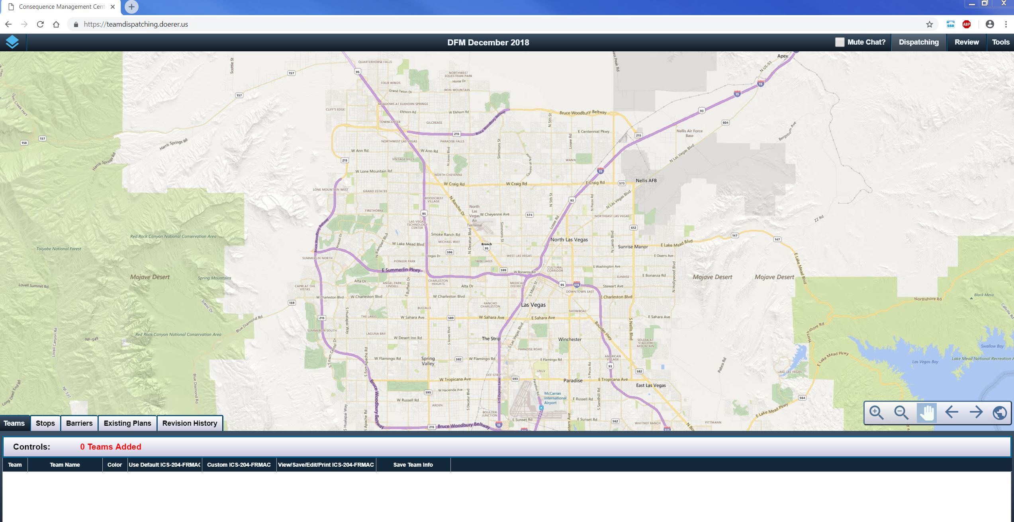

Dispatching
What CMC was made for… Click “Dispatching” to start.
Dispatching Controls - Bottom Left of Screen

Slide 37
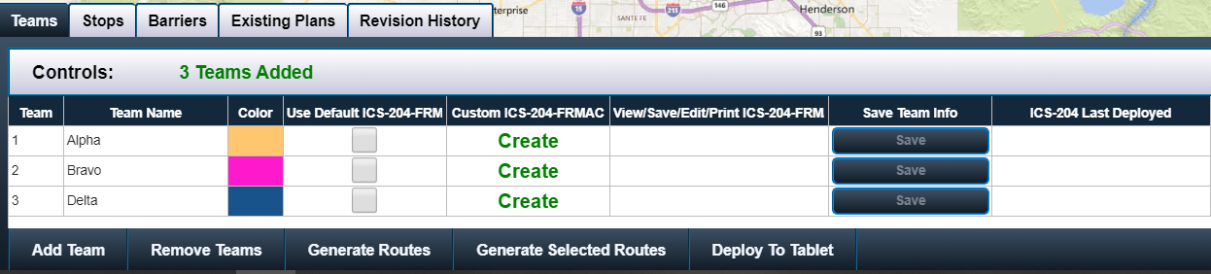
Dispatching – Add Teams
Click “Add Team” to create a team.
  Able to change team name to an already existing team name in RAMS or
  CMC will create a team in RAMS with the name you assign (custom names available).
NOTE: After creating a team in CMC, you still need to go into RAMS to assign start/stop dates and meters/probes to that team before the information shows in the tablets.
Notes:
Operational hint: The Monitoring Manager can create teams and inform the Field Team Supervisor to go into RAMS and finish creating the team with the start/stop date and meters/probes.

Slide 38
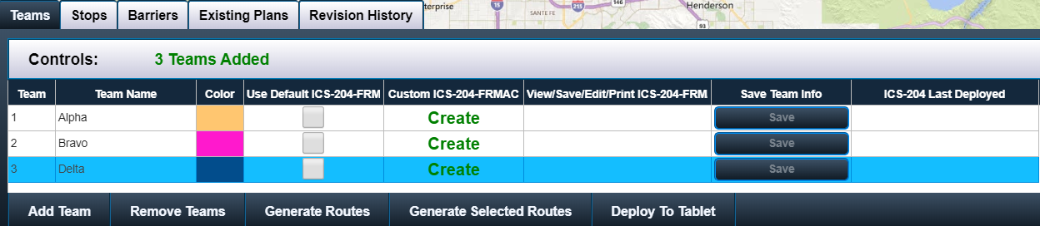
Dispatching – Remove Teams
Click “Remove Team” to delete a team.
  Need to select the team and then click “Remove Team”

Slide 39
Dispatching - Stops
“Stops” is a shorter way to say measurement and sample locations.
Click on “Stops” to place dots on a map

Slide 40



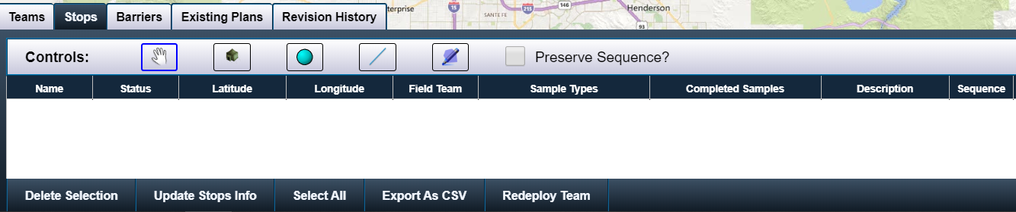
Dispatching - Stops
The hand icon is to pan around the map. Also if you hold the shift button and the mouse button, you have a polygon select tool.
The tent icon is placed at the location from where the field teams are departing
  Later, field team routes will originate from this location.
Click the turquoise circle to place 1 stop on a map at a time.
  Each click on the map will be another stop.

Slide 41

Dispatching – Line Stops
Click the line icon to place points on a line at a equal distance apart.
Double click the mouse to stop the line.

Slide 42
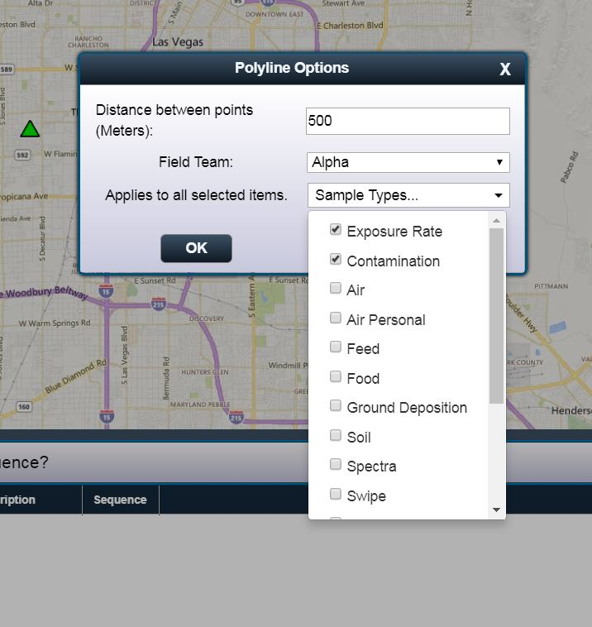
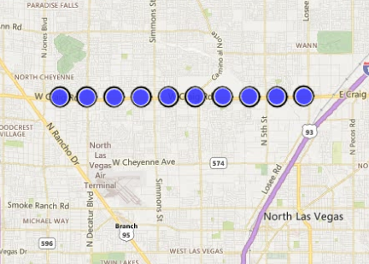
Dispatching – Line Stops
After double clicking, this screen appears.
Assign a distance between the points.
Select a field team to assign these points to (optional)
Click the sample types desired for each point in the line (optional)

Slide 43

Dispatching – Polygon Stops
Click the polygon icon to place points in a polygon at a equal distance apart.
Double click the mouse to stop the polygon.

Slide 44
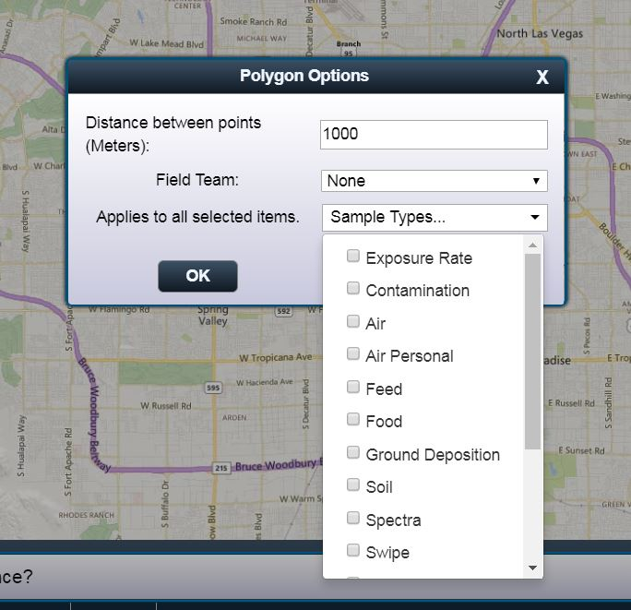
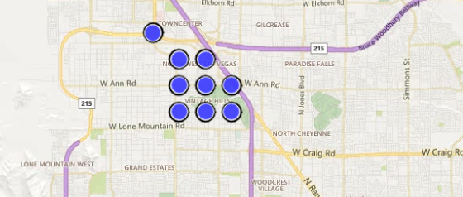
Dispatching - Polygon Stops
After double clicking, this screen appears.
Assign a distance between the points.
Select a field team to assign these points to (optional)
Click the sample types desired for each point in the line (optional)

Slide 45
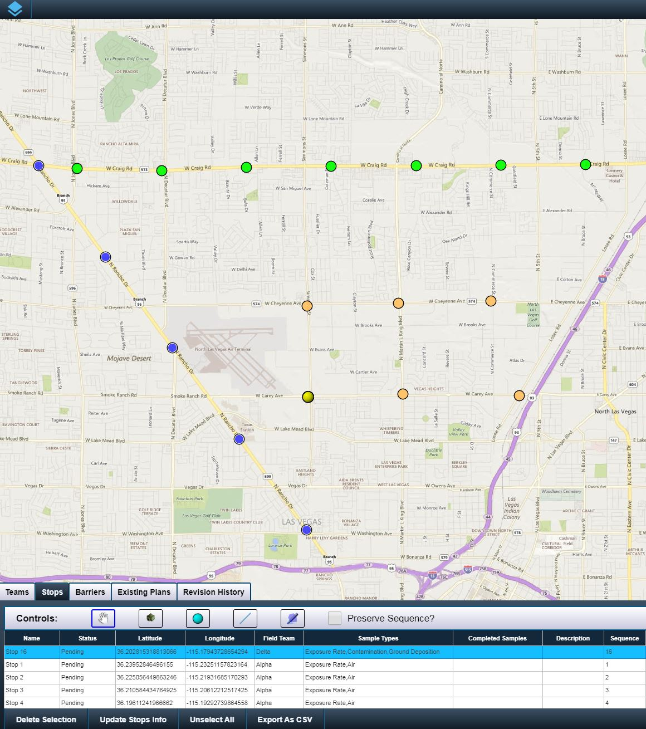
Dispatching - Stops
After placing stops on the map, you may have something that looks like this picture.
Teams were assigned when creating the stops, hence the stops are colored to match the field team.
If no field teams were assigned, then the stops on this map would all be one color.
(Optional) Name the stops in the “Description” column. So if you know you are surveying the governor’s mansion, you can denote that in the description column.
If someone wants a list of sample locations, export the stops table by clicking “Export as CSV.”

Slide 46
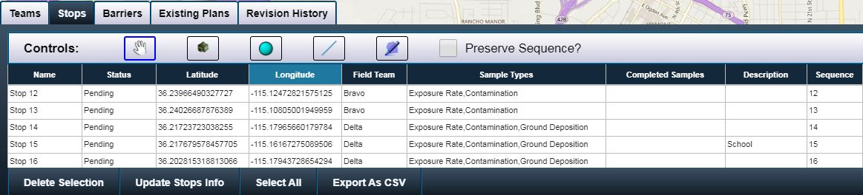
Dispatching – Update Stops Info
Click the “Update Stops Info” button to edit the team assigned to that stop location or assigned sample types.

Slide 47
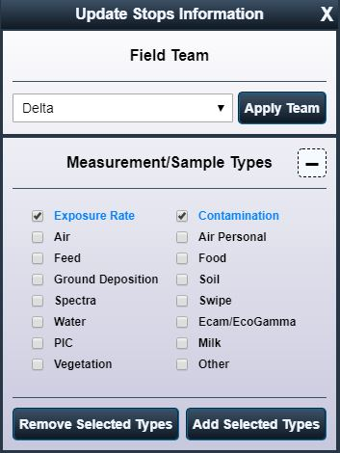
Dispatching – Update Stops
After you click the “Update Stops Info” button, the “Update Stops Information” box appears.
When you select a stop (either in the table or on the map), the stop information appears.
  You will see what team is assigned to the stop under the “Field Team” section.
  Assigned measurements and samples for that stop will be in blue text.

Slide 48
Dispatching – Update Stops
To edit a stop, first select the stop from the table or from the map.
To change the field team assigned to the stop, select the team from the drop down menu and then click “Apply Team.”
To REMOVE measurement/sample types from the stop:
  Select the sample type that you want removed (remember: active sample types are in blue font) then
  Click “Remove Selected Types.”
You can verify that the stop was updated in the table of stops.

Slide 49
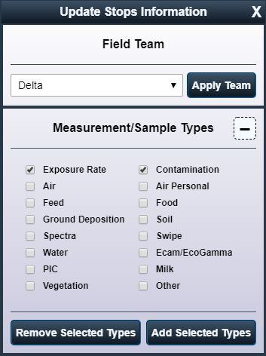
Dispatching – Update Stops
To edit a stop, first select the stop from the table or from the map.
To change the field team assigned to the stop, select the team from the drop down menu and click “Change Team.”
To ADD measurement/sample types to the stop:
  Select the sample type that you want (remember: active sample types are in blue font) then
  Click “Add Selected Types.”
You can verify that the stop was updated in the table of stops.

Slide 50
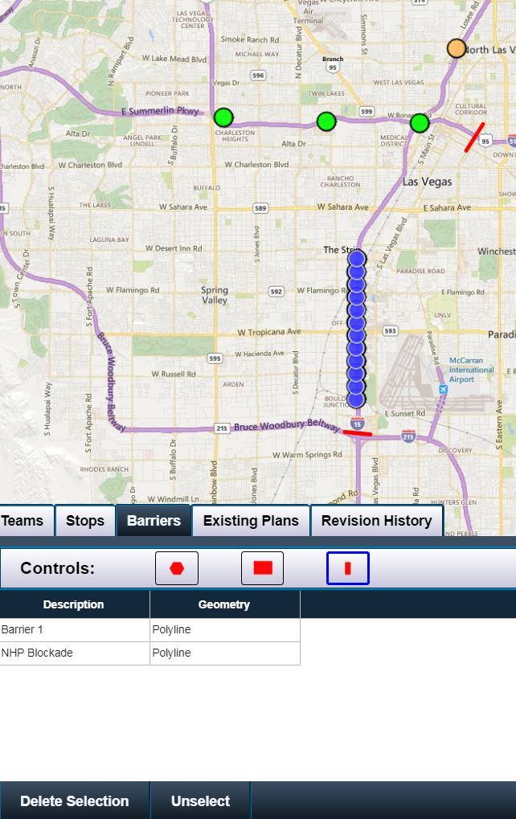
Dispatching - Barriers
By clicking “Barriers,” you can capture where road blocks or other impassable areas are located.
There are 3 types of barriers:
  Polygon
  Rectangle
  Lines
Name the barrier in the description column, if desired.
When field team routes are created, barriers are impassable and the algorithm must find a route around the barrier.
You can delete barriers by selecting the barrier in the table and then clicking “Delete Selection.”

Slide 51
2 ways to generate field team instructions
Default ICS-204 instructions
  Implements FRMAC default field team instructions for 5 teams
  Need to put stops on the map before clicking the “Use Default ICS-204-FRMAC?
  This is the quickest way to create instructions.
Create ICS-204 instructions
  Not default instructions.
  Can choose locations after you click “Create” in the “Custom ICS-204-FRMAC” column.

Slide 52
Generate field team instructions – Option 1
Using default ICS-204 instructions
  Implements FRMAC default field team instructions for 5 teams
  Need to put stops on the map and assign the stops a team before clicking the “Use Default ICS-204-FRMAC”
  This is the quickest way to create instructions.

Slide 53
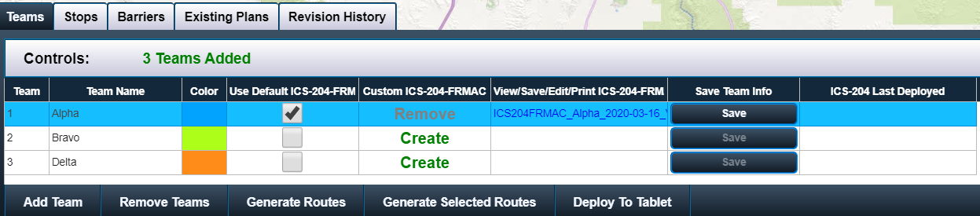

Dispatching – Use of Default ICS-204-FRMAC
Ensure that stops have been created and assigned to the desired field team.
Click the “Use Default ICS-204-FRMAC” check box.
A hyperlink is automatically created with the field team name, date, and version number in the “View/Save/Edit/Print ICS-204-FRMAC” column.
Click on the hyperlink to view the field team instructions.

Slide 54
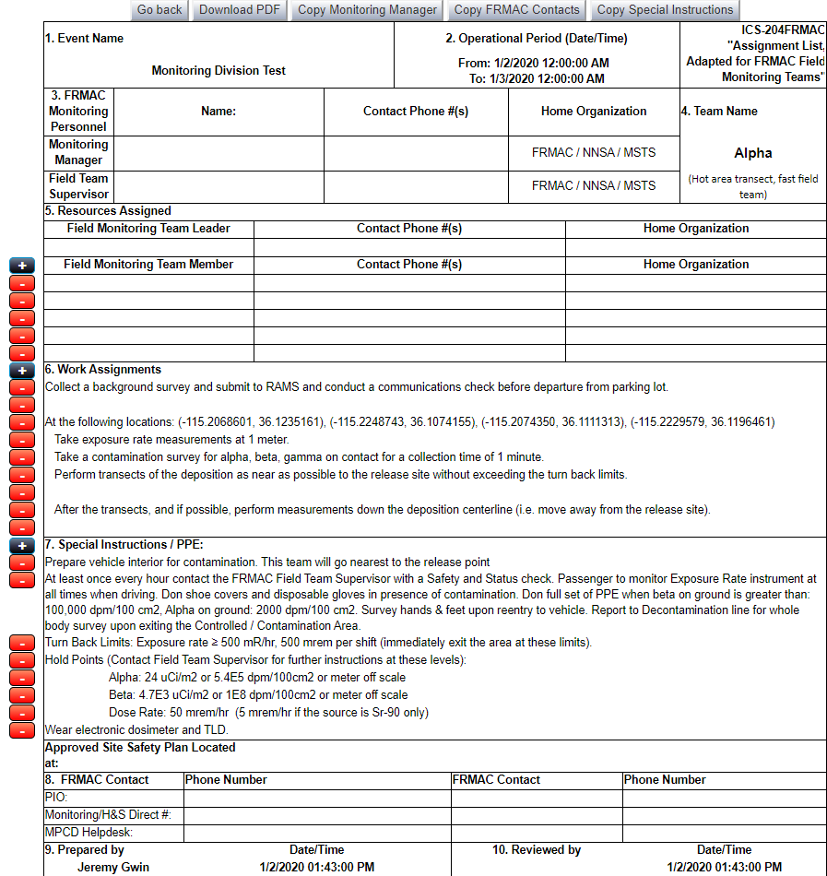
Dispatching – Use of Default ICS-204-FRMAC
A completely editable form appears.
In section 6, the coordinates for the stops appear and also the default field team instructions.
Each team (Alpha, Bravo, Delta, Echo, and Foxtrot) have their own default instructions. See the FRMAC Monitoring Manual Volume 1 for more information.
Once the instructions are completed, click either:
  “Go Back” to return to the main CMC screen or
  “Download PDF” to save and print a copy of the form.
Notes:
October 2019 update: Buttons added that are labelled “Copy Monitoring Manager,” “Copy FRMAC Contacts,” and “Copy Special Instructions.” Clicking the “Copy Monitoring Manager” button will copy the Monitoring Manager information from this ICS-204FRMAC form to all of the 204s created during the session. Clicking the “Copy FRMAC Contacts” button will copy the FRMAC Contacts (Section 8) from this ICS-204FRMAC form to all of the 204s created during the session. Clicking the “Copy Special Instructions” button will copy the special instructions (Section 7) from this ICS-204FRMAC form to all of the 204s created during the session.

Slide 55
Generate field team instructions – Option 2
Create custom ICS-204 instructions
  This method will be used most often in a CM response.
  Not default instructions.
  Can choose locations after you click “Create” in the “Custom ICS-204-FRMAC” column.

Slide 56
Dispatching – Create Custom ICS-204
Click on “Create” to start the process.

Slide 57
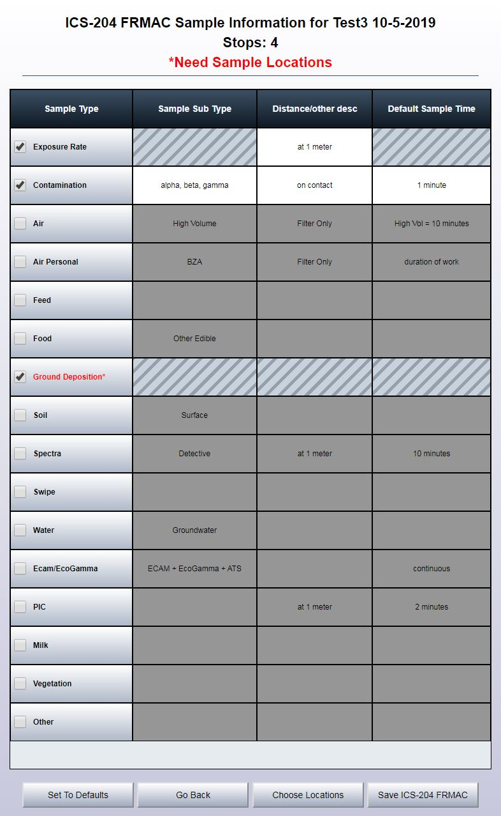
Dispatching – Create Custom ICS-204
This screen appears after clicking “Create.”
Click which sample type you want.
  If you check multiple sample types, all the sample types will be assigned to the locations selected when you click “Choose Locations.”
  You are able to select one sample type at a time and assign different locations for each sample type.
  A sample type with no locations assigned to it will appear in red font.
Select/Review/Edit the information in the other 3 columns (Sample Sub Types, Distance/other desc[ription], and Default Sample Time)
Click “Choose Locations.”

Slide 58
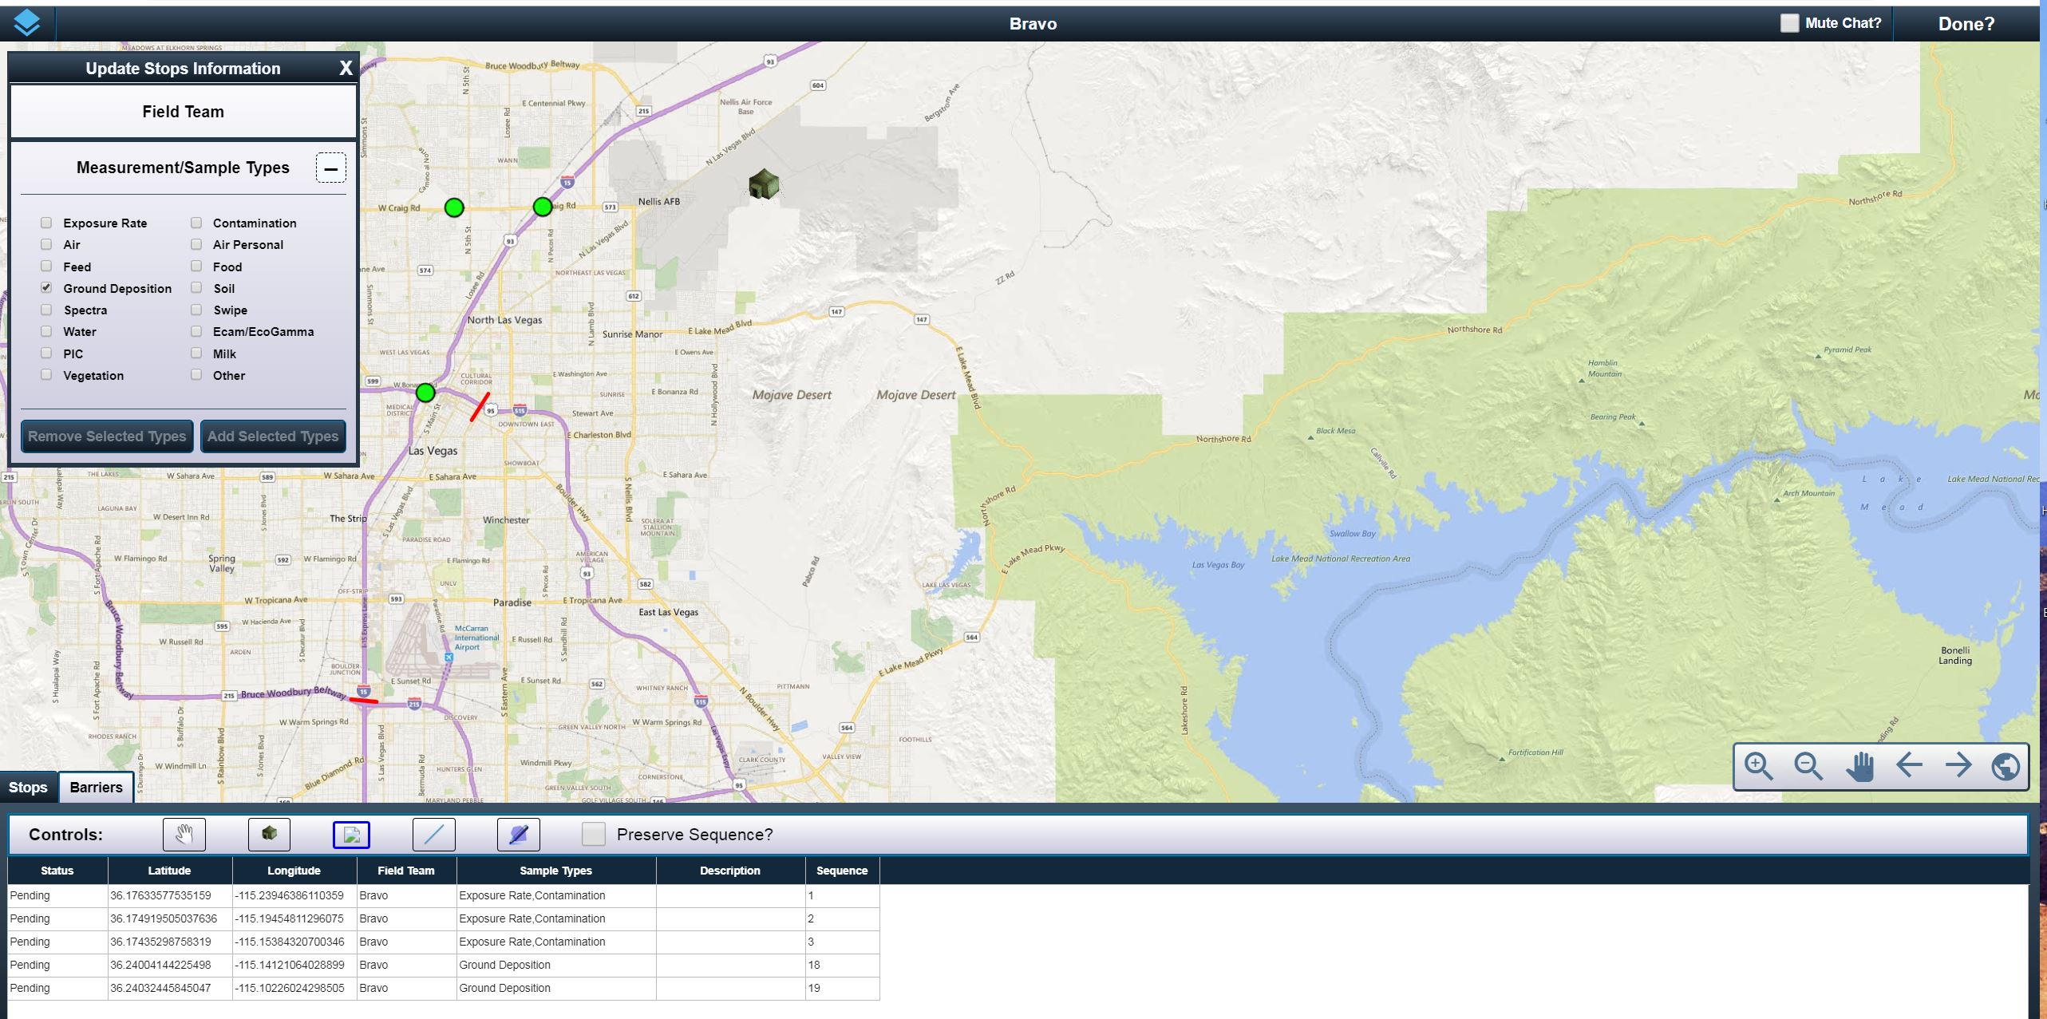
Dispatching – Choose Locations
Place “stops” on the map.
Click “Done” in the top right hand corner when all stops have been placed for the team.
Notes:
October 2019 update: When stops are created with no field team assigned to them, and then you create a custom ICS-204FRMAC, during the choosing locations process you may notice that the stops did not make it into the 204 form. This is because the stops need to have a field team assigned to them. Do this in the “Update Stops Information” box by clicking “Field Team” and assign a team to the selected stops. Then click “Done” and the stops will be incorporated into the 204 form.

Slide 59
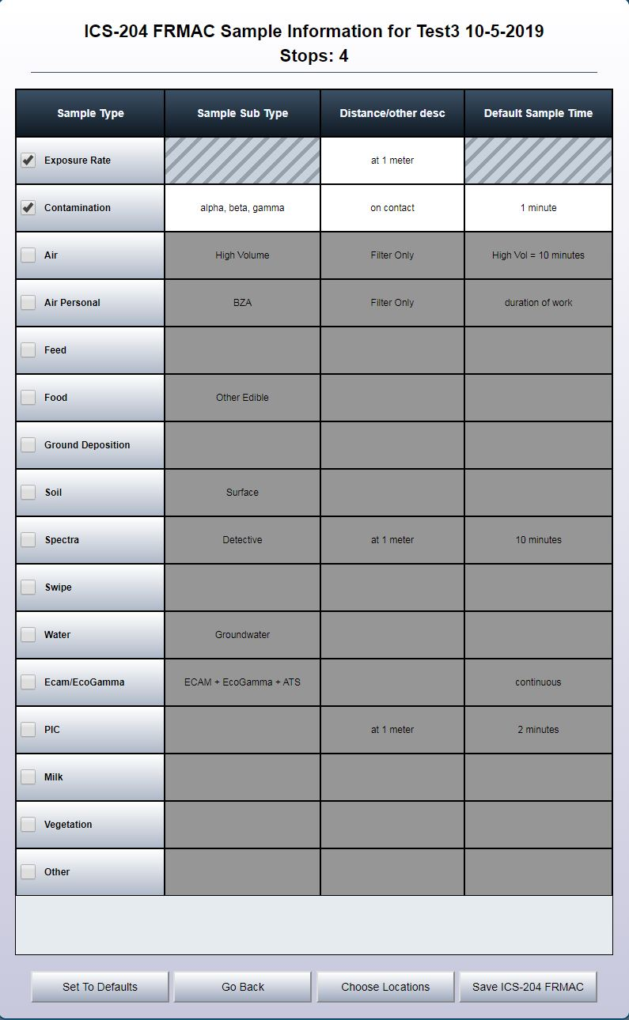
Dispatching – Create Custom ICS-204
When you click “Done” in the previous screen, this screen appears.
Since all stops were entered for each sample type in the picture to the right, there are no warnings or red font.
Click “Save ICS-204 FRMAC” on the bottom right of the screen.

Slide 60
Dispatching – Complete Custom ICS-204
A completely editable form appears.
In Section 3, fill in contact information for the monitoring manager and field team supervisor.
In Section 5, fill in field team member information.
In Section 6, the coordinates for the stops appear for each sample type. Edit wording if desired.
In Section 7, default field team special instructions appear. Edit section to apply to specific response.

Slide 61
Dispatching – Complete Custom ICS-204
In Section 8, fill in other contact information for various things (if desired).
Insert name of reviewer in Section 10, or wait until the form is printed.
Once the instructions are completed, click either:
  “Go Back” to return to the main CMC screen or
  “Download PDF” to save and print a copy of the form.
Notes:
October 2019 update: Buttons added that are labelled “Copy Monitoring Manager,” “Copy FRMAC Contacts,” and “Copy Special Instructions.” Clicking the “Copy Monitoring Manager” button will copy the Monitoring Manager information from this ICS-204FRMAC form to all of the 204s created during the session. Clicking the “Copy FRMAC Contacts” button will copy the FRMAC Contacts (Section 8) from this ICS-204FRMAC form to all of the 204s created during the session. Clicking the “Copy Special Instructions” button will copy the special instructions (Section 7) from this ICS-204FRMAC form to all of the 204s created during the session.

Slide 62
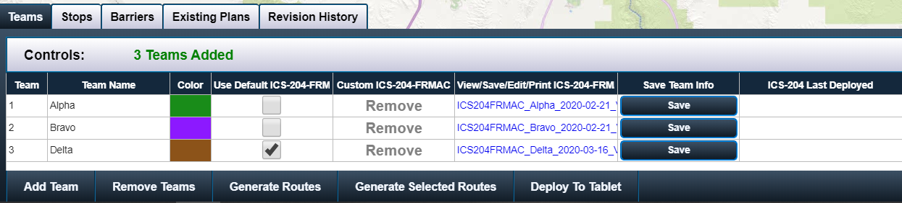
Dispatching - Generate Routes
“Generate Routes” will generate routes for all the created field teams.
“Generate Selected Routes” will only generate routes for a selected team (selected teams are highlighted in blue).

Slide 63
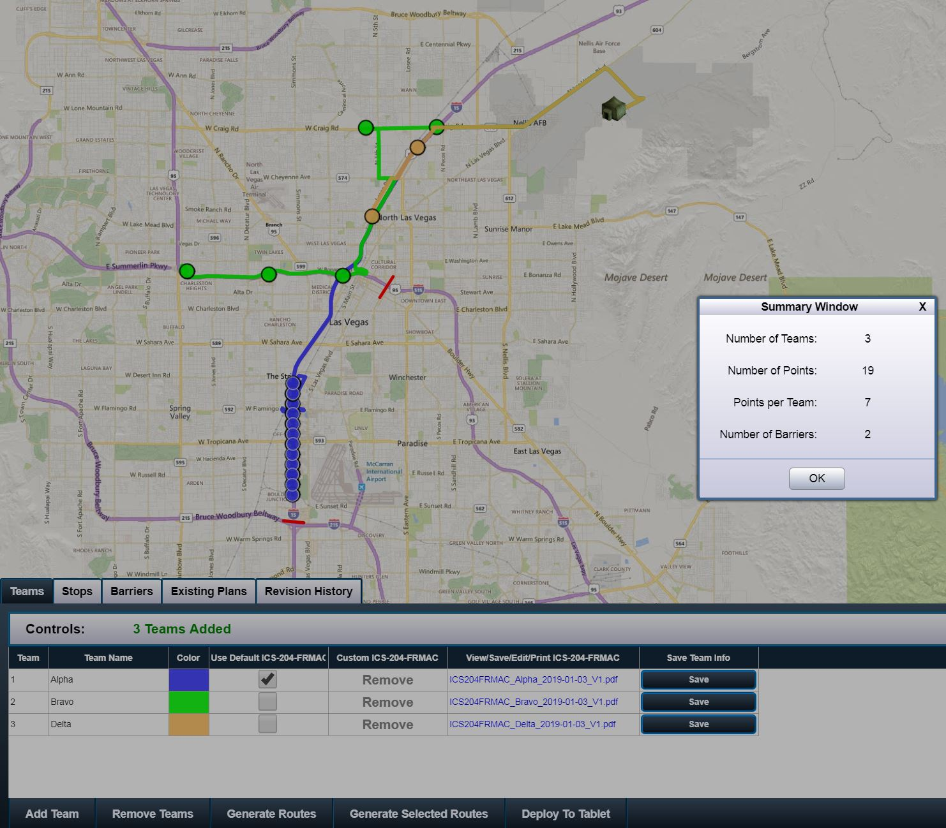
Dispatching - Generate Routes
After clicking, “Generate Routes” or “Generate Selected Routes,” allow some time for the computer to process.
When complete, a summary window will appear.
Click “OK” in the summary window.

Slide 64
Dispatching – Save Team Info
After the routes and the ICS-204-FRMAC forms are complete for each team, click “Save” in the “Save Team Info” column.
Saving will place these plans in the “Existing Plans” and “Revision History” tabs. You are able to edit existing plans and look at older plans.

Slide 65
Dispatching - Deploy Team ICS-204
“Deploy To Tablet” will send the locations, route, and ICS-204FRMAC to the field team tablet via the Chat function.
A good practice would be to send a chat message out to the field teams alerting them that new instructions should be appearing in the tablet.

Slide 66
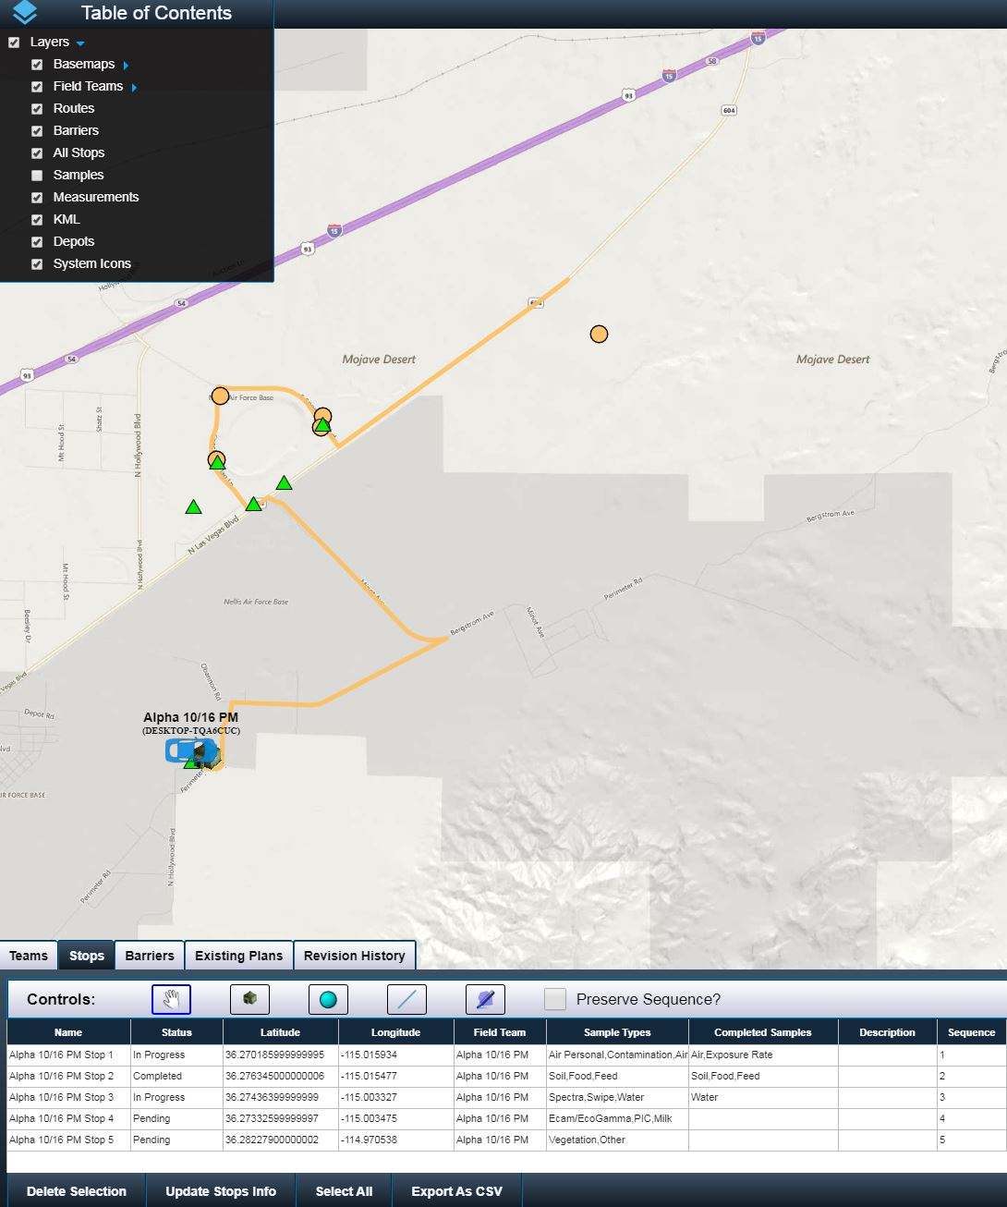
CMC - Dashboard
As field teams go in the field, a system icon will represent them (car icon) labelled as the team name.
If the sample and measurement layers are turned on, then data will appear when it is uploaded into RAMS.
Under the “Stops” tab, there is a “Name” column which is the name of the stop that the field team sees in the tablet.

Slide 67
CMC - Dashboard
Under the “Stops” tab, there is a “Status” column which will show either
  “Pending” – waiting on the team
  “In progress” – team is in the vicinity of the sampling location
  “Complete” – field team completed sampling of assigned sample types at the location.
Under the “Stops” tab, there is a “Completed Samples” column which will show which samples/measurements were collected at the stop.
Use these techniques to track your field teams and review data in real time.

Slide 68
Advanced Options

Slide 69
Redeploy a Team
Notes:
2020 update will add the ability to redeploy a team.

Slide 70
Redeploy a Team
If a team is finished with their plan and want more to do, then you can redeploy the team.
This option will add another starting point specific to that team. Place the starting point where the team currently is located.
Add stops, assign measurement/sample types, and then generate a selected route.
  This will tack on the new points to the ICS-204 form.
  The points will be visible to the field team.
  The previous stops (completed) will disappear from view.

Slide 71
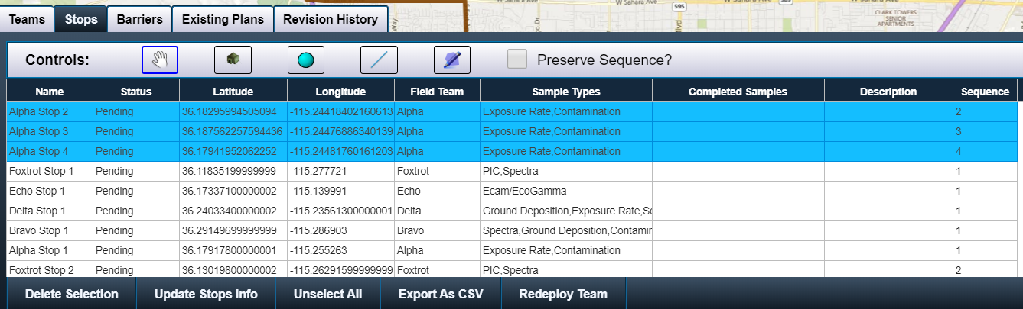
Redeploy a Team
Navigate to the “Stops” tab
Click “Redeploy Team”

Slide 72
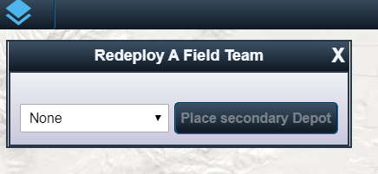
Redeploy a Team
The following box appears after clicking “Redeploy Team”
Select the team you want to redeploy
Click “Place secondary Depot”

Slide 73
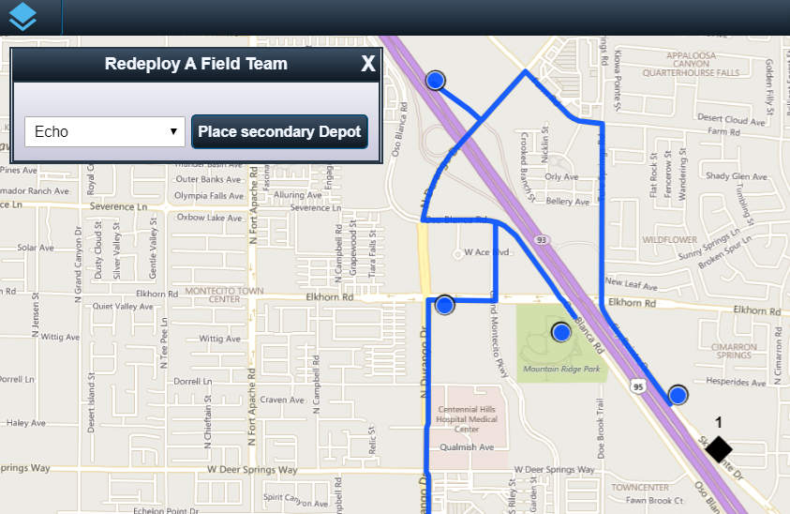
Redeploy a Team
After clicking “Place secondary Depot,” you will be able to place a secondary depot on the map by clicking on the map.
Place the secondary depot on the map where the field team is currently located.

Slide 74
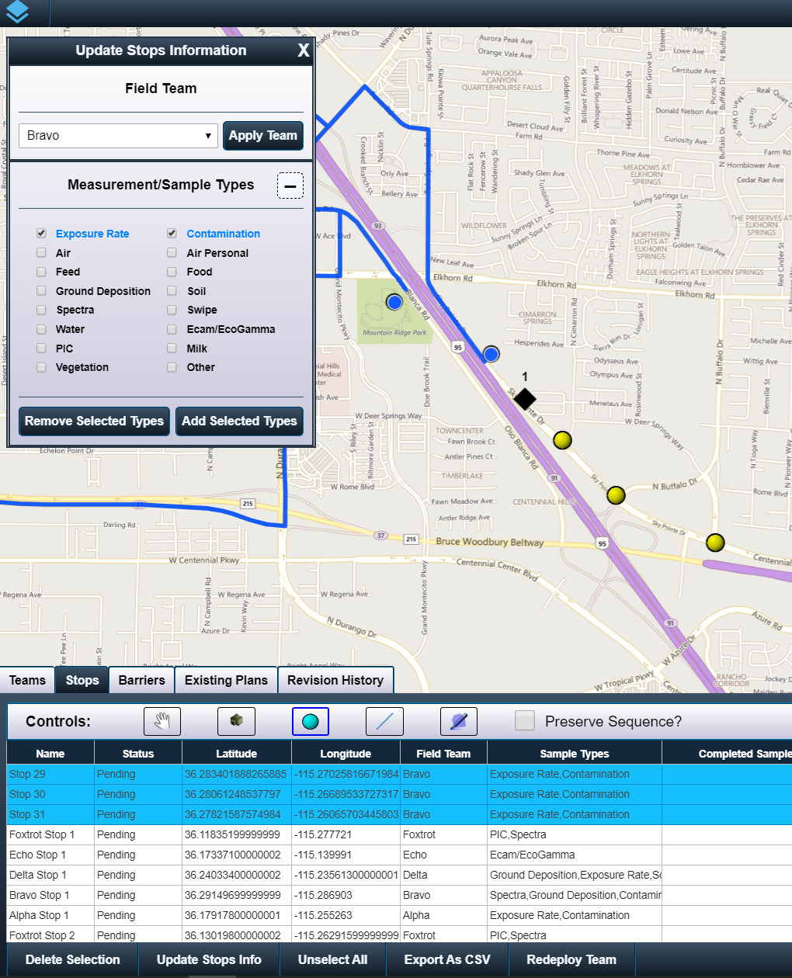
Redeploy a Team
Add stops (points, lines, or polygon)
Select the recently created stops
Click “Update Stops Info”
Select the field team name and click “Apply Team”
Assign Measurement/Sample Types and click “Add Selected Types”

Slide 75
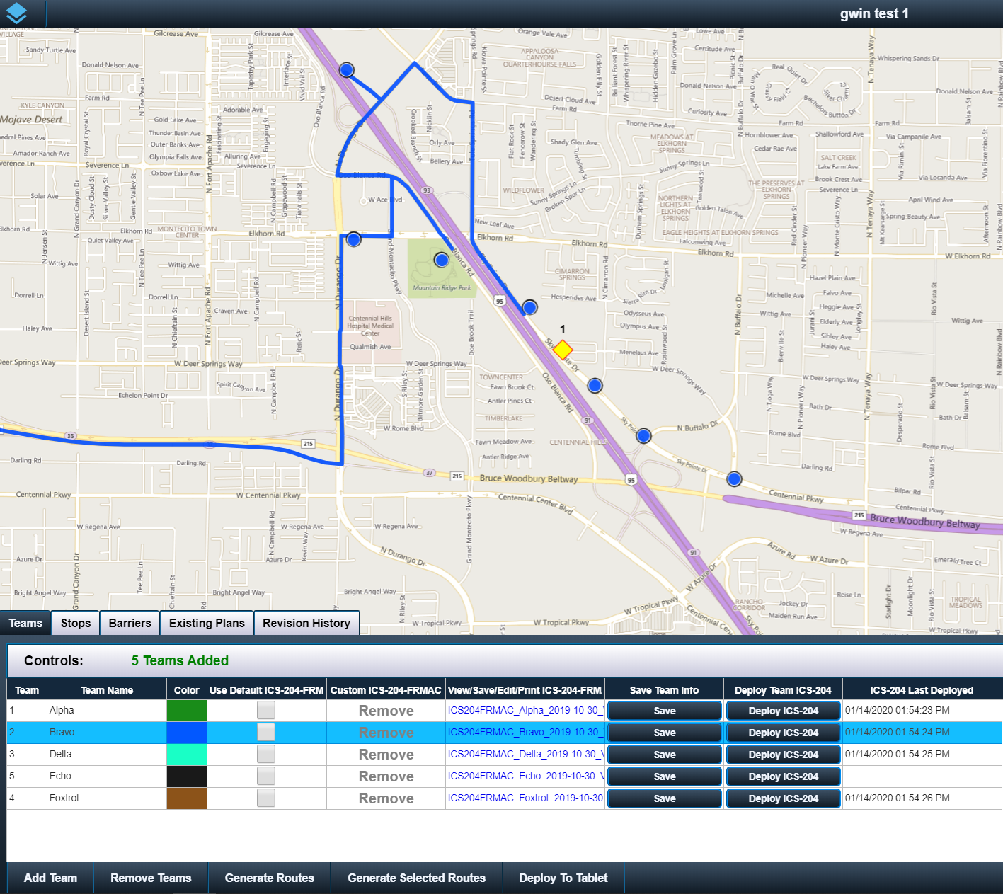
Redeploy a Team
Navigate to the “Teams” tab
Click “Generate Selected Routes”

Slide 76
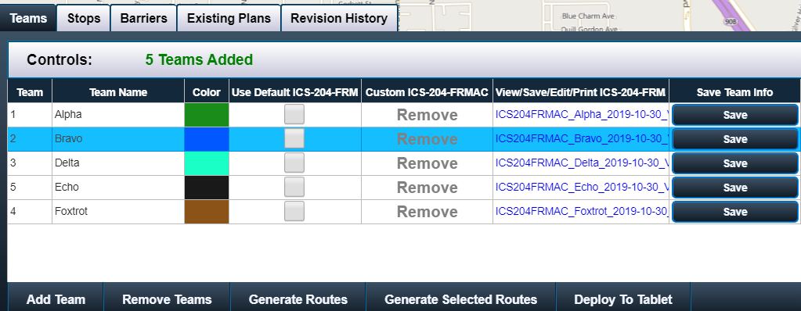

Redeploy a Team
Select the team that will be redeployed
Save the route by clicking “Save”
Deploy the ICS-204 form to the team by clicking “Deploy To Tablet”

Slide 77
Existing Plans

Slide 78

Existing Plans
The “Existing Plans” tab will contain all the saved field team instructions, routes and stops for the event.
If “One-Click Loading” is checked, once you click on a row in the “Uploaded Timestamp” column, the field team routes and stops will load on the map and the teams and ICS-204-FRMAC will load in the Teams tab.
If “One-Click Loading” is not checked, select a row in the “Uploaded Timestamp” column, then click “Load Route Plan and Forms” to load the field team routes and stops on the map and the teams and ICS-204-FRMAC in the Teams tab.
Notes:
October 2019 update: A “Prepared By” column was added to help identify previously prepared plans.

Slide 79


Existing Plans – Viewing
Example of using the “One-Click Loading” to load different plans.

Slide 80

Existing Plans – Editing Existing Plan
Load a plan from “Existing Plans,” then go to the “Teams” tab to view the teams and ICS-204-FRMAC.
You can edit the existing plan by clicking “Remove” in the “Custom ICS-204-FRMAC” column and then creating a new set of instructions. When you save, the plan will be saved with the existing plan with an updated date in the “Existing Plans” tab in the “Last Updated” column. You can also add more teams to the existing plan.

Slide 81

Existing Plans – Changing to New
Load a plan from “Existing Plans,” then go to the “Teams” tab to view the teams and ICS-204-FRMAC.
Click the “Change to New?” to create a new instruction and not edit the loaded plan. Any visible teams and stops will disappear from the screen.
You can create or remove teams and plans as necessary, change stop locations and sample types, or other edits. When you save, the plan will be saved as a new “Existing Plan” which means that the starting plan was not saved over.

Slide 82
Revision History

Slide 83

Revision History
With each saved change to a ICS-204-FRMAC, a revision number is created.
Go to the “Revision History” tab to see all the revised copies.
Click “Load Form, Stops, and Route” to load the revision into the current view.

Slide 84
Digital Field Monitoring (DFM) Tablets

Slide 85
DFM Tablet
CMC is linked to the Digital Field Monitoring tablet software.
Field teams do not need CMC accounts or CMC permissions to use the functionality in the tablets.

Slide 86

DFM Tablet View
The tablet format is similar to previous versions.
Click “Menu” in top left corner.
Click “Chat” to send message to CMC.
The ICS-204 will come through as an attachment in the chat function.
  Download and save the ICS-204 on the tablet.

Slide 87

New chat notification
DFM Tablet View
If the field team is not in the chat menu (for instance they are looking at the map), they will be notified of a new message by the conversation bubble icon in the status menu at the top right of the screen.

Slide 88


DFM Tablet Map View
When a new or updated route is issued from CMC to the tablet, the green “New Routes” button will appear.

Slide 89

DFM Tablet Map View
An information box will appear if you click or touch a stop location.
Field teams will be able to see what measurements or samples are needed at each stop in the route.
The stop number on the tablet screen is the same stop number in the CMC dispatching controls.

Slide 90
Questions?
Contact a fellow CMC user or the Monitoring and Sampling Working Group Chair, Jeremy Gwin, at gwinjs@nv.doe.gov

Slide 91
Go and Practice!
CAUTION!!!
To test or practice using CMC, use the event
“Monitoring Division Test!”
The events are tied to the active RAMS database, so do not overwrite any event.

