Slide 1
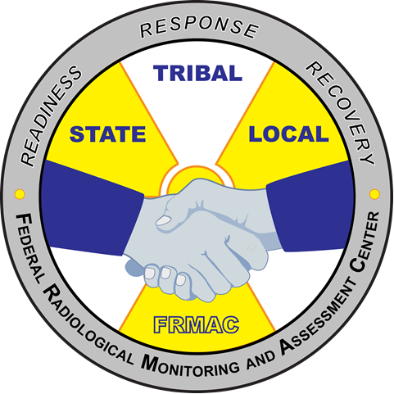
FRMAC Monitoring Manager Initial Training
MS-300
FRMAC Monitoring Division Training
April 2020
Notes:
This course is required by all FRMAC Monitoring Managers. The course will provide an overview of the roles and responsibilities of the FRMAC Monitoring Manager. This initial training is to familiarize FRMAC Monitoring Managers with the duty position, responsibilities in a managerial role, and overall Monitoring and Sampling Division operations. .

Slide 2
Outline
Command Structure in Monitoring Division
Roles and Responsibilities
Assets
Workflow
Deployment Interactions
Software Tools
Operational Topics
Notes:
This course will provide the student with an overview of the FRMAC Monitoring Division with specific focus on the roles and responsibilities of the Monitoring Manager. A lecture portion will cover command structure, equipment and instruments utilized, the workflow process, deployment interactions, and common software tools used in the division. A hands on portion of the course will cover setting up necessary software accounts and practice using those software tools.

Slide 3
Command Structure

Slide 4
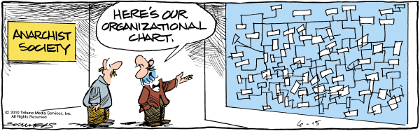
Command Structure in Monitoring Division
Brief ICS Structure
Brief FRMAC/CMRT structure

Slide 5
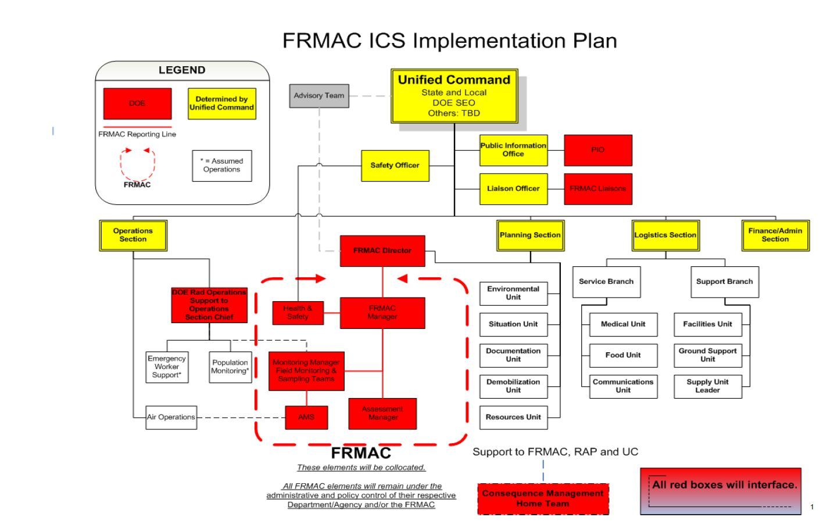
Notes:
In the past, this is how FRMAC thought it would fit into the ICS command structure, typically in the Planning Section. The Monitoring Division and AMS will work closely with the Operations Section (by nature of the Monitoring Division mission).

Slide 6
FRMAC in the ICS Structure
FRMAC fits in the Incident Command System (ICS) however Incident Command would like.
The Monitoring Division will typically be placed in the Operations Section.
The following slides show the organizational charts at the FRMAC level, the Monitoring Division level, and the Health and Safety Division level.
Notes:
Some things to think about:
If there is an Air Operations Branch set up, there still needs to be a way for the Monitoring Manager (who would be in a different branch) to still communicate and give direction to AMS for radiological characterization missions. This would need to be addressed and worked out with the Operations Section Chief.
Use ICS forms to document and communicate within the ICS structure. We may have to adapt some of our processes to meet the needs of the Operations Section Chief.

Slide 7
Structure of the FRMAC
FRMAC Director
FRMAC Dep. Director
Senior Scientific Advisor
Technical Team Leader
Offsite Support
Support Manager
Monitoring Manager
Assessment Manager
Health & Safety Manager
Laboratory Analysis Manager
FRMAC Liaison
Comms
Field Team Supervisor
Assessment Scientist
H&S Supervisor
Sample Control
CMHT
Shipping Specialist
Logistics
Field Monitoring Specialist
Product Scientist
H&S Tech
NARAC
FAL Supervisor
Document Control
AMS Mission Manager
GIS Specialist
REACTS
Public Information
FAL Analyst
AMS Team Scientist
AMS Data Analyst
AMS Technician
Lab QA/QC
Interagency Support
Advisory Team
EPA
NRC
State
Notes:
FRMAC and CMRT have a similar organization chart. The Technical Team Leader (TTL) is a contractor who leads the Division managers. The Division Managers constitute the FRMAC Management Team (FMT). The command chain is set forth in this organization chart. The Monitoring Manager reports to the TTL.

Slide 8
Monitoring Organization Charts
Monitoring Manager
Deputy Monitoring Manager
Field Team Supervisor
AMS Mission Manager
Field Monitoring Specialist
Specialists (In-Situ, ECAM)
AMS Scientists and Technicians
Rotary and Fixed Wing Crews
Monitoring Staff
AMS Staff
Notes:
The Field Team Supervisor (FTS) and AMS Mission Manager are direct reports to the Monitoring Manager. The Field Monitoring Specialists report to the FTS. The FTS may be responsible for multiple field teams, but in keeping with ICS structure guidelines, the FTS should have no more than 5 field teams. The AMS Mission Manager is in charge of flight operations for the DOE aircraft. If AMS is particularly active, it is suggested to have a AMS Mission Manager with the Monitoring Division at the FRMAC location to act as a liaison between the Monitoring Manager and AMS.

Slide 9
Health & Safety Organization Charts
H&S Manager
Deputy
Dose Analyst/Safety/IH
Hotline Manager
Dosimetry Technician
Site Survey Technician
Hotline Technician
Health and Safety Staff
Monitoring Staff
Monitoring has a responsibility to supply personnel to Health & Safety to staff these areas
Notes:
H&S will need assistance from the Monitoring Division to staff certain positions. These are mainly technician positions with contamination control experience. Be prepared to lose some of your field team members so they can assist with H&S.
It may be wise to rotate people into H&S to avoid the monotony of the job or on the other hand, keep certain people there if they are enjoying the work and doing a good job.

Slide 10
Roles and Responsibilities

Slide 11
Roles and Responsibilities
Monitoring Manager and Deputy
Field Team Supervisor
AMS Mission Manager
Field Monitoring Specialist

Slide 12
Monitoring Manager and Deputy Roles
Manage operations for the division
Attend/participate in planning meetings
Help create Execution and Implementation Plans
Complete field team instructions (ICS-204FRMAC)
Brief AMS Missions Managers and Field Team Supervisors on objectives and expectations
Review field team data
Relay information up the command chain
Training: Must complete the Monitoring Manager training courses and be approved by a rostering process before being able to take duty. Must complete annual Monitoring Manager training.

Slide 13
Responsibilities Pre Deployment
Work with CMHT staff to gather all initial information on incident*
  Type of incident, source term, metrology, current status and contact info for state, local responders performing monitoring activities
Confer with FRMAC Management Team (FMT) to discuss response priorities
Obtain all available NARAC plots or monitoring data from First Responders/RAP
Brief the Field Team Supervisor to begin selecting equipment to palletize and then organize teams
Work with the Health and Safety Manager to share information, personnel, and resources.
*Appendix A – Monitoring Manual Volume 1

Slide 14
Responsibilities – IN the Field
Develop the execution plan. Work with FRMAC Management to:
  Get enough info to complete field team instructions
  Support Health & Safety with staffing and resources
  Prioritize action requests and conflicting task
Work with the AMS Mission Manager to determine aerial survey missions
Develop and brief assignments for field teams

Slide 15
Responsibilities Within the ICS/UC Structure
Request resources from Command to support monitoring teams in field when required
Coordinate activities with the Operations Section for FRMAC field teams and FRMAC aerial assets
If Requested:
Attend Planning Meetings to brief Command on the resources and capabilities
Participate in regular tactics and planning meeting to support development of the IAP

Slide 16
How it Really Works
IN REAL LIFE…
The Monitoring Manager attends a lot of meetings.
  There is not enough time for the manager to attend to meetings and operations.
The Deputy Monitoring Manager is typically the operational manager.
  Works with the FTS
  Creates field team instructions
  Reviews data
  Reports to the monitoring manager on field activities
Notes:
If there is a Manager and Deputy at the FRMAC location, it would be wise to have the most operational (or even computer savvy) person be the deputy Monitoring Manager to coordinate field activities.

Slide 17
Field Team Supervisor Roles
Before Team Deployment
  Assist in deployment activities
    Assist with palletizing deployment equipment
    Field team composition
    Establish communications with field teams
  Ensure necessary equipment available and ready
  Brief the ICS-204FRMAC
During Field Deployment
  Establish communications with field teams
  Reroute or change task
  Approve data
After Field Deployment
  Take report from field team
  Return to Monitoring Manager (or Deputy) and Report Status
Notes:
The FTS roles are listed here to help the Monitoring Manager understand what the FTS roles are throughout the response. In large responses, a FTS may act as a forward monitoring post manager. This position will still report to the Monitoring Manager, but take on more manager like responsibilities as needed and determined by the Monitoring Manager.

Slide 18
AMS Mission Manager/Scientist
Coordinate flights/ ensure safety of assigned personnel
Brief AMS staff on objectives
Communicate flight details and situational awareness to the Monitoring Manager
Assist the Monitoring Manager with mission planning
AMS data product creation/review
Notes:
The AMS Mission Manager roles are listed here to help the Monitoring Manager understand what the roles are throughout the response. It is easy for AMS to feel isolated from the FRMAC as they usually will not share the same location. It is imperative to establish communication with the AMS Mission Manager in order to acquire the best AMS data. If the response involves multiple flights per day from multiple agencies, it would be prudent to request an AMS Mission Manager to sit at the FRMAC location with the Monitoring Division to act as a liaison.

Slide 19
Field Monitoring Specialist Roles
Instrument QA/QC before deployment
Ensure tablets and MPCDs are ready
Follow ICS-204FRMAC instructions
Communicate status to Field Team Supervisor
Help less experienced field team members and/or specialty field teams
Notes:
The FTS will assist field teams in preparing for field deployment, ensuring that the instruments and equipment are ready. eFRMAC personnel may be called upon to assist in troubleshooting hardware or software issues with computers, tablets, and software.

Slide 20
Specialty Field Team Roles
ECAMs
  This may include a eFRMAC specialist on the team
  Test system prior to deployment
  Set up at designated location
  Ensure system works at location
Notes:
There may be more specialty type teams. Usually this team is trained in taking a specialty sample/measurement. One example would be an ECAM team. This team could possibly consist of non-Monitoring Division personnel (such as eFRMAC). These specialty teams are rare, but do occur. These teams still report under the FTS.

Slide 21
Assets

Slide 22
Assets
Consequence Management Advance Command (CMAC)
Consequence Management Response Team (CMRT)
Aerial Measuring System (AMS)
Consequence Management Home Team (CMHT)

Slide 23
CMAC
CMAC consists of some the FRMAC Division Managers (Assessment, H&S, Monitoring), Liaison, Operations Specialist, and a Federal Official.
CMAC may deploy before CMRT.
Main goals are to:
  Facilitate the transfer of command and operations from RAP to CMRT
  Prepare for the arrival and operations of CMRT
Guidance: CMAC Arrival Checklist and FRMAC Advance Party checklist
Notes:
CMAC consists of some the FRMAC Division Managers (Assessment, H&S, Monitoring), Liaison, Operations Specialist, and a Federal Official). This team may even deploy as a stand alone team, meaning that CMRT will not deploy. There is a CMAC Checklist to help guide CMAC actions. This can be found:
in the files section of the “CMRT Monitoring Division” Team on the Shire
in the FRMAC Deploy Files and in the files section on the deployed laptop
Or the CMAC Arrival Checklist and the FRMAC Advance Party Meeting Checklist can both be found in Volume I of the FRMAC Monitoring and Sampling Manual.

Slide 24
CMRT
Response team that originates from RSL.
Ability to deploy within 4-12 hours after notification.
DOE operated and the majority of the team is comprised of NNSS employees.
  The Lab Analysis and Assessment divisions have a strong Sandia and Livermore component.
Not all the CMRT equipment fits in the aircraft with the team.
Notes:
CMRT will be activated for accidents/incidents that exceed the state/local capacities. The Monitoring Division typically deploys with 1 Monitoring Manager, 2 Field Team Supervisors, and 10 Field Monitoring Specialists. If the accident can be detected by AMS aircraft, they will deploy independently from CMRT.
CMRT can grow or shrink to meet the response needs. If the response will require heavy use of field teams, request a deputy monitoring manager be deployed ASAP.

Slide 25

AMS
AMS is a separate asset from CMRT. They perform search missions as well as radiological characterizations of large areas.
AMS has 2 locations: Nellis Air Force (Las Vegas, NV) and Joint Base Andrews (Washington D.C.) Bases.
AMS can deploy earlier than CMRT.
When a CMRT/FRMAC is activated, AMS reports under the Monitoring Division.
Notes:
For more information on AMS, go to: https://www.energy.gov/nnsa/aerial-measuring-system-ams
AMS is part of the FRMAC Monitoring Division. Typically, AMS would be part of the Air Operations Group within the ICS command structure.

Slide 26

AMS (cont.)
AMS uses sodium iodide based radiation detection system (manufactured by RSI) in their fixed wing or helicopter to characterize large areas.
The AMS Mission Manager is in charge of the mission. The mission crew consists of the following personnel:
  Pilot
  Co-pilot
  AMS Mission Manager
  AMS Equipment Specialist
Other necessary AMS personnel include: mechanics, data scientists, and data analysts as part of the AMS home team.
Notes:
AMS fixed wing aircraft is deployed initially to perform surveys. Fixed wings perform large area surveys. Helicopters can fly at a lower altitude and at a slower speed to perform a more comprehensive survey of a particular area. The AMS Mission Manager works with the FRMAC Monitoring Manager to coordinate flights to collect data that will meet Incident Command’s objectives.
Beechcraft King Air B350ER :
Twin-engine turbo prop
All weather rated
300 knots (345 mph)
Range 1878 nm (2161 sm)
Max Endurance 10 hrs
(without refueling)
Mission Altitudes: 500–2000 feet AGL
Bell-412
Twin-Pac turboshaft engine
IFR (all weather) rated
Range 360 nm (410 sm)
Max Endurance 3 hrs (without refueling)
Mission Altitudes: 50–500 feet AGL
Mission Speed: 70 knots (80 mph)

Slide 27
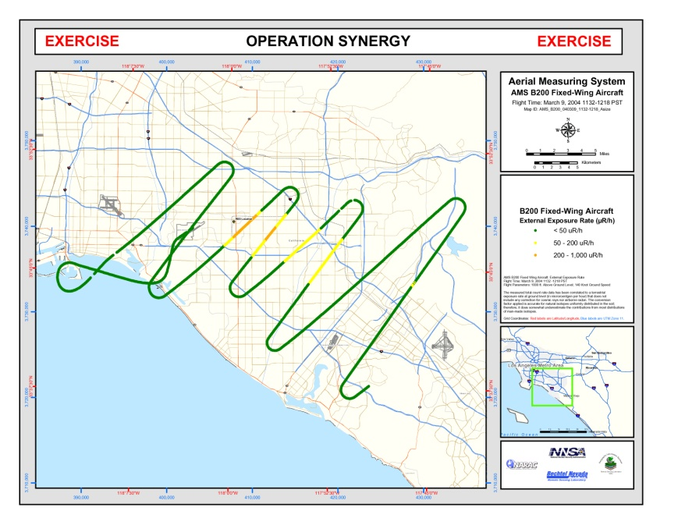
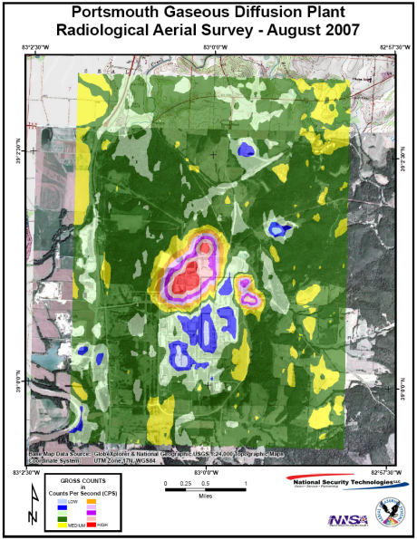
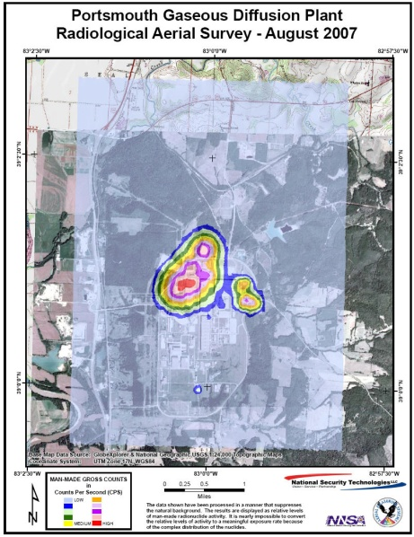
AMS Mission Parameters
Radiological Mapping Phase
Rapid Overview – Emergency Response
  Altitude: 500 feet
  Spacing: 0.5 mile
  Speed: 80 knots
  Helicopter
Small Area (<25 mi²) – Detailed Survey
  Altitude: 50-300 feet
  Line Spacing: 100-500 feet
  Speed: 70 knots
On-Call Response Phase
Large Area (>25 mi²)
  Altitude: 500-1,000 feet
  Spacing: 1-5 miles
  Speed: 140 knots
  Fixed-wing Aircraft
-27-
Notes:
AMS will fly a serpentine pattern to characterize a large area quickly (usually performed with the on-duty fixed wing aircraft). To characterize the area more fully, a series of parallel lines would be flown (this could be done with the fixed wing, but the helicopter will give better resolution). It is imperative that a Monitoring Manager talk with the AMS Mission Manager and explain what the objective is and determine the best flight type to meet the objective.
There are a couple of flight patterns available as noted in the “AMS First 5 Flights – v2 03232014.pdf” found in the files section of the “CMRT Monitoring Division” Team on the Shire or in Volume I of the Monitoring Manual. These patterns are: serpentine, road search, isodose, or parallel lines.

Slide 28
CMHT
The majority of the responders are from RSL-Nellis, Sandia, and Livermore (NARAC).
After notification, CMHT needs to be stood up within 2 hours.
CMHT is scalable and can pull in other responders or scientists from the different DOE/NNSA laboratories or sites.
CMHT exists to provide assistance to the field.
Notes:
CMHT will most likely be activated and participating in the response before CMRT. The Monitoring Manager will work with CMHT to gather situational awareness, initial data or products, and plan for deployment.

Slide 29
CMHT (cont.)
Monitoring is one division in the FRMAC
  Other FRMAC divisions can help answer questions
  CMHT could also help
CMHT could be tasked with:
  Generating equipment/instrument lists
  Estimating doses to the responder of public
  Providing maps (situational awareness, public protection areas, or worker protection areas)
  Data review
  Random tasks
Notes:
While in the field, Monitoring could be overtasked. If some non-field dependent tasks require more resources, then the CMHT could be a helpful asset.

Slide 30
Equipment and Instruments

Slide 31
Equipment and Instruments
CMRT/FRMAC may have instruments that are different from what your site uses.
MS-200 “Field Monitoring Specialist Training – Introduction” covers instrumentation and sampling techniques in more detail and with a hands on practicum.
Operator aids exist in the field for all instruments and main sampling techniques.
Notes:
The FRMAC Monitoring and Sampling Manual Volume II contains the procedures, forms, and operator aids for field activities. The operator aids are provided to the field team specialists to use as a reference.

Slide 32
Monitoring Equipment
MPCDs – These devices ensure communication between the field team tablet and the database via cellular or satellite connections
Tablets – Each field team will have a tablet with the Digital Field Monitoring software to enter samples and measurements directly into the database
Sample collection kits – Each field team will have a sampling kit to perform environmental sampling of soil, vegetation, or liquids
Generators – generators may be used to power air samplers or other monitors
Notes:
Not all equipment is listed here.

Slide 33
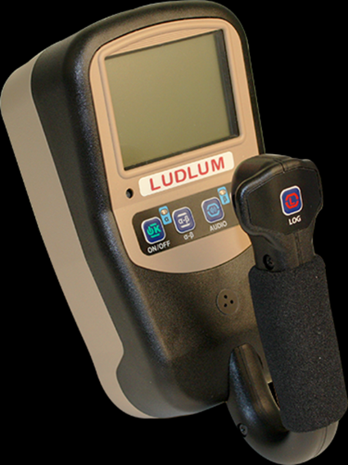
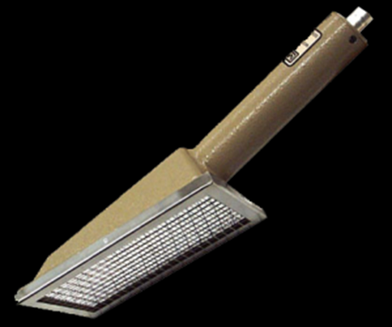
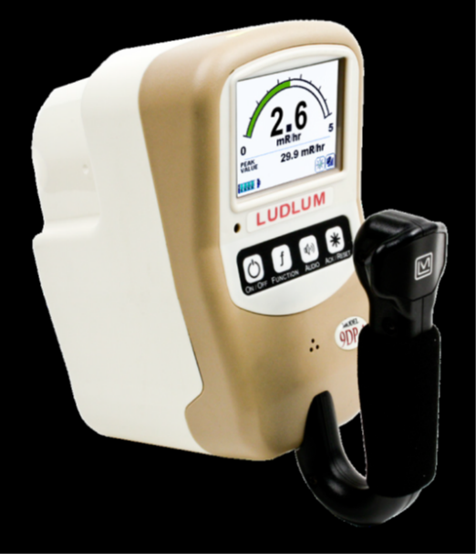
Instruments
Health Physics Kits
3002 with 44-93 Alpha/Beta scintillator -For alpha/beta contamination measurements
9DP-1 Ion Chamber
-Handheld ion chamber for dose rate measurements
Notes:
The Health Physics Kits are the standard hand held instruments for every response. A kit is provided to every field team. AMS also has an HP Kit on board the aircraft.
CMRT Health Physics Kits contain the following:
Ludlum 3002 (alpha/beta meter) connected to a 44-93 (alpha/beta scintillator). These are used for contamination measurements (range: 0 cpm to 999 kcpm) .
Ludlum 9DP-1 (ion chamber). These are used for dose rate measurements (range: 200 µR to 50 R/hr).

Slide 34
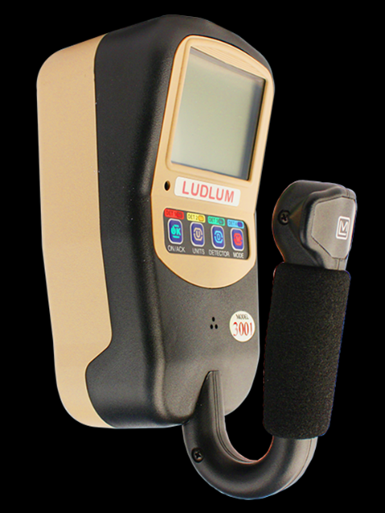
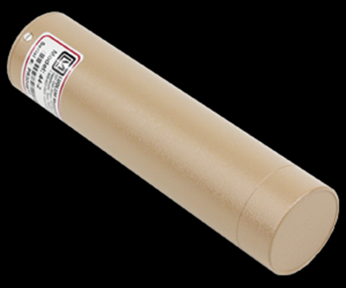
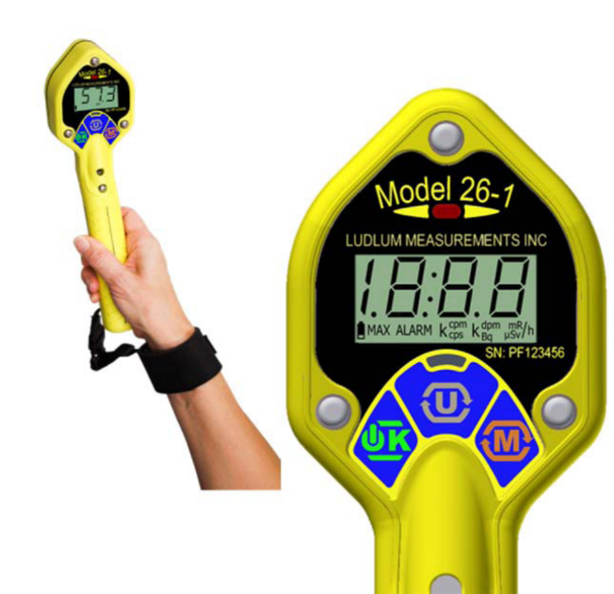
Instruments (cont.)
Health Physics Kits
Model 3001 with Model 44-2 NaI Detector
-For detecting gamma emitting sources or contamination
26-1 Frisker with Dose Equivalent Filter
-For performing quick contamination surveys
Notes:
CMRT Health Physics Kits contain the following:
Ludlum 3001 (meter) connected to a 44-2 (NaI detector). These are useful for surveying gamma emitters for either a counts per second (Range: 0 cpm to 999 kcpm) or exposure rate (Range: 0 uR/hr to 49.9 mR/hr).
Ludlum 26-1 (handheld GM). These are useful for frisking equipment and personnel for contamination (Range: 0 cpm to 999 kcpm). With an attached filter, it may also read out in exposure rate units (Range: 0 to 500 mR/h).

Slide 35
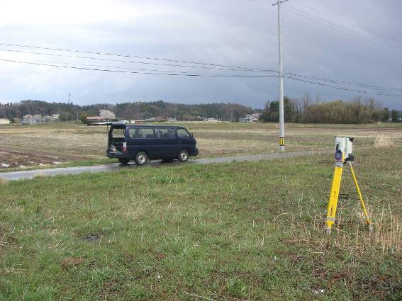
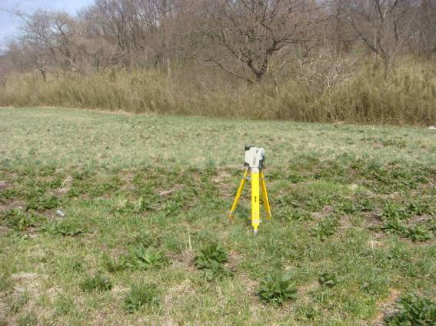
Instruments (cont.)
High Purity Germanium (HPGe)
ORTEC Detective (electronically cooled)
Canberra Inspector 2000 (liquid nitrogen cooled and will be phased out)
HPGe measurements are used for:
  Radionuclide ID
  Determining radionuclide concentrations deposited on the ground
Notes:
All field monitoring specialists will learn how to use the ORTEC Detectives to collect in-situ ground deposition measurements in MS-200/410.

Slide 36
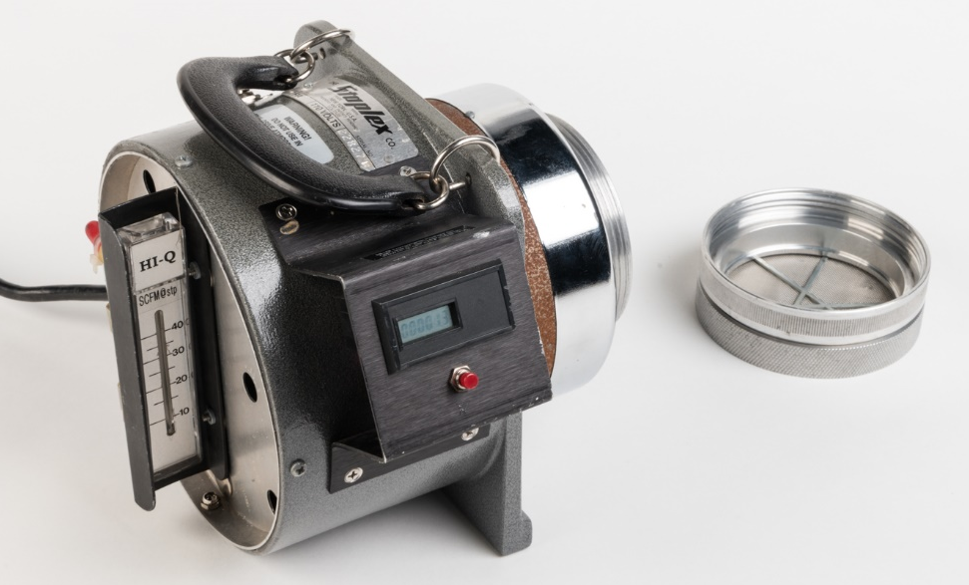
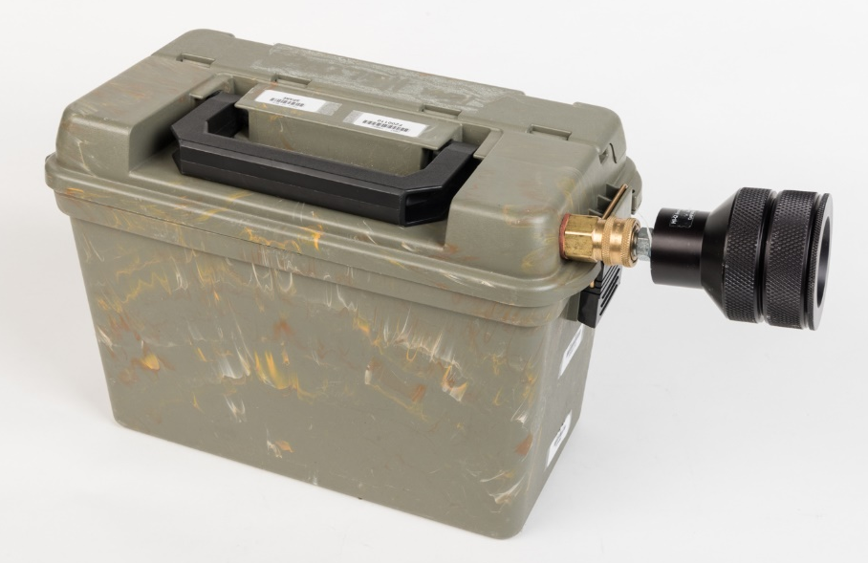
Instruments (cont.)
Air Samplers
  High Volume
  Low Volume
Notes:
High volume air samplers are used for grab samples (lots of air in a short amount of time) during field team operations and releases. High volume air samplers require a power source.
Low volume air samplers have an air flow similar to the human breathing rate and the air samples are usually collected for many hour or days. Air samples are useful in determining the resuspension rate of ground contamination. Low volume air samplers can run with a battery. Low volume samplers may operate with a particulate filter alone or in combination with a charcoal or silver zeolite cartridge.

Slide 37
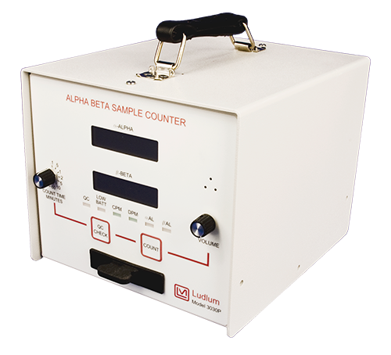
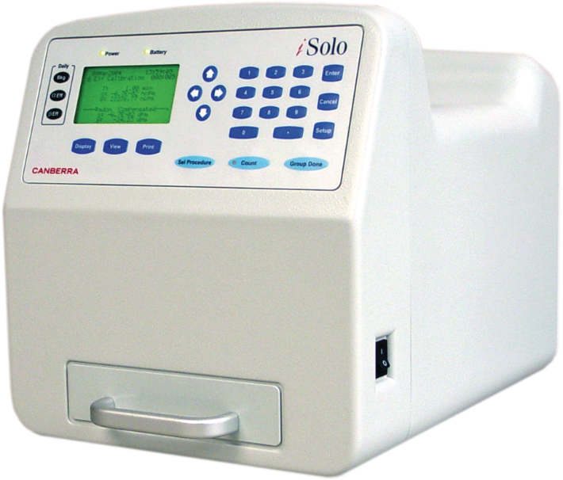
Instruments (cont.)
Proportional Counters
Ludlum 3030P
-for operational swipe counting
Mirion iSOLO (Fly Away Lab)
-for counting swipes or air filters with radon subtraction
Notes:
CMRT Monitoring Division uses the Ludlum 3030P to count operational swipes. The Fly Away Lab (which is part of the Laboratory Analysis Division) uses the iSOLO for counting swipes or air filters. The iSOLO has a radon discriminator which makes it desirable to count air samples.

Slide 38
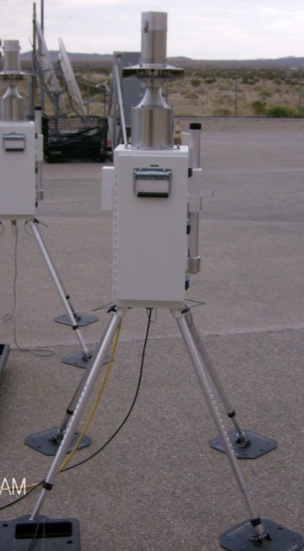
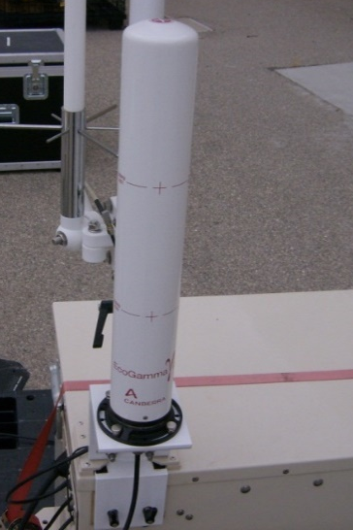
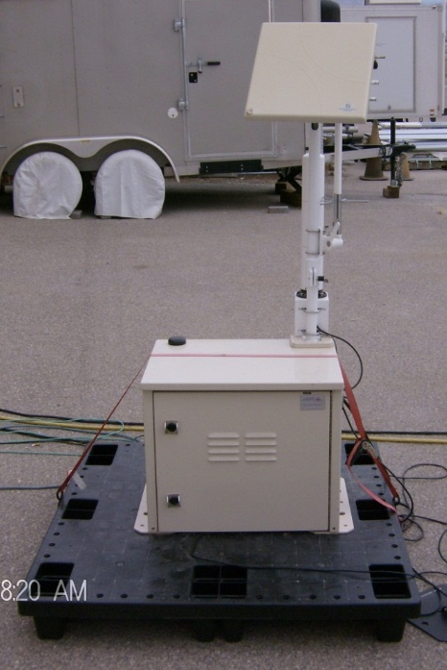
Instruments (cont.)
Environmental Continuous Air Monitor (ECAM)
  Alpha and beta air concentrations (spectral)
  EcoGamma attachment reports exposure rates
ECAM
EcoGamma
ATS
(for telemetry)
Notes:
The ECAM system is composed of 3 pieces of hardware. First, the ECAM is the environmental continuous air monitor (a low volume air sampler). Second, the EcoGamma is a Geiger Mueller detector which reads out in exposure rate. The ATS is the computer and telemetry portion of the system which allows the data to be shared with the central database. The ECAM and EcoGamma may be used together or separately when attached to the ATS, depending on the data needs of the mission.
We typically deploy these to prepare for known events (like NASA launches utilizing an RTG). But these could be useful to determine decay curves after a nuclear detonation or large reactor release. These systems are heavy and take up space on the DOE plane. So, we typically don’t deploy with them right away.

Slide 39
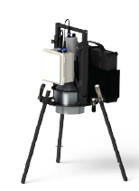
Instruments (cont.)
Ion Chamber: GE RSDetection
  Detector mounted to a tripod for accurate dose rates.
SpecFIDLERs
  Alpha contamination via gamma detection
Portal Monitors
  Detect contamination on people or vehicles (multiple models)
Notes:
The ion chamber is what the division uses to collect extremely accurate exposure rates. Usually this is what we bring to characterize the area AMS is using to calibrate their detectors.
The SpecFIDLER is used only for alpha contamination. The detector is a FIDLER, but the software attached to the detector makes it different than other FIDLERs.
CMRT has a multiple models of portal monitors if necessary. These are typically not brought with the initial deployment of CMRT unless requested.

Slide 40
Workflow

Slide 41
Default Guidance
Data is required/expected from the Monitoring Division even before official objectives are set by command.
Initially, the Monitoring Division does not need to wait for state/local objectives to collect data.
  Default ICS-234 and ICS-204FRMACs have been created with default objectives and field team instructions.
  See Monitoring and Sampling Manual, Volume I (2019), Appendix E-F for the approved guidance.
https://www.nnss.gov/pages/programs/FRMAC/FRMAC_DocumentsManuals.html
Notes:
Default guidance takes the burden from the Monitoring Manager in creating plans when arriving at the incident site. Things that need to be worked out to deploy field teams are: sample/measurement locations to complete the ICS-204FRMAC forms, permission from the state/local to access the incident area, and prepping field teams (vehicles and equipment). Default guidance is used in the CMC software if you check the “Use Default ICS-204” box. Default guidance contains the ICS-234, ICS-204, and ICS-204FRMAC forms nearly completed (no personnel names or contact information or locations). These forms will be given to Incident Command so they are aware of FRMAC field activities.

Slide 42
Ideal Workflow
Incident Action Plan (IAP)
  From Incident Command
  Provides overall objectives
Execution Plan
  From FRMAC Division Managers
  Determines how to accomplish command objectives
ICS-204FRMAC
  From Monitoring Manager/Deputy
  Instructions for field team to get applicable data to satisfy objectives
IAP
Execution Plan
ICS-204FRMAC
Notes:
Eventually, there will be an Incident Action Plan (IAP) which states objectives for the response. These are typically general objectives. The Execution Plan meeting involves the FRMAC Management team and the goal is to be able to address the tactics on how to accomplish the objectives from the IAP. The Monitoring Manager will participate in the Execution Plan. This is the meeting where all the details of sample collection and measurements are agreed upon by each division. It is imperative that the FRMAC Management Team are all involved in the Execution Plan. Do not end the meeting without enough information to make field team instructions. This could include information such as: specific area locations, sample size, count times, types of samples and measurements, etc.
After receiving enough information at the Execution Plan meeting, then the Monitoring Manager prepares the field team instructions on the ICS-204FRMAC forms. We create field team routes and instructions through the Consequence Management Center (CMC) software which we will talk about later.

Slide 43
Execution Plan
Execution Plan can be developed from the details of the IAP or implementation plan
This is done by collaboration of all FRMAC Managers (Assessment, Lab, H&S, Monitoring)
The Execution Plan should have enough detail to provide the Monitoring Manager enough information to create field team instructions.
Notes:
The Execution Plan should include the details relevant to all divisions per Action Item/RFI in order to close it out as completed. This plan should inform the documents and plans carried out by the divisions individually. If executed properly, data collected by the field should directly support analysis needs of lab analysis that can reasonably supply the results/data assessment needs in order to carry out assessment method to answer the question asked by the customer.
It is understood by the group that this may put the FRMAC on a different response schedule from the rest of the response staff. However, getting these plans in place before beginning work will save time on the back end in trying to fit samples/data collected to the need. Furthermore, as the response progresses these plans should become easier to create.
While the team is meeting to create these plans, deputies from the divisions should be tasked to take what is learned to rest of the division staff in order that they may begin working on the tasks.

Slide 44
ICS-204FRMAC Field Team Instructions
The execution plan has the generic who, what, where, how, and when. Document tasks on an ICS-234 form.
The ICS-204FRMAC has specific details for each field team.
Field teams are expected to follow the instructions on the ICS-204FRMAC. Deviations should be communicated to the Field Team Supervisor.
Notes:
The Monitoring Division uses a web application called CMC to prepare field team instructions. This application saves time and effort. The Monitoring Manager or Deputy will prepare the field team instructions. Consult with FTS to know the capabilities of each field team. FTS will also have access to CMC, but should not prepare field team instructions.
Once complete, the ICS forms are easily transmitted to other FRMAC divisions and command.

Slide 45
AMS Instructions
The Monitoring Manager plans all field operations to meet objectives and provides status reports to command.
The AMS Mission Manager will assist the Monitoring Manager in planning and coordinating flights for the operational period.
If there is an Air Operations Branch in the ICS structure, AMS will coordinate with the Air Ops Branch and the Monitoring Manager. May use the ICS-220 “Air Operations Worksheet” for documentation.
Notes:
The Monitoring Manager will provide the AMS Mission Manager with a general plan on where flights should occur and the objective of the flight. The Monitoring Manager should be ready to submit a kmz (or at least 4 corners of a box with latitude and longitude) of the area that should be surveyed, the objective of the flight (ex: determine relocation area), how the results would be best presented (exposure rate or radionuclide concentration), type of flight (ex: parallel lines or isodose), and a priority for the flight compared to other scheduled flights.
The AMS Mission Manager will then plan the details of the flights and coordinate the flights. If there is an Air Operations Branch established, AMS will need to coordinate with the branch and also the Monitoring Manager. The exact way to coordinate flight planning and operations will need to be worked out during the event.

Slide 46
Common ICS Forms for the
Monitoring Division
ICS-234 “Work Analysis Matrix”
  Work Analysis Matrix is derived from the Execution Plan objectives (State/Local Agency priorities)
ICS-215 “Operational Planning Worksheet”
  Operational Planning Worksheet is derived from Work Analysis Matrix
ICS-204 “Assignment List”
  Team Assignment List is derived from the Work Analysis Matrix
ICS-220 Air Operations Worksheet
  Air Operations Worksheet is derived from the Team Assignment List
ICS-204FRMAC “Assignment List, Adapted for FRMAC Field Monitoring Teams”
  Field team assignments with specific instructions
ICS-214 “Activity Log”
  A simple form to report on daily activities
https://training.fema.gov/icsresource/icsforms.aspx
Notes:
Activity: Open some of the forms and go through them.

Slide 47
Resources
Main Guidance for Monitoring Activities:
Monitoring and Sampling Manual Volume 1, Revision 3 – Monitoring Division Operations
  Revised in 2019 to document operations within the Monitoring Division
  Contains the default field team instructions
Monitoring and Sampling Manual Volume 2, Revision 3– Radiation Monitoring and Sampling
  Prepare for a revision in 2020-2021.
  https://www.nnss.gov/pages/programs/FRMAC/FRMAC_DocumentsManuals.html
Notes:
Here are the manuals that guide our operations. Please read them.

Slide 48
Workflow Section Takeaway
IN REAL LIFE…
Monitoring Manager needs to have default guidance documentation ready
  (Should be in the FRMAC Deploy Files on the laptops)
The execution plan meeting is crucial. You need every division manager (or designee) there
  With input from all the divisions, the field team instructions will have a high probability of meeting the data needs.
Document instructions and tasks on ICS forms. It will save you time.

Slide 49
Deployment Interactions

Slide 50
Deployment Interactions for the Monitoring Manager
  Is part of the Consequence Management Advance Command (CMAC) and may interact with states and locals.
  Interacts with other FRMAC Division Managers, the Technical Team Leader, and FRMAC Director for planning FRMAC operations.
  May receive instruction and provide advice to the ICS Operations Chief, or designee.
  Coordinates with the Deputy Monitoring Manager to ensure operations will meet FRMAC’s objectives.
  Coordinates with AMS Mission Manager to plan aerial operations.
  Coordinates with Field Team Supervisors to ensure that field team instructions are reasonable. Receives situational updates from the field.
Notes:
As part of the CMAC, you may interact with states/locals or other DOE assets already responding (like RAP).
As part of CMRT/FRMAC, the main interactions will be with the FRMAC Management Team and someone in the ICS Operations Section. Operations will necessitate the need to communicate with FTS and AMS Mission Managers for monitoring and sampling activities and Health and Safety to prepare for field team activities.

Slide 51
Deployment Interactions (cont.)
IN REAL LIFE…
Work with the FRMAC Management Team to develop the Execution Plan!
  Assessment: to find out the questions
  Laboratory: to find out what to collect
  H&S: to find the safe way to do it
  TTL: to de-conflict taskings
Notes:
Often, other managers do not know what it takes to deploy a team, how long it takes for field teams to collect samples, and other logistical issues associated with the division. Be prepared to think about logistics (specifically what the division can accomplish during a shift) while at the execution plan meeting. Typically there will be more objectives to complete than time allotted to the complete those tasks.

Slide 52
Deployment Interactions (cont.)
Brief AMS mission manager on aerial requirements to meet response objectives
  What questions are we trying to answer?
    Isotopic mix?
    Extent of deposition?
The AMS Mission Manager can assist in planning the flights considering:
    Meteorology constraints
    Aircraft availability and constraints (including no-fly zones or other unsafe areas)
    Radionuclide detectability
Notes:
As the Monitoring Manager, you do not need to know everything about AMS - just some basic concepts. The Mission Manager will take care of the flight specifics.

Slide 53
Deployment Interactions (cont.)
Select staff to assist Health & Safety to:
  Staff and operate a hotline
  Provide and track dosimetry provided to responders
  Conduct FRMAC facility radiological and industrial hygiene surveys
Notes:
Also would need to work with the H&S Manager to prepare the safety briefing for field team activities.

Slide 54
Software Tools

Slide 55
Software Tools
SHIRE
COSMOS
RAMS
RadResponder
CMWeb
CMC/ Tablets
AVID
VSP
This section will discuss/demonstrate the listed software tools and ensure that required accounts are created or verified.

Slide 56
SHIRE
The “SHIRE” is a Microsoft Azure Cloud space.
The SHIRE has Microsoft 365 applications like: Outlook, Excel, Word, One Drive, Teams, etc.
Many applications reside on the SHIRE and use a single sign on to access these apps including the RSL Portal.
Field Team Supervisors, Monitoring Managers, and All AMS personnel (manager/scientists/and technicians) are required to have a SHIRE account.
https://login.microsoftonline.com
Notes:
The RSL Portal is where applications like RAMS, CMC, and COSMOS reside. These apps will be discussed later.
Currently, only Field Team Supervisors and Monitoring Managers need SHIRE accounts to access these applications.

Slide 57
RAMS
RAMS is the DOE database that stores the monitoring and sampling data for the incident.
Accounts are needed to access the database.
Field Team Supervisors and Monitoring Managers are required to have access to RAMS.
https://rslportal.doerer.us/
Notes:
Eventually, RAMS will be discontinued and RadResponder will be the main data collection software.

Slide 58
RadResponder
RadResponder is the FEMA database that stores the monitoring and sampling data for the incident. Many states and locals use it.
Accounts are needed to access the database.
ALL personnel in the Monitoring Division need accounts.
https://www.radresponder.net/
There is also a mobile app for Windows, Apple, and Android devices.
Notes:
RadResponder is a data collection system based on collaboration between Federal Emergency Management Agency (FEMA), Department of Energy (DOE) / National Nuclear Security Administration (NNSA), and the Environmental Protection Agency (EPA), and is provided free of charge to all Federal, state, local, tribal, and territorial response organizations. There is a website and also an app for iOS, Android, and Microsoft devices.
You may have to log into the RadResponder app on the tablet. Download the app on your phone and check it out before you have to use it for real. When you sign up for an account:
In the “Reason for Request” section, type “Member of the FRMAC Monitoring Division”
Select “Join Existing Organization”
Select “DOE FRMAC” as the existing organization.

Slide 59
AVID
AVID is the DOE software that visualizes and analyzes mobile data (aerial, vehicle, or backpack).
Other data, such as the ECAM, is being incorporated into AVID as well.
AVID is a stand alone software that needs to be loaded onto your computer.
All AMS personnel (manager/scientists/and technicians) in the Monitoring Division must have AVID.
Notes:
AVID is used by other DOE/NNSA emergency response assets for mobile data. Currently, CMRT does not use AVID, but hopes to be able to incorporate data with it in the future.

Slide 60
CMWeb
CMWeb is where the FRMAC shares data and decision support products to the customer.
Accounts are needed to access the database.
Monitoring Managers are required to have CMWeb accounts.
https://cmweb.llnl.gov/
Notes:
CMWeb is hosted by Lawrence Livermore National Lab. This system is typically used to share final data products with the states/locals. Monitoring Managers may need to upload documents to this system.

Slide 61
COSMOS
COSMOS is the software tool the FRMAC uses to track the progress of home team and field team action items.
SHIRE accounts are needed to access COSMOS.
Monitoring Managers are required to have COSMOS accounts.
https://login.microsoftonline.com
Notes:
COSMOS was developed by Sandia National Lab. A production version will be available in October 2020. COSMOS is heavily used by FRMAC management to track the progress of certain high level tasks.

Slide 62
CMC
CMC is software that provides situational awareness for Monitoring Managers and allows them to plan field team activities, interact with teams in the field, and review data.
MS-260 “CMC Training” is required for Field Team Supervisors and Monitoring Managers
Monitoring Managers and Field Team Supervisors are required to have CMC accounts.
https://rslportal.doerer.us/
Notes:
CMC was developed by RSL specifically for the FRMAC/CMRT Monitoring Division. CMC is used to create field team routes and instructions. CMC is a tool used by Monitoring Managers and Field Team Supervisors to communicate with field teams and to track their progress.

Slide 63
CMC Highlights
Select the event.
Create field teams.
Place sample locations.
Create field team instructions.
Send sample locations instructions to the tablet.
Track and chat with field teams in the field.
Review incoming data.
Import kmz or csv files to view on map.
Plan for the next shift.
Review previous instructions and sample locations.
https://rslportal.doerer.us/
“MS-260 CMC Training” required for only Field Team Supervisors and Monitoring Managers

Slide 64
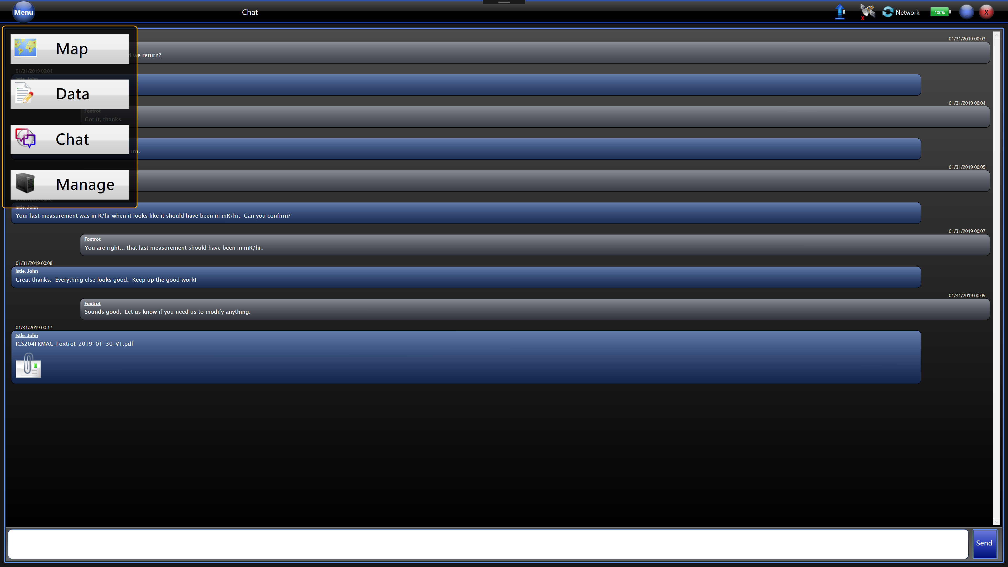
Digital Field Monitoring (DFM) Tablet
Each field team will be given an MPCD and a tablet to use in the field.
The primary method of collecting CMRT data is using the DFM tablet which directly inputs data into RAMS.
The tablet also has the RadResponder application for those in other agencies that use it for operations.
The tablet format is similar to previous versions.
Click “Menu” in top left corner.
Click “Map” to view map.
Click “Data” to collect data.
Click “Chat” to send message to CMC.
Click “Manage” to see status of data transfer.
The ICS-204 will come through as an attachment in the chat function.
  Download and save the ICS-204 on the tablet.
Notes:
Along with the MPCD, the DFM tablet is a way for field teams to telemeter data to the RAMS or RadResponder database. This allows for data to be reviewed and analyzed quickly. If the telemetering does not work in the field, the tablet buffers the data until a solid connection is made to download the data to the database. Field Monitoring Specialists will receive training on how to use the tablet in MS-200 “Field Monitoring Specialist Training – Introduction.”

Slide 65
VSP
Feeling the need for more statistics in sampling? There is software for that named Visual Sample Plan (VSP).
Monitoring Managers should be aware of VSP. However, we do not expect you to be proficient in it.
Make a VSP request to CMHT.
  VSP is made and maintained by PNNL.
  PNNL will be able to run VSP for you.
https://vsp.pnnl.gov

Slide 66
Operational Topics

Slide 67
Operational Topics
Set up division at FRMAC
Incorporate other agencies
AMS interactions
ICS interactions/ information flow
Incident Management Team (IMT)

Slide 68
Set Up at FRMAC
Monitoring Division needs a good amount of space for personnel and equipment.
  Tables/chairs for management
  Tables for equipment
Prefer to have a large screen/projector so we can use and display CMC.
May need a board to keep track of equipment and personnel.
Notes:
The setup of the FRMAC at the FRMAC location is a bit hectic. Be sure to coordinate with other managers where each division will sit. Monitoring typically needs access to exterior doors and requires tables for instrument operability checks. The FRMAC Support Manager will be able to obtain needed supplies.

Slide 69
Incorporating Agencies into FRMAC Field Teams
Personnel from RAP/EPA/State/Locals/other agencies will be incorporated into the FRMAC Monitoring Division.
Be aware of which agencies are part of the division and their advantages/limitations.
Push the dividing of personnel into teams to the Field Team Supervisors.
Note that some agencies will have different safety procedures and dose limits.
Notes:
Some managers or captains from these field teams could help serve in management positions. It should be noted that they should shadow current FRMAC Monitoring Managers/Field Team Supervisors for a time before they are able to act in the position alone. Consider using non-FRMAC trained monitoring managers in alternate roles, such as writing requested plans, acting as a liaisons to other groups, or helping with the myriad of administrative tasks.
If you learn of agencies performing monitoring and sampling on their own, address this to command and incorporate them into the Monitoring Division.

Slide 70
AMS Interactions
AMS will typically be operating out of the airport they are using.
Communications between the AMS Mission Manager must be established early on.
If there is a heavy AMS presence with multiple flights per day, it is a good idea to have an AMS Mission Manager located at the FRMAC with the Monitoring Manager.
  The Mission Manager would act as a liaison between the Monitoring Manager, AMS, and the Air Operations Group.
Notes:
The AMS Mission Manager can help plan flights to ensure objectives will be met. Also, the AMS Mission Manager can provide real time status of the flights while viewing the Search Management Center (SMC) or AVID.

Slide 71
ICS Interactions/Information Flow
Monitoring will be under the ICS Operations Section Chief.
Use ICS forms to communicate objectives, tasks, and tactics.
  ICS-234: Use this when someone asks for a “Monitoring and Sampling Plan.” This form explains the general tactics used for the response.
  ICS-204: This is a general overview of what the field teams are doing for the shift.
  ICS-204FRMAC: This is specific field team instructions.
These forms have proven to save time (less paperwork generated).
Notes:
If someone requests a “Monitoring and Sampling Plan,” then reply that the division uses ICS forms to document daily activities. Start with the ICS-234 as a general overview of what the division is trying to accomplish. Use the ICS-204 and ICS-204FRMAC forms when more specific information is needed. If they want more specific information on how samples or measurements are collected, point then towards the FRMAC Monitoring and Sampling Manual, Volume I.

Slide 72
IMT
In a large event, an IMT may be initiated by Headquarters.
The IMT is well versed in ICS structure and operations.
  They can help with ICS paperwork and coordinating information flow up or down the chain of command.
  They can also help keep track of personnel and equipment.
Notes:
Welcome IMT personnel into the division. They have proven to be helpful during large events.

Slide 73
Conclusion

Slide 74
Questions?
Ask:
a fellow Monitoring Manager OR
the FRMAC Monitoring and Sampling Working Group Chair.
  Jeremy Gwin
  Email: gwinjs@nv.doe.gov

