Slide 1
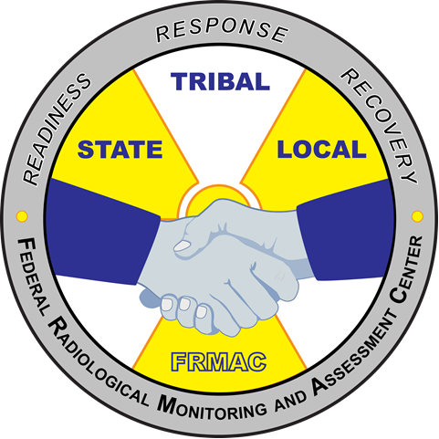
FRMAC Field Monitoring Specialist Training - Advanced
MS-400
FRMAC Monitoring Division Training
April 2020
Notes:
This course is required by all FRMAC Field Monitoring Specialists. It is advised that FRMAC Field Team Supervisors and Monitoring Managers attend the drill portion of the course.

Slide 2
MS-400 Purpose
To provide a refresher for FRMAC Field Monitoring Specialists with FRMAC sampling and monitoring equipment, data collection methods, and operations.

Slide 3
Course Outline
Updates in Monitoring Division Operations (from FRMAC Monitoring Skill Set Leader)
Lessons learned from previous experiences (group discussion)
Refresher topics from MS-200 (topics focus on sample collection and instrument proficiencies)
Field Drill
Notes:
This training course refreshes FRMAC field equipment and methodologies to existing FRMAC Field Monitoring Specialists. Students will review use of FRMAC monitoring instrumentation and equipment. They will also review FRMAC monitoring and sampling procedures, use of data collection software, and proper documentation. A field drill will also be conducted.

Slide 4
Note to Instructor
The core slides to this course are limited to section headings. Add slides into each section as appropriate. Save the slides as MS-400 and the date of the course (example : “MS-400 January 2020.pptx”).

Slide 5
Monitoring Division Updates

Slide 6
Monitoring Division Updates
Operational
Technical
Personnel
This is a chance for the FRMAC Monitoring Skill Set Leader to update the Field Monitoring Specialists on any operational changes (manual updates, operational changes, incorporating Incident Command Structure changes etc.), technical updates (use of new software or equipment), and personnel updates (promoting certain personnel, departures, etc.).

Slide 7
Lessons Learned

Slide 8
Lessons Learned
Real Worlds
Exercises
This is a chance for Feld Team Supervisors and Field Monitoring Specialists to share experiences and lessons learned from previous deployments.

Slide 9
Proficiencies

Slide 10
Proficiencies
Instruments
Equipment
Sample Collection
Instrument proficiencies will cover the most used FRMAC field instruments to include Health Physics kits, High Purity Germanium detectors, and SpecFIDLERs. Field team tablets will also be used in conjunction with instruments. Content from MS-200 may be used to refresh on the topics if needed.
Notes:
Field Monitoring Specialists will get hands-on experience with FRMAC radiation detection instruments and equipment. A proficiency style of training is appropriate. Field Monitoring Specialists may (and are encouraged to) use FRMAC Operator Aids to assist them in accomplishing tasks.

Slide 11
Field Drill

Slide 12
Field Drill
A field drill will be conducted to practice deployment activities.
This requires additional personnel such as:
FRMAC Monitoring Manager
Field Team Supervisors
eFRMAC specialists
The field drill will help Field Monitoring Specialists understand how to prepare for field deployment, follow ICS-204FRMAC instructions, the use the tablet and CMC, and collecting appropriate measurements and samples. Measurements and sample collection will occur outside of the classroom and should include air, soil, vegetation, and water if possible.
Notes:
The afternoon session will be a field drill. Teams will drill on field deployment activities by collecting measurements and samples by following current Monitoring Division field planning operations. Field Team Supervisors and Monitoring Managers will participate in the field drill to build division cohesiveness. This drill may require some eFRMAC personnel to participate to troubleshoot hardware and software issues (MPCD, tablet, and CMC).

