Slide 1
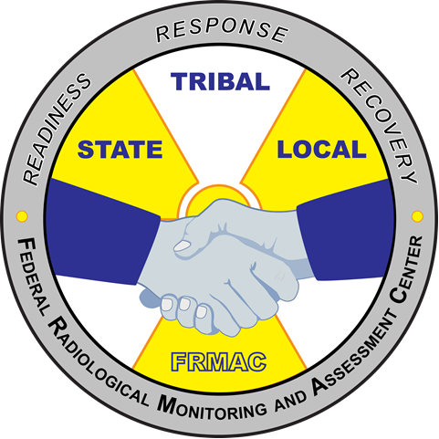
FRMAC Field Team Supervisor Training - Advanced
MS-410
FRMAC Monitoring Division Training
April 2020
Notes:
This course is required by all FRMAC Field Team Supervisors.

Slide 2
MS-410 Purpose
To provide a refresher of the roles and responsibilities of the FRMAC Field Team Supervisor (FTS) and to discuss current topics and lessons learned relevant to the Monitoring Division.
This class was designed to be based on group discussion.

Slide 3
Course Outline
Updates in Monitoring Division Operations (from FRMAC Monitoring Skill Set Leader)
Lessons learned from previous experiences (group discussion)
Refresher topics from MS-250 (topics selected by Field Team Supervisors, Monitoring Managers, or FRMAC Monitoring Skill Set Leader)
Notes:
FRMAC FTS take this course to review their roles and responsibilities, operations, and learn any new developments in the Monitoring and Sampling Division since their previous training. Topics will be chosen by the FTS, FRMAC Monitoring Managers, and/or the skill set leader.

Slide 4
Note to Instructor
The core slides to this course are limited to section headings. Add slides into each section as appropriate. Save the slides as MS-410 and the date of the course (example : “MS-410 January 2020.pptx”).

Slide 5
Monitoring Division Updates

Slide 6
Monitoring Division Updates
Operational
Technical
Personnel
This is a chance for the FRMAC Monitoring Skill Set Leader to update the Field Team Supervisors on any operational changes (manual updates, operational changes, incorporating Incident Command Structure changes etc.), technical updates (use of new software or equipment), and personnel updates (promoting certain personnel, departures, etc.).

Slide 7
Lessons Learned

Slide 8
Lessons Learned
Real Worlds
Exercises
This is a chance for Feld Team Supervisors to share experiences and lessons learned from previous deployments. Constructive criticism and correction is to help better Monitoring Division management.

Slide 9
Special or Refresher Topics

Slide 10
Special or Refresher Topics
Refresher topics from MS-250.
Special Topics
Topics are picked by members of the group or the FRMAC Monitoring Skill Set Leader. Topics from MS-250 may be used to refresh. Special topics may include (but not limited to): Deployment operations, discussions with Monitoring Managers (joint meeting), invited guest lecturers from other divisions/agencies.

