Slide 1
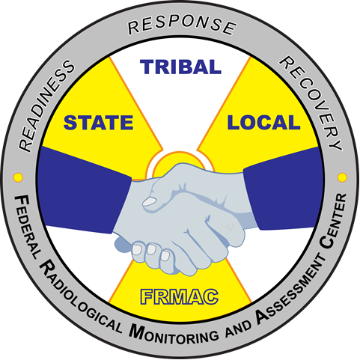
Federal Radiological Monitoring and Assessment Center
Monitoring and Sampling Division Training
U.S. Department of Energy
National Nuclear Security Administration
Nevada National Security Site
MS-50 Module 1
“Technical Field Team Training”
November 2020
Notes:
This course provides states/locals with an overview of FRMAC monitoring and sampling techniques during state outreaches.
There are 4 modules to this course. Module 1 contains a description of the FRMAC and the FRMAC Monitoring Division. Module 2 describes monitoring equipment and techniques. Module 3 describes sampling techniques from some common sample types. Module 4 describes some of the data and documentation needed for monitoring and sampling activities.
There is also a hands-on practical portion that to this course, if desired and weather permitting. The practical can cover basic monitoring techniques for exposure rate or contamination surveys as well sampling techniques for soil and air samples.

Slide 2
MS-50 Content Outline
Module 1: Overview of the FRMAC and Monitoring Division
  Recall responsibilities of the Monitoring Division
  Review and understand the general structure of the Monitoring Division.
  Review roles and responsibilities of the major positions.
  Recognize other assets with which Monitoring may be interacting.
Module 2: Demonstration of FRMAC monitoring and sampling equipment to include eFRMAC data tablets
  Monitoring Equipment
  Monitoring Techniques
  Contamination Control
Notes:
Outline of modules 1 and 2.

Slide 3
MS-50 Content Outline
Module 3: Overview of FRMAC sampling techniques
  Sampling Techniques
    Air
    Ground Deposition/Soil
    Water
    Vegetation
    Milk/Feed
  Sample Receipt
Module 4: Data, Forms, and Documentation
  Field Team Instructions
  Recording Field Data
  Documents and References
Notes:
Outline of modules 3 and 4.

Slide 4
MS-50 Content Outline
Practical (if offered):
The practical will use FRMAC procedures and Operator Aids.
  Practice operating FRMAC instruments and equipment.
    CMRT HPKIT
      Exposure Rate
      Contamination Probes
    Sample Collection
      Air Sampling
      Soil Sampling
  Data collection and submit data using RAMS or RadResponder
  Practice field deployment activities.
Notes:
Outline of the practical (if available). Activities may be limited due to weather, time constraints, or other factors.

Slide 5
MS-50 Module 1 Outline
What is FRMAC?
  FRMAC Divisions
  Role of the Monitoring Division
Assets During a Radiological Response
  How It All Comes Together
Notes:
This is the beginning of module 1 content. In this module we will discuss what the FRMAC is, the different divisions within FRMAC, and the role of the FRMAC Monitoring and Sampling Division (commonly known as the Monitoring Division). During a FRMAC response, FRMAC would like to incorporate state/local field teams into their operations and they would be operating in the FRMAC Monitoring Division. We will also discuss different radiological emergency response assets available during a response and their roles.

Slide 6
What is FRMAC?

Slide 7
What is FRMAC?
The Federal Radiological Monitoring and Assessment Center (FRMAC) is a federal asset available on request by the Department of Homeland Security (DHS) to respond to nuclear and radiological incidents.
FRMAC is an interagency organization with representatives from various federal, state, and local radiological response organizations.
The purpose of the FRMAC is to assist the states, local and tribal governments in their mission to protect the health and well-being of their citizens with:
  verified radiation measurements;
  interpretations of radiation distributions based on Environmental Protection Agency (EPA), Food and Drug Administration (FDA), or local Protective Action Guidelines; and
  characterization of overall radiological conditions.
Notes:
FRMAC’s mission statement: Provide timely, high-quality predictions, measurements, analyses, and assessments to promote efficient and effective emergency response for the protection of the public from the consequences of nuclear or radiological incidents.
For a more complete answer:
Check the website: https://www.nnss.gov/pages/programs/FRMAC/FRMAC.html

Slide 8
FRMAC Mission Space
Mission space includes any deliberate or accidental incident that results in a real, potential, or perceived release of radioactive material that exceeds the capacity of local responders (e.g. nuclear detonation, radiological dispersal device (RDD), nuclear facility accident, or weapon accident).
Notes:
FRMAC coordinates the federal off-site response to any nuclear or radiological incident. This mission space includes responding to a nuclear detonation, radiological dispersal device (RDD), nuclear reactor or nuclear facility accident, or nuclear weapon accident. FRMAC collects and assesses the data, but does not provide recommendations to the states/locals. Data can be compared against protective action guidelines, but the protective action recommendations and decisions are the responsibility of the state/locals.

Slide 9
FRMAC in the ICS Structure
FRMAC fits in the Incident Command System (ICS) however Incident Command would like.
The Monitoring Division will typically be placed in the Operations Section.
The following slide shows the organizational charts at the FRMAC level.
Notes:
Since it is up to Incident Command on how to organize their responders, where exactly in the ICS structure FRMAC would be placed is subjective. Generally, the Monitoring Division is placed under the ICS Operations Section.

Slide 10
Structure of the FRMAC
FRMAC Director
FRMAC Dep. Director
Senior Scientific Advisor
Technical Team Leader
Offsite Support
Support Manager
Monitoring Manager
Assessment Manager
Health & Safety Manager
Laboratory Analysis Manager
FRMAC Liaison
Comms
Field Team Supervisor
Assessment Scientist
H&S Supervisor
Sample Control
CMHT
Shipping Specialist
Logistics
Field Monitoring Specialist
Product Scientist
H&S Tech
NARAC
FAL Supervisor
Document Control
AMS Mission Manager
GIS Specialist
REACTS
Public Information
FAL Analyst
AMS Team Scientist
AMS Data Analyst
AMS Technician
Lab QA/QC
Interagency Support
Advisory Team
EPA
NRC
State
Notes:
FRMAC and CMRT have a similar organization chart. The FRMAC is led by the FRMAC Director and Deputy (federal officials). The Technical Team Leader (TTL) is a contractor as well as the rest of the FRMAC positions. Each FRMAC division is led by a manager. There is an offsite component of FRMAC which includes the Consequence Management Home Team (including the National Atmospheric Release Advisory Center -NARAC), liaisons, and a DOE Public Information Officer.

Slide 11
FRMAC Divisions

Slide 12
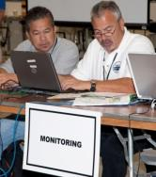

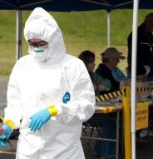
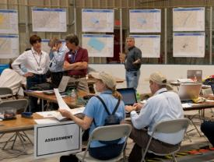
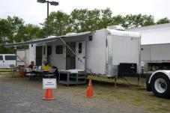
FRMAC Divisions
Support
Health & Safety
Laboratory Analysis
Assessment
Liaison
Monitoring
Notes:
We will briefly discuss each division within the FRMAC.

Slide 13
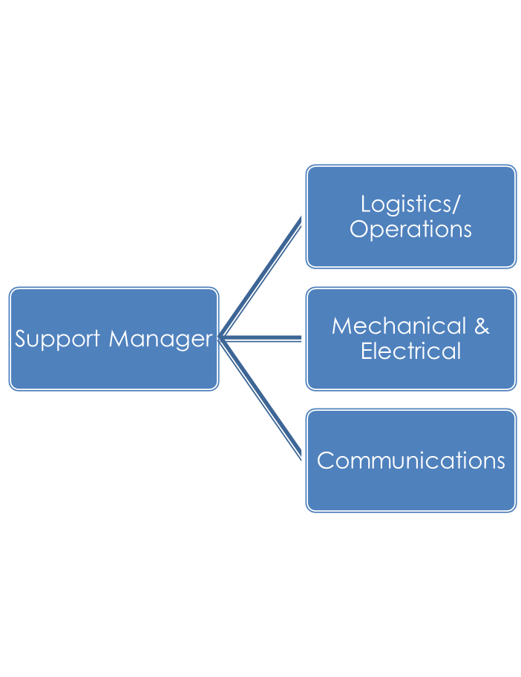
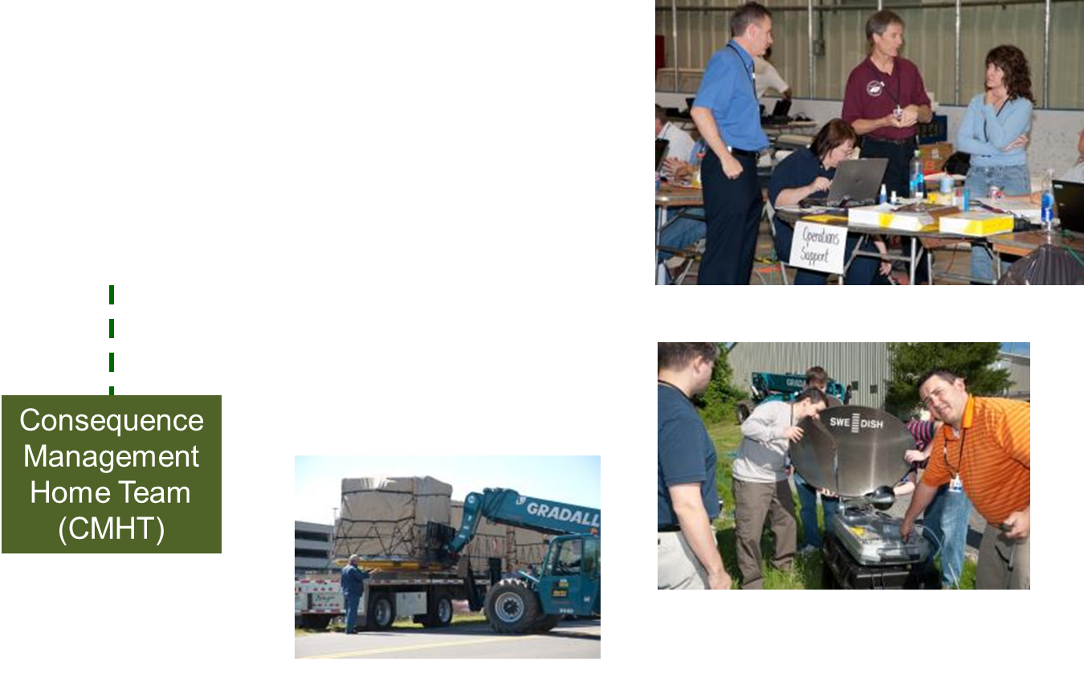
Support Division
Notes:
The Support Division is most active during the mobilization/demobilization of the FRMAC. Logistics personnel coordinate the movement of the assets to the incident location and work with states/locals to find suitable accommodations for a large number of individuals. Setting up the FRMAC location includes mechanical/electrical personnel to unload/load equipment from planes and trailers and to provide power and also eFRMAC personnel (communications and software/hardware set up) to provide phone, internet, and network services.

Slide 14
Support Division Responsibilities
Obtaining equipment and supplies and coordinating mobilization/demobilization
Assisting with state/local logistics for choosing a suitable FRMAC location
Providing logistics for deployed assets (hotels, rental cars)
Tracking On-scene personnel locations and assignments
Communications
Computer maintenance
Coordinating personnel schedules with the Home Team
Field Command Post support
Badging (e.g. to limit access to authorized personnel)
Property Protection and Operations Security (OPSEC)
Notes:
During the response, documentation specialists assist FRMAC management with task tracking, documenting actions taken by the FRMAC, or any other needs of the FRMAC management.

Slide 15
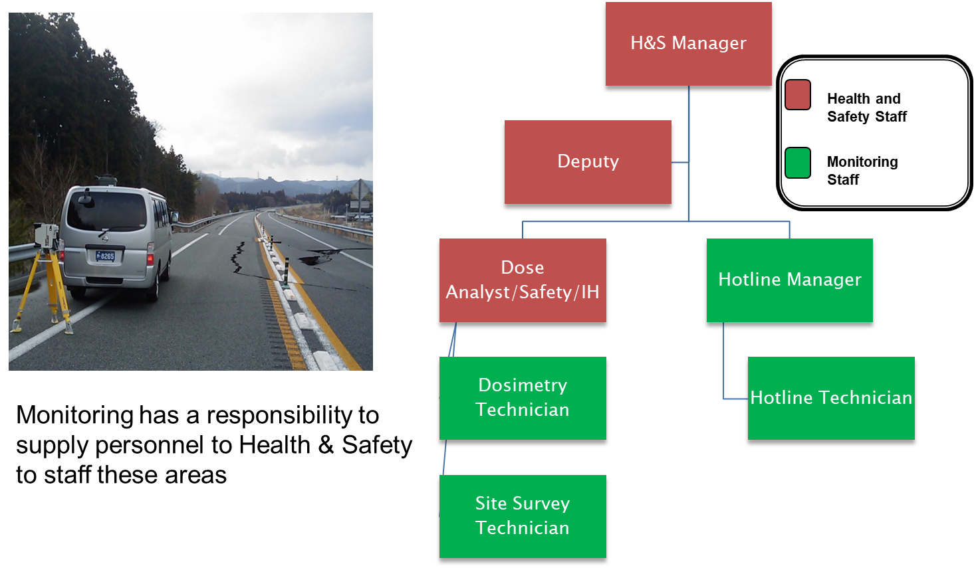
Health and Safety Division
Notes:
The Health and Safety (or H&S) Division is responsible for radiation protection, industrial hygiene, decontamination, waste storage, respiratory equipment, facility surveys, and dosimetry. The division is responsible for the general safety of the workforce, and to coordinate and oversee medical care and treatment of all federal and contractor FRMAC participants.
H&S will use technicians from the Monitoring Division to complete some of their responsibilities.

Slide 16
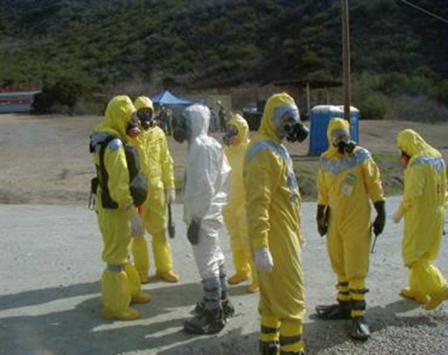
Health & Safety Responsibilities
Complete a Site Health & Safety Plan
Identify:
  Radiological hazards from the event
  Natural environmental hazards
    In the field
    Around the FRMAC
    Other potential dangers
Establishing
  Dosimetry requirements
  Hazard control procedures
  Decontamination/Hot line
Notes:
H&S works with other divisions to ensure worker safety throughout the operation. The division objectives include:
Developing the Health and Safety plan
Identifying and evaluating possible hazards including radiological hazards, natural environmental hazards in the field and around the FRMAC, and other potential dangers.
Establishing dosimetry requirements, hazard control procedures, and decontamination and hot line operations

Slide 17
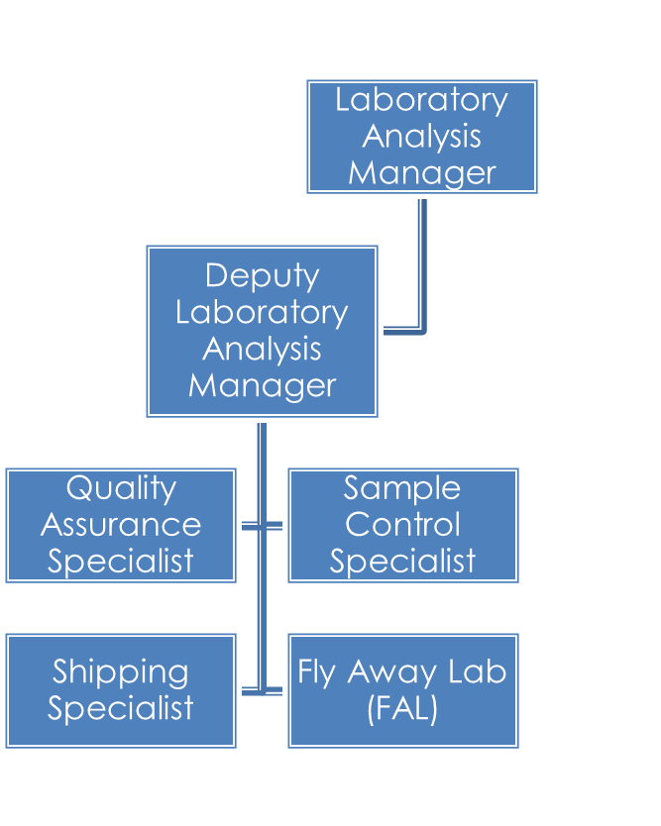
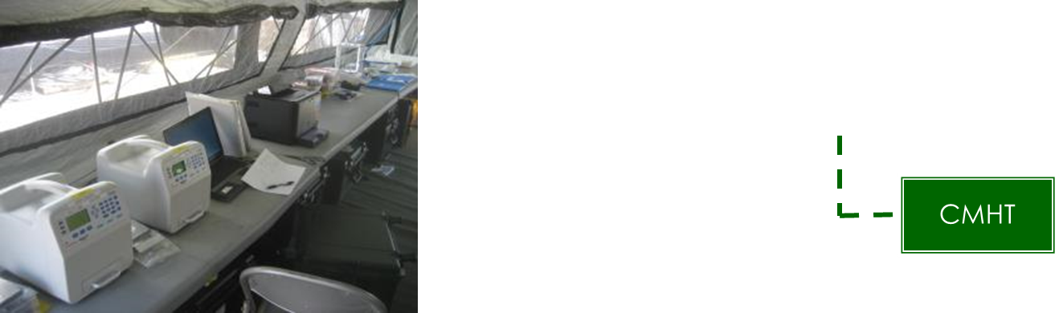
Laboratory Analysis Division
Notes:
The Laboratory Analysis Division is responsible for managing FRMAC laboratory operations, manning field deployable laboratory facilities (known as the Fly Away Lab or FAL), handling sample receipt, assisting with sample shipping, tracking samples throughout the process, and interpretation of sample results.

Slide 18
Laboratory Analysis Responsibilities
Sample Receipt and Control
Staffing the Fly Away Laboratory
Coordinate with on-site and off-site labs to determine where the sample will be analyzed
Prepare samples for shipment
Review and interpret sample results
Notes:
Laboratory Analysis Division plays an important role in ensuring that all samples are processed in an accurate and timely manner, and that the chain-of-custody process is properly executed. Each sample has a distinct purpose, and this purpose governs the entire process, from collection to analysis.
FRMAC managers will determine the type of samples to be collected to meet objectives. Then, the samples are collected, delivered to the hotline, processed, and stored. The Laboratory Analysis Division will coordinate with on-site and off-site labs to determine where the sample will be analyzed. The sample is prepared and shipped to the designated laboratory. Sample results are reviewed. The results are recorded in the database and if necessary, a summary of the results is provided.

Slide 19
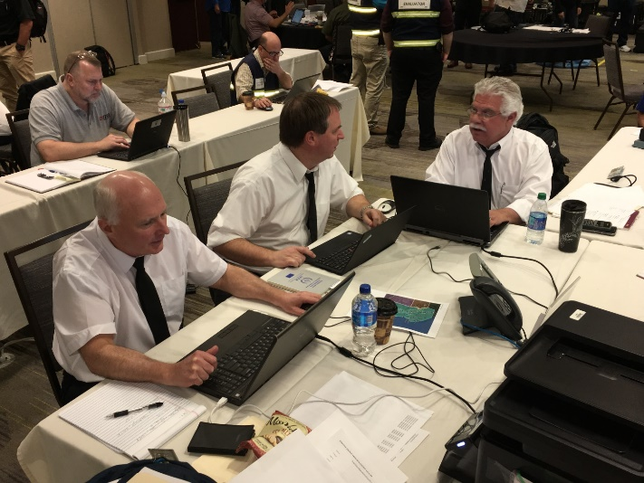
Assessment Division
Assessment Manager
Product Scientists
Assessment Scientists
GIS Specialists
Notes:
The Assessment division group is in charge of responding to the requests for information and oversees FRMAC’s process to answer questions. The Assessment Manager oversees scientists and specialists. Product Scientists work with Geographical Information Systems (GIS) specialists and oversee making data products.

Slide 20
Assessment Division Responsibilities
Respond to requests for information
Perform various dose assessment calculations including:
  Projected doses to the public and workers
  Derived Response Levels for protective action guidelines
  Calculate worker stay times
  Ingestion calculations
Participate in FRMAC mission planning to ensure samples and measurements will aid in addressing objectives
Review FRMAC data for quality
Work with NARAC to update models and validate results
Generate data products (maps, reports, etc.) to satisfy request for information
Post and share data products with applicable decision makers
Brief data products as necessary
Notes:
The Assessment division group is in charge of responding to the requests for information and oversees FRMAC’s process to answer questions. The Assessment Division’s main role is to perform dose assessment calculations and translate the answers into easily understood information for decision makers. Assessment scientists will review and analyze modeling and field team data to produce data products (or reports) for decision makers. The Assessment Division also consists of Geographic Information Systems (GIS) specialists and product scientists which help create mapping products.

Slide 21
Liaisons
FRMAC would like to have a liaison at each affected Emergency Operations Center (EOC).
Typical liaison duties include:
Coordinate EOC requests to the FRMAC
Relay contact information, status, and information from both entities
Coordinate a data sharing strategy to effectively share data between the two organizations
Brief FRMAC data products to the EOC
Notes:
There may be FRMAC liaisons at multiple locations. Chances are that multiple EOCs will request the same or very similar products from the FRMAC. To assist in coordinating requests, there is a FRMAC Liaison Coordinator either located at the Consequence Management Home Team or in the field.

Slide 22
Monitoring Divisions
Notes:
The last FRMAC division we will discuss is the Monitoring Division.

Slide 23
Monitoring Organization Charts
Monitoring Manager
Deputy Monitoring Manager
Field Team Supervisor
AMS Mission Manager
Field Monitoring Specialist
Specialists (In-Situ, ECAM)
AMS Scientists and Technicians
Rotary and Fixed Wing Crews
Monitoring Staff
AMS Staff
Notes:
Monitoring Manager and Deputy Roles: Manage operations for the division, Attend/participate in planning meetings, Help create Execution and Implementation Plans, Complete field team instructions (ICS-204FRMAC), Brief AMS Missions Managers and Field Team Supervisors on objectives and expectations, Review field team data, Relay information up the command chain.
Field Team Supervisor Roles: Assist in deployment activities, Assist with palletizing deployment equipment, Compose field teams, Establish communications with field teams, Ensure necessary equipment is available, Brief the field team instructions daily, Reroute or change task of field team during shift, Review field team data.
Field Monitoring Specialist Roles: Instrument QA/QC before deployment, Ensure tablets and MPCDs are ready, Follow field team instructions, Collects/Records measurements and samples, Communicate status to Field Team Supervisor, Help less experienced field team members and/or specialty field teams.
Aerial Measuring System (AMS) Mission Manager/Scientist: Coordinate flights/ ensure safety of assigned personnel, Brief AMS staff on objectives, Communicate flight details and situational awareness to the Monitoring Manager, Assist the Monitoring Manager with mission planning, AMS data product creation/review.
There may be more than one Deputy Monitoring Manager, Field Team Supervisor, or Aerial Measuring System (AMS) Mission Manager. Field Monitoring Specialists will be scaled in number as necessary and will include employees from other government agencies. It is possible for a Field Team Supervisor to be stationed at a forward monitoring post (which is not located at the FRMAC location).

Slide 24


FRMAC Team Integration
Integrate Team Members from each Agency
  DOE
  EPA
  State
  CST
Balance Knowledge Level, Training, Experience across all of the teams to ensure similar capabilities
Notes:
DOE = Department of Energy
EPA = Environmental Protection Agency
State = state or local responders
CST = Civilian Support Team (Department of Defense)
Because FRMAC encompasses many different government agencies, field teams will be integrated to balance experience. It is preferable for each FRMAC field team to have a state/local representative as they are familiar with the area. Differences in team abilities, safety guidelines, and data recording will be worked out prior to departing for field activities.

Slide 25
Role of the Monitoring Division
This division is responsible for performing radiological monitoring and sampling operations.
The Monitoring and Sampling Division within the FRMAC/CMRT performs operations in accordance with two manuals:
  FRMAC Monitoring and Sampling Manual, Volume 1
  FRMAC Monitoring and Sampling Manual, Volume 2
https://www.nnss.gov/pages/programs/FRMAC/FRMAC_DocumentsManuals.html
Notes:
The full FRMAC/CMRT division name is the “Monitoring and Sampling Division.” It is also referred to as the “Monitoring Division” or “M&S Division.” The Monitoring Division uses 2 manuals to guide its operations. Volume I is about Monitoring Division Operations. This high level document outlines operations for the division and common strategies to respond to an event. Volume 2 contains more of the technical side for the Monitoring Division. Volume 2 documents the process FRMAC uses to collect measurements and samples and contains operator aids and common field forms.

Slide 26
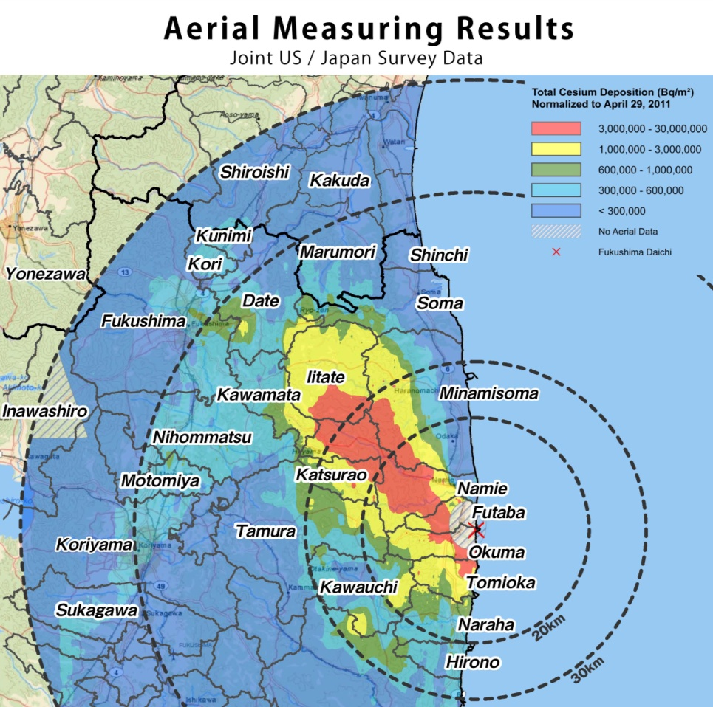
Role of the Monitoring Division
The FRMAC Monitoring Division is primarily responsible for the coordination and direction of:
Aerial measurements to delineate the footprint of radioactive contaminants after they have been released into the environment.
Monitoring radiation levels in the environment.
Notes:
Aerial measurements are performed by the Aerial Measuring System (AMS) asset. AMS joins the Monitoring Division when a FRMAC is established. More information on AMS will be presented later in the presentation.

Slide 27
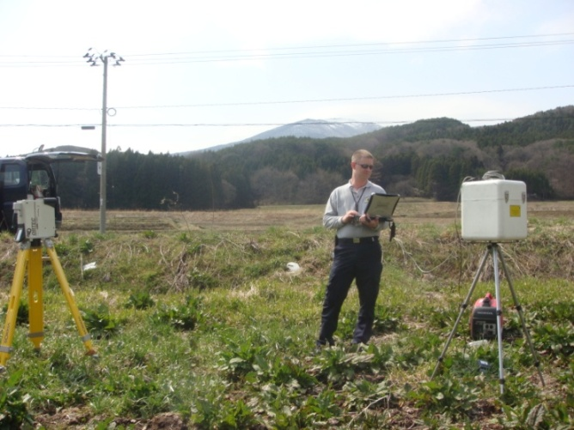
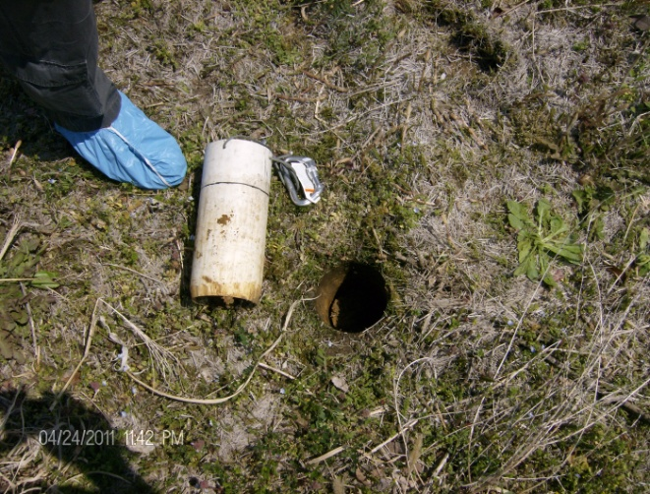
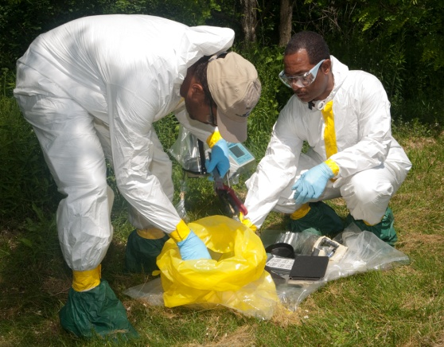
Role of the Monitoring Division
The FRMAC Monitoring Division is primarily responsible for the coordination and direction of:
Sampling to determine the extent of contaminant deposition in soil, water, air, and vegetation.
Preliminary field analyses to quantify soil concentrations or depositions.
Notes:
Monitoring and sampling techniques used during FRMAC operations are specifically selected for use during radiological emergencies where large numbers of measurements and samples must be acquired, analyzed, and interpreted in the shortest amount of time possible. In addition, techniques and procedures are flexible so that they can be used during a variety of different scenarios

Slide 28
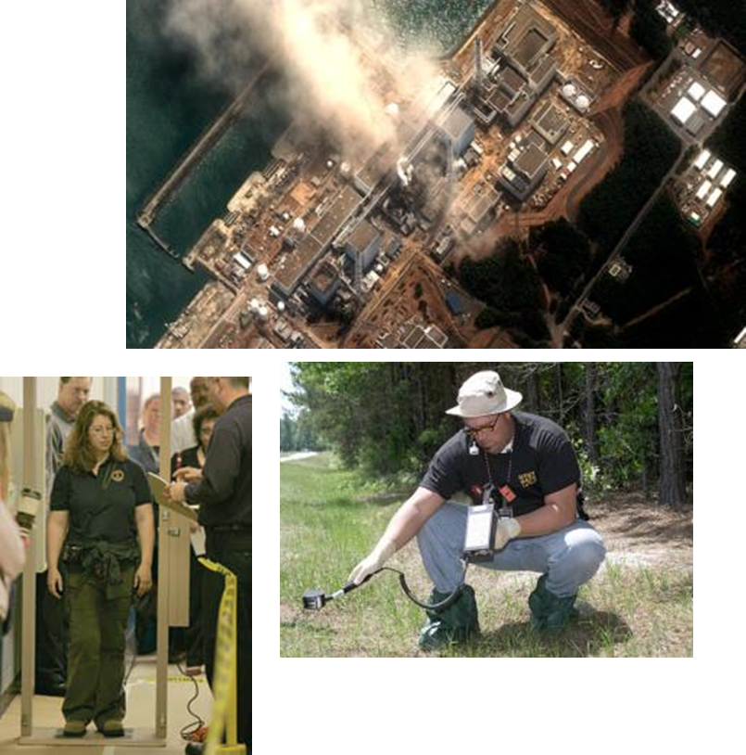
Early Phase
Monitoring and Sampling Examples
Ground Deposition
  Exposure rate
  Contamination
  In situ
  Ground deposition sample
Public Support
  Infrastructure
  Evacuation / reentry
Air Samples
  Worker protection
  Plume tracking
  Resuspension
Soil Samples
Notes:
The Monitoring Division will collect radiological data to fulfill its roles and responsibilities. The type of measurements and samples will evolve during each phase of the response as certain samples and measurements become more beneficial to answering questions.
After the release has stopped and the plume has passed, surveys will shift to learning where material has been deposited. Monitoring will work to ascertain the extent of the contamination which is valuable information for local authorities as they work to restore critical infrastructure such as communications, water and/or power.
In concert with instrument surveys, the division will be collecting environmental samples, such as air and soil. These initial samples will be used to determine the isotopic mix of the release and provide responders and decision makers with vital data to determine public protective actions.

Slide 29
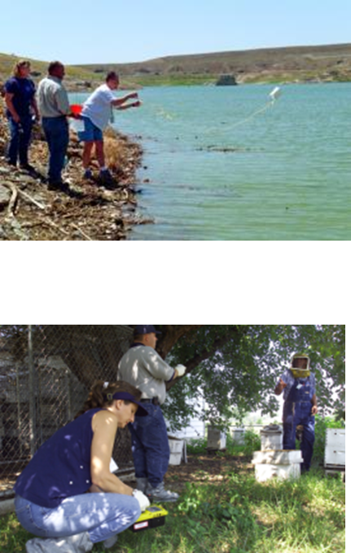
Intermediate & Late Phase Monitoring and Sampling Examples
Air
  Re-suspension
Soil
  Migration
  Defining protective areas
Water
  Drinking - Ingestion Pathways
Milk, Vegetation & Other
  Crops - Ingestion Pathways
  Animal - Stored Feed
  Milk - Ingestion Pathways
Notes:
As the event progresses, Monitoring will shift their focus from instrument measurements to collecting environmental samples.
There are a variety of pathways that pose a threat to the public, and samples from air, soil, water, milk and vegetation will be collected to address these concerns.

Slide 30
Role of the Monitoring Division
When Monitoring Division team members are selected for tasks, some will be assigned to support the Health and Safety (H&S) Division. The Monitoring Division provides technicians to support specific H&S Division activities, including the following:
  Operation of the hotline
  Facility surveys
  Assistance with H&S functions at checkpoints
  Assistance at population assembly areas which require support from the FRMAC
  Dosimetry
Notes:
Field Monitoring Specialists with experience in contamination control will be used by H&S.

Slide 31
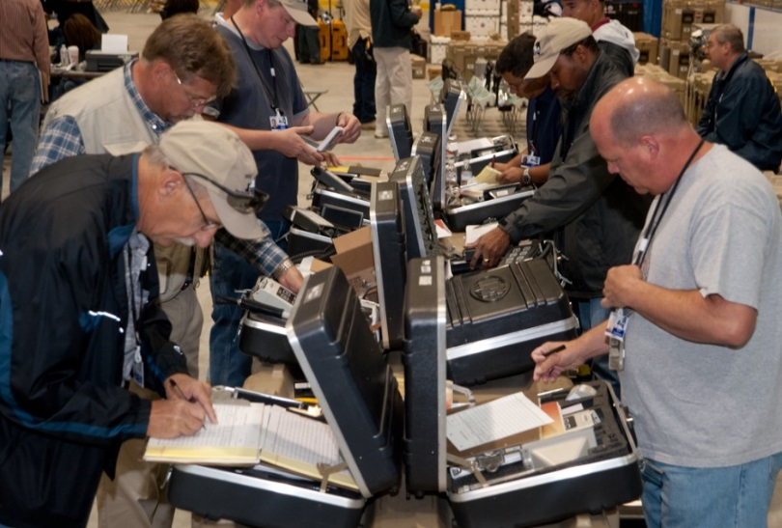

On The Job Training
FRMAC will conduct “On The Job” Training to help unify the Teams Members
Ensure all of the teams are using the same procedures
FRMAC monitoring and sampling “Operator Aids” can be practiced before departure
https://www.nnss.gov/pages/programs/FRMAC/FRMAC_DocumentsManuals.html
Notes:
Collecting measurements and samples in a consistent manner is an important part of performing field work. For this reason, On-the-Job training is performed to ensure that all participating team members from all the various agencies collect samples and measurements in a consistent manner. FRMAC provides “Operator Aids” to help unify the collection methods from the various responding agencies. The FRMAC “Operator Aids” can be found on the FRMAC website: https://www.nnss.gov/pages/programs/FRMAC/FRMAC_DocumentsManuals.html. Operator Aids can be tailored as needed to meet data quality objectives.

Slide 32
Assets During a Radiological Response

Slide 33
Assets During a Radiological Response
RAP
CMHT
AMS
CMRT
FRMAC

Slide 34
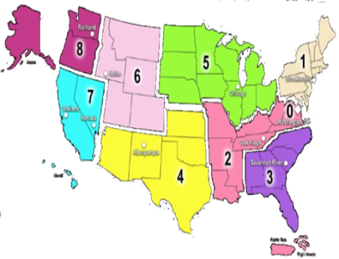
Radiological Assistance Program (RAP) Deployment
RAP is geographically regionalized
to support rapid deployment in
emergencies
  9 Regions located throughout the USA
Mobilized and ready to deploy
  within two hours of notification during normal working hours
  within four hours of notification during off hours
Arrival upon incident scene will be determined
by distance and mode of transportation
  Access to ground and air transportation
Notes:
NOTE: If RAP is present Let them supply their own slides or talk about capabilities
RAP is regionalized into 9 different regions to support rapid deployment to an incident site. These nine regions are centered around existing DOE/NNSA laboratory or sites. For example, RAP Region 7 is support by the Lawrence Livermore National Laboratory. RAP Region 3 is support by the Savannah River Site.
Upon notification, RAP will be ready to deploy within two hours during normal duty hours, and within 4 hours during off hours. Arrival upon incident site will be largely determined by distance the team will have to travel. RAP has access to both ground and air transportation. Air transportation normally takes the form of charter aviation that can be ready to be wheels up within the required deployment timeframes.

Slide 35
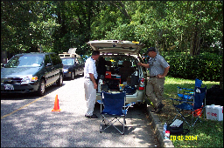
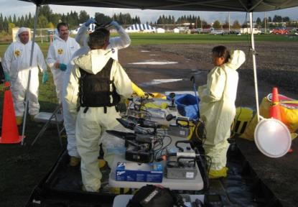
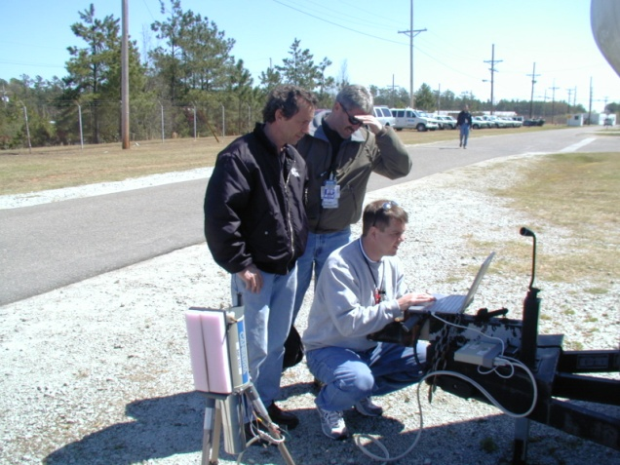
RAP Personnel and Composition
Volunteers from the DOE/NNSA complex
“Standard” RAP Team composition
  (1) Federal Team Leader (FTL)
  A mission dependent mix of up to 7 Health Physics Support Personnel (HPSPs) & Team Scientists
RAP team configuration and load-out is tailored to response requirements and organizational needs
Notes:
RAP is primarily made up of volunteers from the various DOE/NNSA labs and sites. That means that most of the personnel are not full time emergency responders. They take on RAP as an extra responsibility. During their normal day jobs, they are radiation protection workers and scientists. RAP responders are people who work with radiation every day. RAP volunteers are given specialized training to ensure that they have the skills and knowledge to support the RAP missions (like search activities and consequence management).
Each RAP region has a minimum of 3 teams. They consist of trained employees from DOE and DOE contractors/facilities. A standard team consists of 9 members; one Team Leader, one Public Information Officer, one Team Captain, one Senior Scientist, and five Health Physics Survey/Support personnel. Additional personnel are available, such as industrial hygienists, transportation specialists, logistics support, etc. Although a standard team consists of 9 members, the RAP response will be tailored to the individual incident. RAP is very flexible; a deployment may only involve two team members or may involve multiple teams.
RAP has expertise in radiological assessment, area monitoring, air sampling, and exposure and contamination control. RAP's capabilities and resources include portable field radiation and contamination monitoring instrumentation (alpha, beta, gamma, and neutron), air sampling equipment, portable gamma spectroscopy systems, decontamination supplies, communications equipment, and personal protective gear.
As the situation demands, RAP teams can also be augmented with specialized expertise, including industrial hygienists, packaging and transportation personnel, advisory scientists (etc.) Specific augmentation would be dependent on the event.

Slide 36
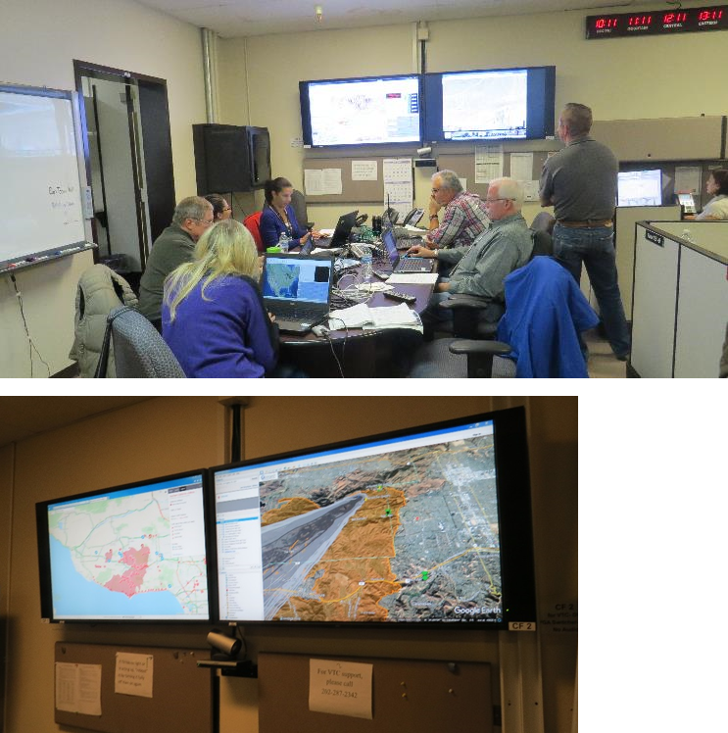
Consequence Management Home Team (CMHT)
Scientific Support
  Atmospheric Modeling
  Assessment Scientists
  Health & Safety
  Aerial Measurements
  Laboratory Methods
Advisory Team (Remote A-Team)
Communications Support
  Bridge Lines & Coordinators
  Data Management
Product Support
  GIS Specialists
  Product development and interpretation
Logistics Support
  Personnel
  Field Samples & Off-Site Laboratory support
Notes:
Consequence Management Home Team (CMHT)
Overview:
CMHT assists other NNSA field assets in the support of federal, state, tribal, and local response organizations with modeling, radiological operations planning, field monitoring techniques, and the analysis, interpretation and distribution of radiological data. CMHT folds into FRMAC operations.
What they provide:
Conference line to coordinate communications
Technical guidance
Data and GIS map products that give meaning to the current and projected radiological conditions
Atmospheric plume and deposition modeling via the National Atmospheric Release Advisory Center (NARAC)
Event status, logistics, and contact information to authorized personnel
Rough number of responders:
CMHT can be scaled to the response. There can be as few as two or three team members and, in a large response, up to 50 or more (with support from across the country).
When they get there:
CMHT is a remote response asset. They are available in the first hours of the response.
How they fit into the BIG picture:
CMHT supports all of the various components of the response. This includes headquarters, the FRMAC responders in the field, all of the other federal agencies, and the state and locals, among others. They provide access to data and create products. They also provide a central bridge line for coordinating communications with responders that may be in many locations.
Where to find more information:
https://www.nnss.gov/pages/programs/FRMAC/ERAssets.html
https://www.nnss.gov/docs/docs_FRMAC/CMHT%20Brochure-sm.pdf

Slide 37
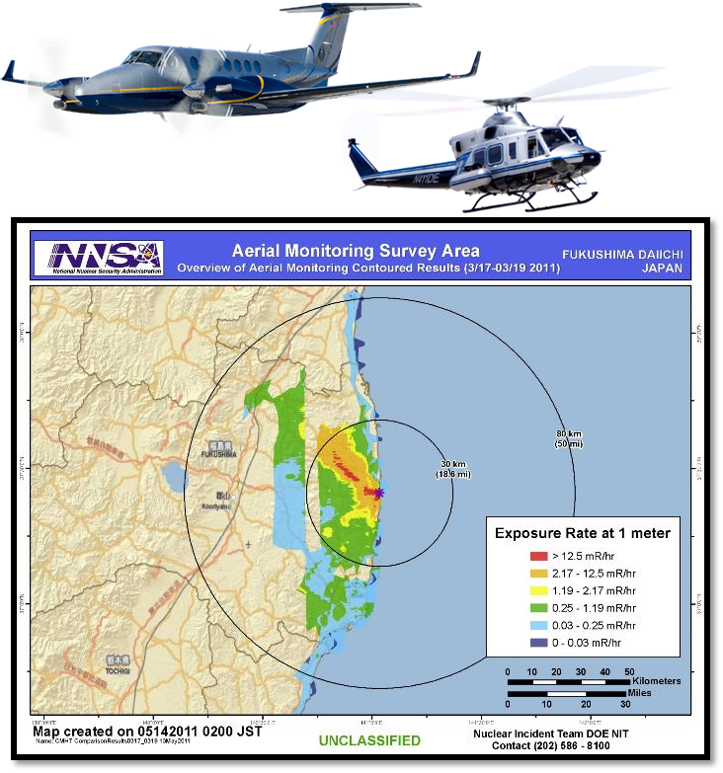
Aerial Measuring Systems (AMS)
Fixed-wing Aircraft
  Rapid response aircraft
  Large Area surveys
Helicopters
  Detailed area surveys
Data collected can be used to:
  Rapidly develop maps of potential radiation exposure to personnel in affected areas
  Develop maps of the radiological materials deposited on the ground
  Provide information to NARAC to improve the models for the release
Notes:
AMS is part of the Monitoring Division when CMRT/FRMAC is activated. As such, AMS Mission Managers receive objectives and directions from the Monitoring Manager. Typically, AMS would be part of the Air Operations Group (if established) within the ICS command structure.
Overview:
AMS provides specialized airborne radiation detection systems to provide real-time measurements of low levels of air and ground contamination.
What they provide:
The fixed-wing aircraft is deployed with the radiation detection system to collect information and determine the location of ground contamination.
The helicopters are used to perform detailed surveys of ground contamination.
Scientists are then able to rapidly develop maps of the radiological materials deposited on the ground and the potential radiation exposure to personnel in the affected areas.
Rough number of responders:
As few as three responders and up to approximately twenty.
When they get there:
The fixed wing aircraft could be onsite during the first day, and the rotary wing would follow (potentially could arrive on day two).
How they fit into the BIG picture:
AMS folds into FRMAC operations.
Where to find more information:
https://www.energy.gov/nnsa/aerial-measuring-system-ams

Slide 38

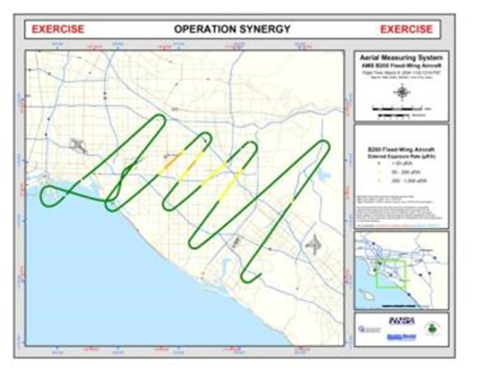
Aerial Measuring System Missions - OCR
On-Call Response (OCR) Phase
Large Area (>25 mi²)
  Altitude: 500-1,000 feet
  Spacing: 1-5 miles
  Speed: 140 knots
  Fixed-wing Aircraft
Beechcraft King Air B-350ER (deploying)
  300 knots (345 mph)
  Range 1878 nautical miles
  Max Endurance: 10 hours without refueling
Notes:
The Aerial Measuring System is the NNSA aerial asset that deploys aircraft with radiation detectors to an incident location. The AMS has two primary missions: On-Call Response (OCR) and Radiological Mapping (RM)
On-Call Response (OCR) uses a fixed-wing aircraft to rapidly deploy to an event location. The sensor system is designed to detect high radiation levels in affected areas where the natural background radiation can essentially be ignored. The results of these flights can be used by decision makers dealing with evacuation and shelter-in-place issues.

Slide 39

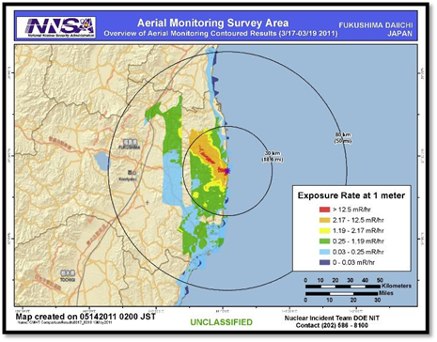
Aerial Measuring System Missions – RM
Radiological Mapping (RM) Phase
Rapid Overview – Emergency Response
  Altitude: 500 feet
  Spacing: 0.5 mile
  Speed: 80 knots
  Helicopter
Small Area (<25 mi²) – Detailed Survey
  Altitude: 50-300 feet
  Line Spacing: 100-500 feet
  Speed: 70 knots
Bell-412 (deploying)
120 knots (140 mph)
Range 360 nautical miles
Notes:
AMS fixed wing aircraft is deployed initially to perform surveys. Fixed wings perform large area surveys. Helicopters can fly at a lower altitude and at a slower speed to perform a more comprehensive survey of a particular area. The AMS Mission Manager works with the FRMAC Monitoring Manager to coordinate flights to collect data that will meet Incident Command’s objectives.
Radiological Mapping (RM) uses a helicopter to fly lower and slower than the fixed-wing to obtain precise radiation measurements. The detection system is much more sensitive than that of the OCR mission, and can discern radiation levels that are closer to the natural background (lower activity areas). The information acquired can be used to assess crop ingestion issues and to characterize the affected area for future remediation.

Slide 40

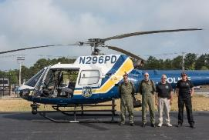
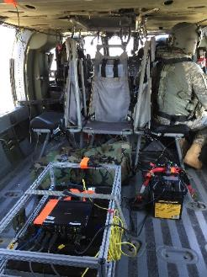
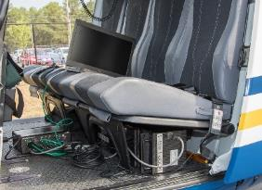
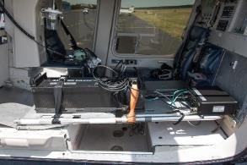



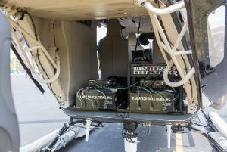
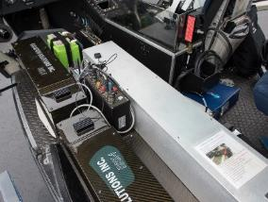
Examples Of Systems on
Law Enforcement Aircraft
Notes:
Some states/locals have an aerial measuring capability. If needed, AMS has the capability to analyze data collected by other agencies. Also, AMS has the capability to put their detectors in other platforms, if needed.

Slide 41
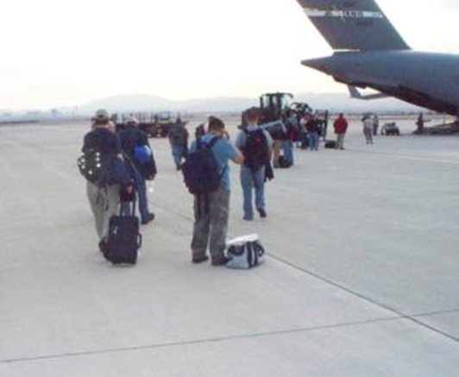
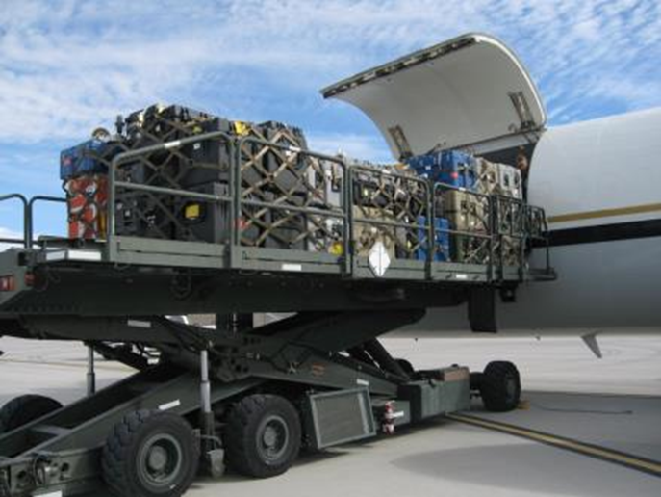
Consequence Management Response Team (CMRT)
CMRT is a fairly large asset and is on duty every day 24/7
CMRT has the same organizational structure as the FRMAC
Consider CMRT as the foundation of the FRMAC
Notes:
CMRT is a fairly large asset and is on recall 24/7/365 with a goal of being ready to deploy within 4 hours of request. More personnel and equipment will be supplied as needed. The first plane transport of CMRT is a 60+ person team with 10,000+ pounds of equipment.

Slide 42
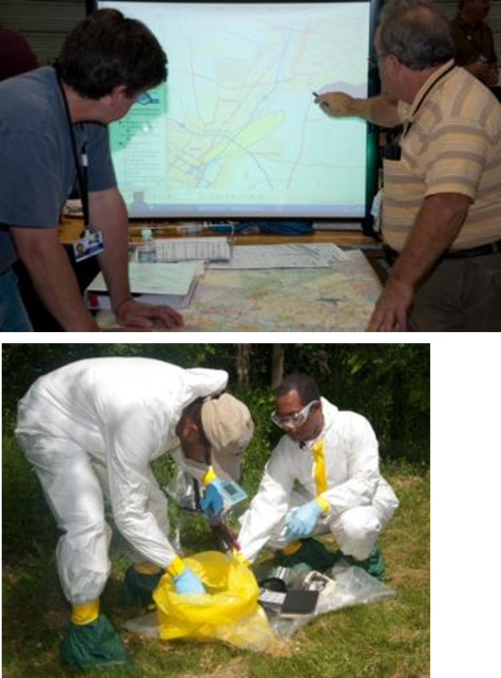
Consequence Management Response Team (CMRT)
Team includes:
  Federal Managers - Senior Energy Officials
  Field Management Team
  Monitoring & Sampling personnel
  Assessment Scientists
  Health & Safety scientists
  GIS
  Logistics Specialists
  Liaison officers
The mission of CMRT is the collection and assessment of radiological data in the environment.
Notes:
The CMRT has the capacity to support early phase operations, including federal management, radiation monitoring, sampling, analysis, assessment, health and safety, and support and logistics functions. The CMRT can effectively manage and support five field teams. The CMRT maintains close contact with CMHT and AMS to ensure a coordinated effort in accomplishing goals with DOE/NNSA assets.

Slide 43
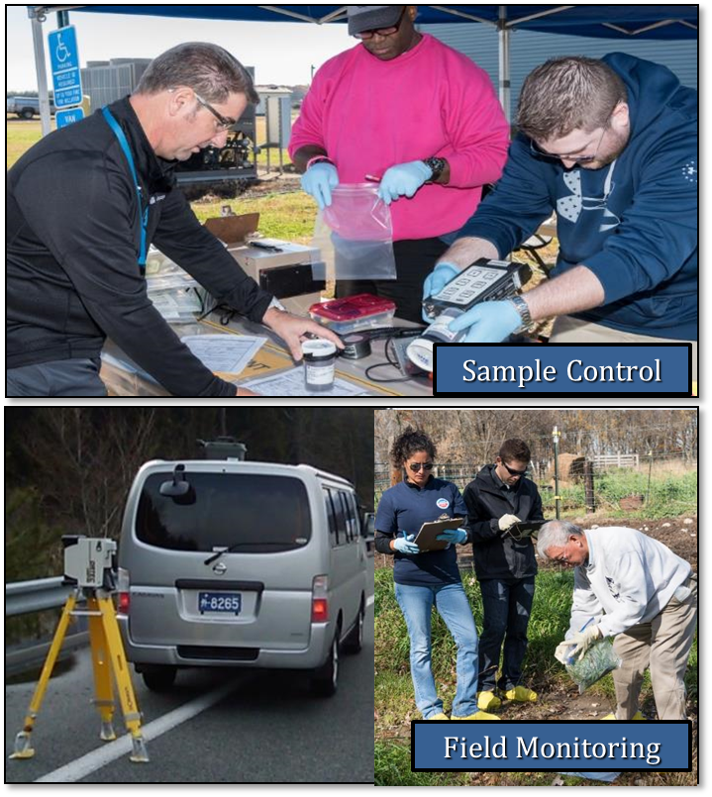
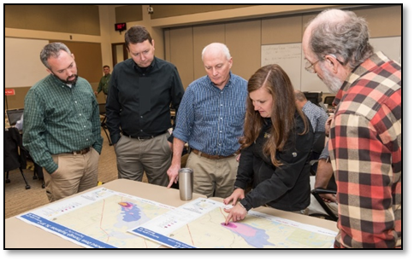

Consequence Management Response Team (CMRT)
Assessment scientists to support data evaluation and visualization and support public & responder safety calculations
Geographical Information Systems (GIS) equipment and personnel for creating map products to visualize data and potential extents
Health & Safety specialists to support responders
Field teams to assist with data and sample collection
Contamination control and Health & Safety personnel to support field team activities
Sample control personnel to catalog and manage sample collection and analysis
Laboratory analysis personnel and equipment to support field deployable instrumentation (Fly-Away Laboratory)
Logistics support for FRMAC teams
Notes:
Overview:
If the State/locals need more resources to respond to a radiological event, then CMRT may be requested. CMRT is a DOE response team deployed from Las Vegas, NV and is the foundational base for the FRMAC. This team is on call 24/7/365.
What they provide:
CMRT maintains a full complement of field team support and equipment. This team can carry 10,000-20,000 pounds of equipment. More CMRT equipment and personnel may arrive after the first plane as circumstances warrant. Because CMRT is large, and will only grow with the establishment of a FRMAC, there will need to be some logistical issues worked out prior to arrival. Some issues to consider are covered later in the presentation. CMRT organizes its personnel into 5 major divisions: Support, Health & Safety, Laboratory Analysis, Assessment, and Monitoring and Sampling. Personnel serving in the divisions are trained to fulfill the responsibilities of their duty positions. Some high level functions of CMRT:
Collection of radiological measurements and samples
Data assessment
Sample control and analysis
Dose assessment
Visualization products
Responder Health and Safety
Rough number of responders:
Between 50-100 personnel (management team, field team members, GIS, assessment scientists, logistics specialists, and database specialists)
When they get there:
CMRT is able to deploy 4-6 hours after notification. Depending on where the incident occurs, they may arrive within 6-12 hours after notification.
How they fit into the BIG picture:
CMRT is the foundation of a FRMAC. CMRT provides assistance in various capacities to assist in the collection and assessment of data.
Where to find more information:
https://www.nnss.gov/pages/programs/FRMAC/FRMAC.html

Slide 44
How It All Comes Together

Slide 45
How It All Comes Together
States/locals request help from federal agencies
Immediate (<6 hours) assistance is available with home teams and regional response assets. Models are available. Begin data collection.
AMS and other federal assets arrive < 12 hours.
CMRT arrives with other federal agencies to form the FRMAC.
More data is collected.
Data is analyzed and presented to decision makers.
Protective Action Recommendations from applicable roles.
Protective Action Decisions made by states/locals
Notes:
The process of collecting and analyzing data repeats until operations cease.
FRMAC will collect, assess, and evaluate radiological data during the response. In order to reduce bias and maintain independence from decision making, FRMAC will not issue recommendations to state/locals. However, the state/locals are not left alone to make protective action recommendations during a radiological emergency. The Advisory Team for Environment, Food, and Health (commonly referred to as the A-Team or Advisory Team) is a radiological emergency response group tasked with providing protective action recommendations to state and local governments on behalf of its member agencies. The permanent membership includes representatives from the Environmental Protection Agency (EPA), the Food and Drug Administration (FDA), the Centers for Disease Control and Prevention (CDC), and the U.S. Department of Agriculture (USDA).

Slide 46
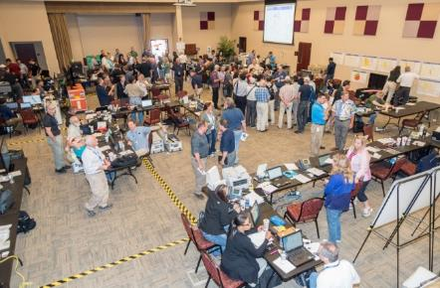


Asset Response Timeline (hours)
6-12
0-6
12 – 24
24 – 48
CMRT
EPA
HRF
Advisory Team
FRMAC Established
AMS
CMAC
REAC/TS
CERFP
Advisory Team- | Advisory Team for Environment, Food, and Health
AMS- | Aerial Measuring Systems
CMHT - | Consequence Management Home Team
CMAC - | Consequence Management Advance Command
CMRT - | Consequence Management Response Team
FRMAC- | Federal Radiological Monitoring and Assessment Center
NARAC - | National Atmospheric Release Advisory Center
REAC/TS - | Radiation Emergency Assistance Center/Training Site
RAP - | Radiological Assistance Program
CERFP - | CBRNE Enhanced Response Force Package
CST - | Civil Support Team
HRF - | Homeland Response Force
State/Local
RAP
CST
CMHT
NARAC
Remote A-Team
REAC/TS
Notes:
This slide depicts a general timeline for when assets are ready to assist. For the assets that respond on location, response timelines may vary due to the event location or weather delays. When multiple government agencies respond and join CMRT, then a FRMAC is established.
Consequence Management Home Team
CMHT is staffed by technical and logistics personnel from DOE. CMHT assists other NNSA field assets in the support of federal, state, tribal, and local response organizations with modeling, radiological operations planning, field monitoring techniques, and the analysis, interpretation and distribution of radiological data. CMHT folds into FRMAC operations.
National Atmospheric Release Advisory Center
NARAC's mission is to provide timely and accurate real-time assessment advisories to emergency managers for rapid decision-making, during an emergency response involving a nuclear or chemical release. The NARAC’s computer-based system provides realistic plots and maps of radiation dose and exposure assessments, and estimates the amount of radiation contaminants released into the environment.
Advisory Team for the Environment, Food, and Health (A-Team)
Combination of federal agencies (FDA, USDA, CDC, EPA) who authored several regulatory and guidance documents and can provide recommendations to the states and locals for their decision making processes. CMHT can reach back to the A-Team to connect responders with additional guidance until the on-site team arrives or in the case there are not enough A-Team staffers to support every operations center involved in a response
Radiation Emergency Assistance Center/Training Site
REAC/TS is an asset located in Oak Ridge, TN who serve as medical advisors during radiological emergencies. REAC/TS members are trained physicians, nurses, and other medical professionals who can provide guidance related to prophylactic medications available to potential victims of contamination and treatment for overly exposed individuals.
Radiological Assistance Program
RAP is a regional response team provided by the DOE. RAP will most likely be the first DOE responders on-scene. In a large radiological event, RAP will fold into CMRT/FRMAC.
Civil Support Teams
CST are National Guard teams who receive specialized training in WMD response. These are state assets which can be called upon to support at the request of a governor. CST can work with FRMAC teams if allowed.
Aerial Measuring Systems
AMS is an asset that provides specialized airborne radiation detection systems to provide real-time measurements of ground deposition and exposure rates.
Consequence Management Advance Command
CMAC is a team composed of CMRT management. This team may be deployed to assist the state/locals with radiological response planning. This team may also deploy earlier than CMRT to prepare for the arrival of CMRT.
CERFP and HRF
Department of Defense support assets which boasts a number of field assets as well as additional command control staffers.
Consequence Management Response Team
CMRT is a DOE response team deployed from Las Vegas, NV and is the foundational base for the FRMAC. This team is on call 24/7/365. They maintain a full complement of field team support and equipment. Between 50-100 personnel (management team, field team members, GIS, assessment scientists, logistics specialists, and database specialists) are deployed within 4-12 hours. This team can carry 10-20 thousand pounds of equipment. More CMRT equipment and personnel may arrive after the first plane as circumstances warrant.
EPA
Environmental Protection Agency – responsible for radiation support as well as other hazards during the event (consider Fukushima: near the plant there were several other large production companies along the coast whose materials were at risk. Chemical and other fuels potentially could have been carried away in flood waters creating additional hazards.)

Slide 47

Coordinated Radiological Emergency Response
Collect data and gather facts.
Use Protective Action
Guidelines (PAGs) and
data to make projections.
FRMAC
RAP, AMS, CMHT, CMRT,
NARAC, etc.
Coordinating Agency
and Advisory Team
State and
Local
Governments
Protective Action Decisions:
Shelter-in-Place
Evacuate
Return
Recovery
Protective Action
Recommendations
(PARs)
Notes:
The Venn diagram shows the relationship of the response to who makes the decisions. Again, FRMAC collects and analyzes data, but does not provide protective action recommendations (PARs) or protective action decisions. PARs are the responsibility of the coordinating agency, Advisory Team, or state/locals. Protective action decisions are made by the states/locals.

Slide 48

Questions?

