Slide 1
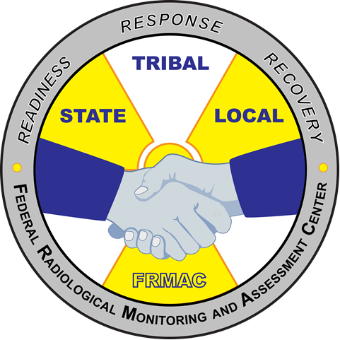
Federal Radiological Monitoring and Assessment Center
Monitoring and Sampling Division Training
U.S. Department of Energy
National Nuclear Security Administration
Nevada National Security Site
MS-50 Module 4
“Technical Field Team Training”
November 2020
Notes:
This course provides states/locals with an overview of FRMAC monitoring and sampling techniques during state outreaches.
There are 4 modules to this course. Module 1 contains a description of the FRMAC and the FRMAC Monitoring Division. Module 2 describes monitoring equipment and techniques. Module 3 describes sampling techniques from some common sample types. Module 4 describes some of the data and documentation needed for monitoring and sampling activities.
There is also a hands-on practical portion that to this course, if desired and weather permitting. The practical can cover basic monitoring techniques for exposure rate or contamination surveys as well sampling techniques for soil and air samples.

Slide 2
MS-50 Module 4 Outline
Data, Forms, and Documentation
  Field Team Instructions
  Recording Field Data
  Documents and References
Notes:
Module 4 is the final module of MS-50. This module will cover common forms and documentation.

Slide 3
Forms
FRMAC will use standard forms for documentation
FRMAC Monitoring and Sampling Manual Volumes I and II both contain forms in appendices.
Volume II contains all the common FRMAC field team forms
Forms can also be found on the FRMAC website:
https://www.nnss.gov/pages/programs/FRMAC/FRMAC_DocumentsManuals.html
As always, feel free to use these forms
Notes:
FRMAC Monitoring Division will use standard forms as documented in the FRMAC manuals. The FRMAC Monitoring and Sampling Manual Volumes I and II both contain forms and operator aids which may be used freely by any agency. Some common monitoring forms and operator aids are available on the FRMAC website as standalone documents.

Slide 4
Field Team Instructions
Notes:
The forms with the most optics are the ones documenting Monitoring Division operations. We will briefly discuss some of the commonly used forms, in particular:
ICS-204FRMAC (documents field team instructions)
Daily Instrument QC Check (documents instrument performance)

Slide 5
Ideal Workflow
Incident Action Plan (IAP)
  From Incident Command
  Provides overall objectives
Execution Plan
  From FRMAC Division Managers
  Determines how to accomplish command objectives
ICS-204FRMAC
  From Monitoring Manager/Deputy
  Instructions for field team to get applicable data to satisfy objectives
IAP
Execution Plan
ICS-204FRMAC
Notes:
When the Incident Command Structure and planning circles are established, then this is the ideal workflow. The FRMAC Monitoring and Sampling Division will use Incident Command System forms to assist with operations and documentation. The Monitoring Manager is involved in the creation of the Execution plan and ICS-204FRMAC forms. The ICS-204FRMAC forms are the field team instructions. A new ICS-204FRMAC form will be generated for each team by the start of the shift. The ICS-204FRMAC forms are written to collect data that will satisfy mission objectives established by Incident Command. The FRMAC Monitoring Division will share completed ICS forms with the applicable command personnel within the Operations Section of the Incident Command System.

Slide 6
ICS-204FRMAC Field Team Instructions
The ICS-204FRMAC has specific details for each field team.
Field teams are expected to follow the instructions on the ICS-204FRMAC. Deviations should be communicated to the Field Team Supervisor.
Notes:
Because the ICS-204FRMAC forms are written to collect data that will satisfy mission objectives established by Incident Command, they should be followed as closely as possible. If deviations are needed, field teams are to communicate with the Field Team Supervisors.

Slide 7
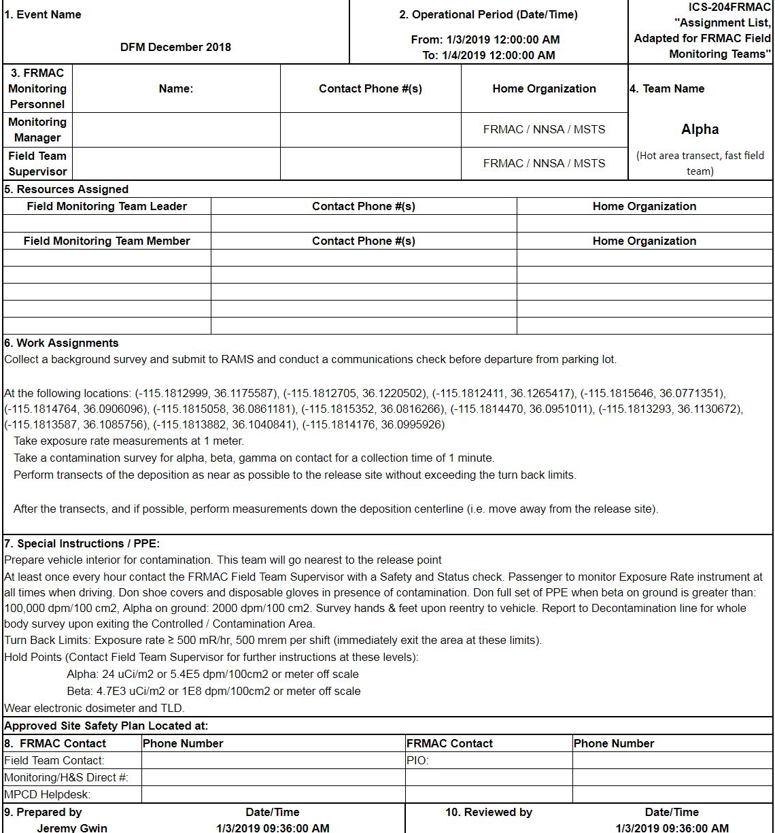
Field Monitoring Team Assignment
Event Name, Operating Shift
Contact Information
Work Assignment
Locations or Survey Spacing
Types of Measurements
Types of Sample to Collect
Example
Special Instructions
Hold Points/Turn back limits
Call back instructions
Notes:
Each FRMAC Field Team will get an ICS-204FRMAC form and a briefing on the content before departure into the field. The ICS-204FRMAC form will contain detailed contact information, locations and requested data, PPE requirements, and turn back levels. Assignments are developed by the FRMAC Monitoring Manager based on ICS objectives and with input from the FRMAC Management Team. Field teams are expected to follow the instructions on the ICS-204FRMAC. Deviations should be communicated to the Field Team Supervisor. ICS-204FRMAC forms are generated and sent to each Field Team using the FRMAC tablets. For those teams without FRMAC tablets, hard copies of the ICS-204FRMAC forms will be available. Those teams without access to the FRMAC tablets will need a device that can direct them to the specific latitude/longitude of the sample locations.

Slide 8
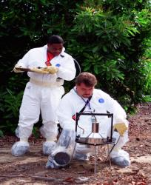
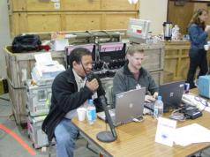

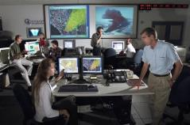
Change in Plans
Communicate with the field teams at regular intervals
Notes:
Sometimes plans do not work out in the field. For this reason, it is important that field teams be able to communicate back to the supervisor. The following items would necessitate a discussion:
Reaching or exceeding Turn-around or hold points
Identifying a safe route away from turn back level
Changing conditions from the release or weather
Reassignment of mission
Changing team assignments in the field is difficult if both sides of the conversation are not using the same maps and instructions. Field Teams utilizing FRMAC tablets will be able to receive updated/revised ICS-204FRMAC forms and available to chat with the Field Team Supervisor or Monitoring Manager.

Slide 9
Recording Field Data
Notes:
Collected data is the most reviewed and scrutinized information during a radiological emergency. For this reason, it is important for the Monitoring Division to accurately collect and record data. We will briefly discuss some of the commonly used methods to capture data, in particular:
Field Monitoring Log
RadResponder
eFRMAC

Slide 10
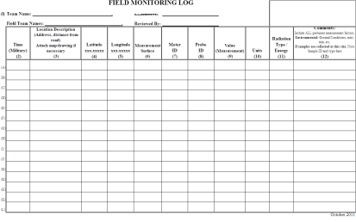

What Makes a Good Record
Collector’s Name
Date & Time
Location (lat/long)
Record measurement data in raw units (what the meter reads)
Contamination levels on a person or equipment
Record other important info such as ground surface, surrounding terrain, etc.
Notes:
Many agencies already have a data collection form or use an electronic data entry software. A good record is one that is complete. Enough information should be provided where the data is clear and can be traced back to a person collecting the data. Recording the raw data in the field reduces the chance of errors. Conversion can be better done automatically via a software program or at a desk back at the Operations Center. Assessment may be asked to reflect data in various ways on map, if a conversion is done in the field there is no way to know that a mistake occurred.

Slide 11
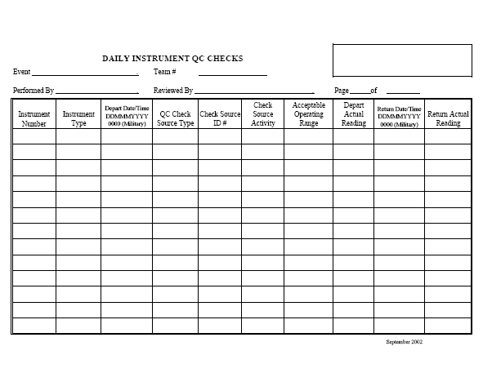
Daily Instrument QC Check
Saving the world
Alpha
Your name here
Field Team Supervisor
2009 AP-100 Th-232 90002 30 nCi 4.2 kcpm optional optional
3.88 – 5.26 kcpm
1.38 – 1.81 mR/hr
2009 BGP-100 Cs-137 55002 8 uCi 1.6 mR/hr optional optional
06DEC2020 0800
Notes:
Before field teams can deploy into the field, each instrument must be checked to see if it is operational. FRMAC deploys with check sources used for daily quality control (QC) checks of each instrument. This form is used to document that QC checks were performed and that the instruments performed as expected. If instruments do not pass the QC check, the instrument is tagged out of service for maintenance/calibration.

Slide 12
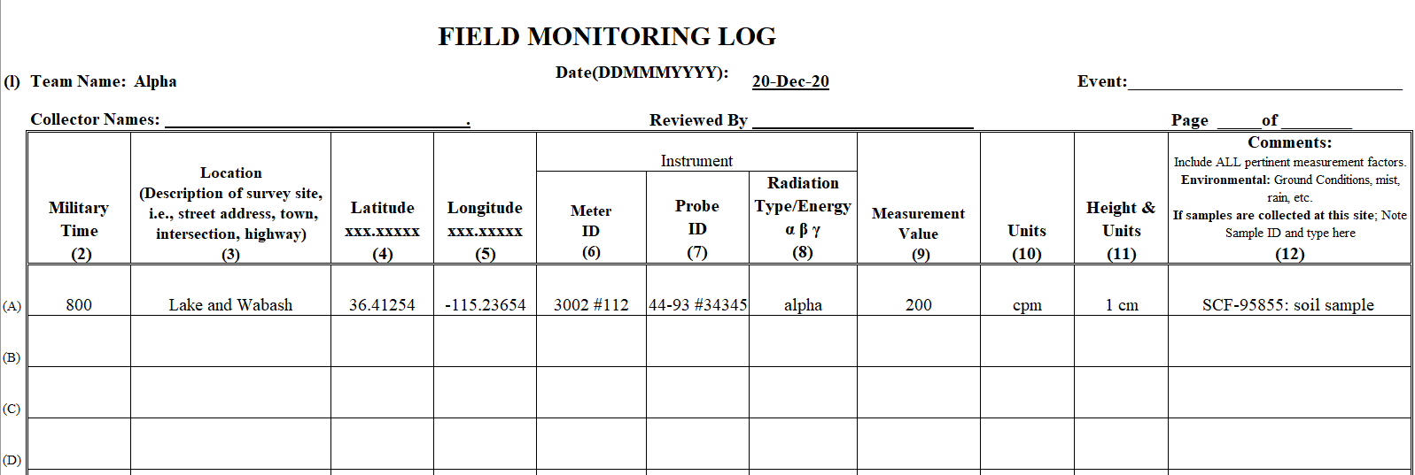
Field Monitoring Log
FRMAC uses the log if electronic collection methods are not available.
Notes:
This form is used by field teams to record data taken in the field if the tablet running DFM (Digital Field Monitor) software or the Rad Responder app is unavailable.
One feature of the log is calling in the data by the numbers, you will notice that the columns are all numbered, that way we can call in the reading using the number column to identify what we are relaying.

Slide 13
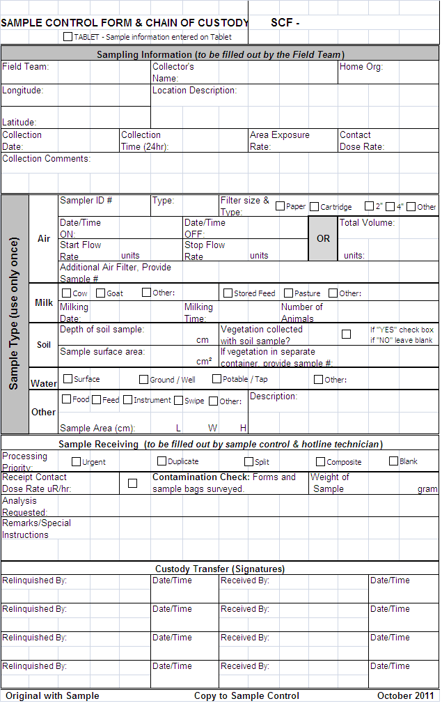
Sample Control Form and Chain of Custody
Example
Unique Sample Control Number – for each sample
Team identification information
Location and collection time information as recorded with Radiological reading
Detailed Sample Matrix information sample type, volume, etc. Use only one form per sample media.
Example
Signed Custody Transfer
Notes:
The Sample Control Form is a hardcopy used by field teams. The Sample Control Form could also contain the chain of custody (or the chain of custody could be a separate form). One Sample Control Form is used for each sample collected. This form is completed in the field, transferred with the sample at sample receipt, and then signed over to the Sample Control personnel.
Minimum Information Required
SCF Barcode #
Collection Team ID
Sample Type
Collection Date & Time
The hard copy of the form should be completed for each sample even if the team collects sample information electronically. The paperwork will be transferred with the sample up until the sample is analyzed at the laboratory.

Slide 14
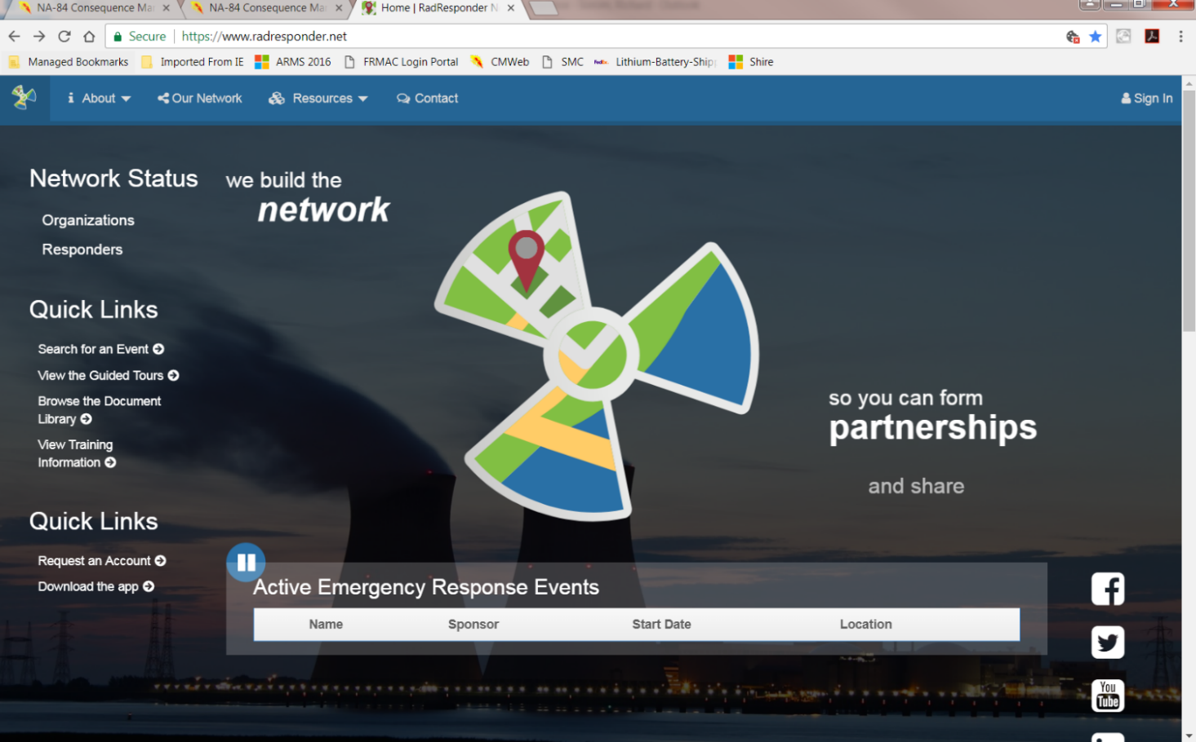
RadResponder Network
FEMA Funded Database for All Emergency Responders
Access RadResponder Network
https://www.radresponder.net/
Notes:
RadResponder is an electronic data collection system based on collaboration between Federal Emergency Management Agency (FEMA), Department of Energy (DOE) / National Nuclear Security Administration (NNSA), and the Environmental Protection Agency (EPA), and is provided free of charge to all Federal, state, local, tribal, and territorial response organizations. There is a website and also an app for iOS, Android, and Microsoft devices. Properly recording data in RadResponder will provide enough information for data analysts.

Slide 15
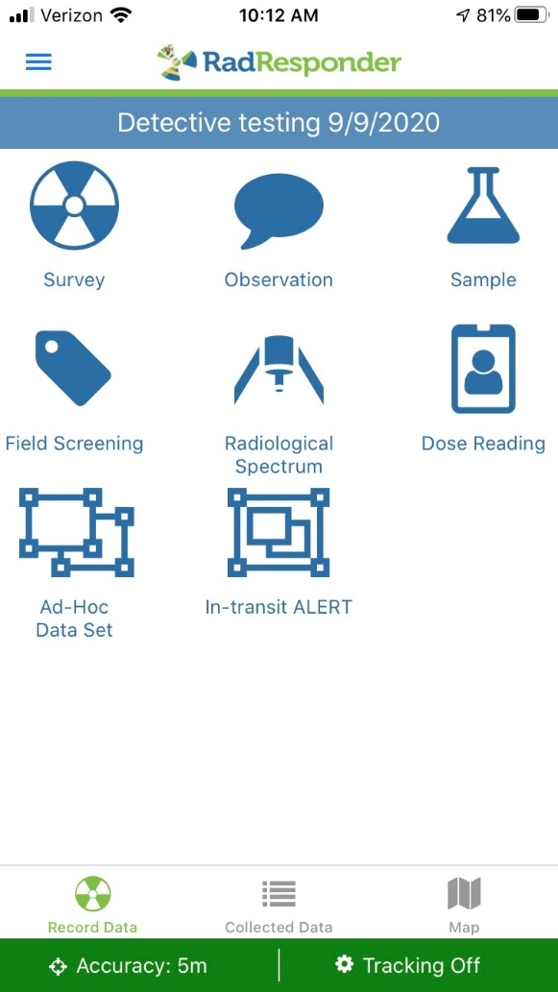
RadResponder App
Available to download on any Smart Phone or Tablet.
The app is loaded on the FRMAC tablets.
Record measurements and samples electronically.
Notes:
The RadResponder app was created for field teams to collect data. Field teams can also be tracked via their device (if permission is granted). The app is a limited subset of the website’s capabilities. The RadResponder app is on the FRMAC tablets and available for any team to use. It is encouraged that field team members have a RadResponder account and know their login information.

Slide 16
electronic FRMAC (eFRMAC)
Replaced DOE paper-based records
  Data storage
  Instrument information
  Basic unit conversion analysis
Radiological Assessment and Monitoring System (RAMS) is the DOE database
Purpose - Move Data Faster
  Faster data assimilation via telemetry
  Broader collaboration via virtual community
  Quicker & wider dissemination via Internet
Notes:
eFRMAC can be viewed as a group of responders within FRMAC Support Division who are responsible for all things computer related (servers, databases, software, hardware, and communications) or as a term representing all the tools created by eFRMAC personnel. eFRMAC was developed many years ago to assist FRMAC responders with the means to collect data electronically, store that data within a field database that would communicate with a server, and enable FRMAC to access data wherever they were located. RAMS is the name of the database. The direction given to FRMAC was to make preparations to retire the RAMS database and to use the RadResponder database.

Slide 17
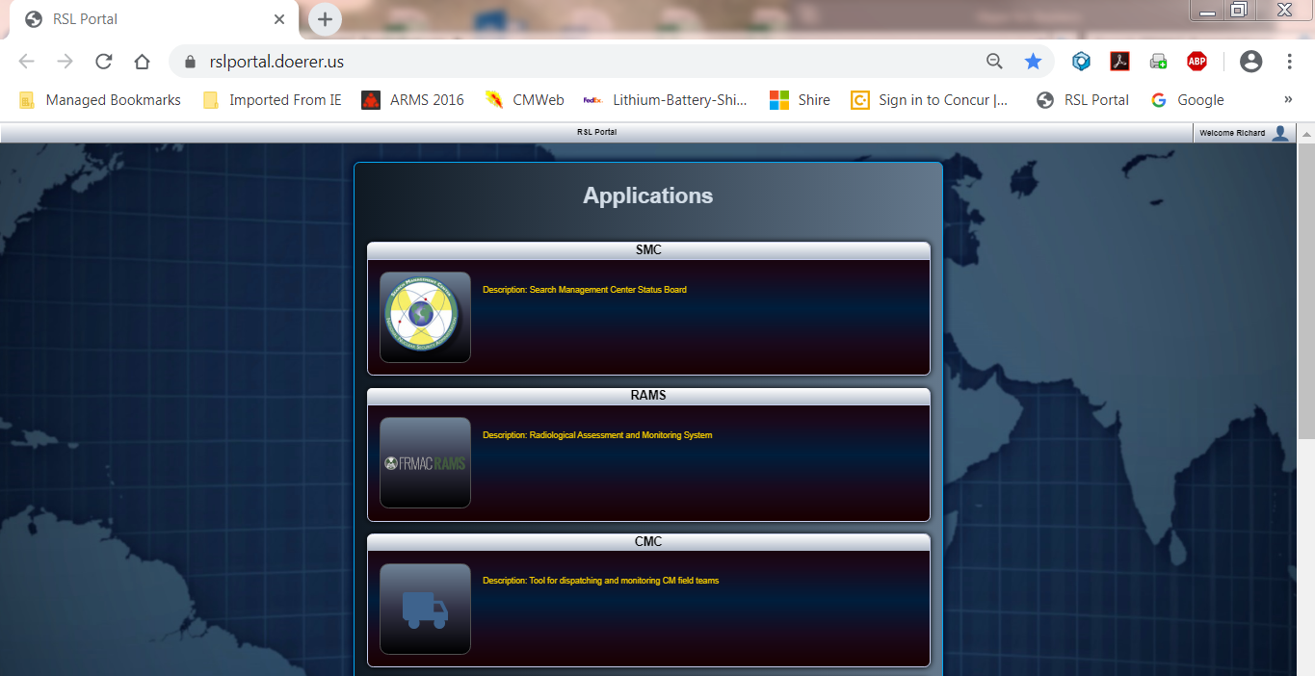
RAMS
Access RAMS site at : https://rslportal.doerer.us/
RAMS is located on the RSL Portal.
Requires a login to access (accessible by DOE responders)
Notes:
RAMS has been the historical database for the FRMAC. Before RadResponder, there was RAMS. There are plans for FRMAC to use RadResponder as the data repository and to retire the RAMS database. The DOE led transition effort is expected to begin during 2021-2022. After a decade (or more) of using the RAMS database, CMRT had built many software tools that interacted with it. CMRT’s main objective is to transition CMRT’s current tools linked to RAMS and allow for the same functionality in RadResponder. When the objective is complete, the RAMS database will be retired.

Slide 18
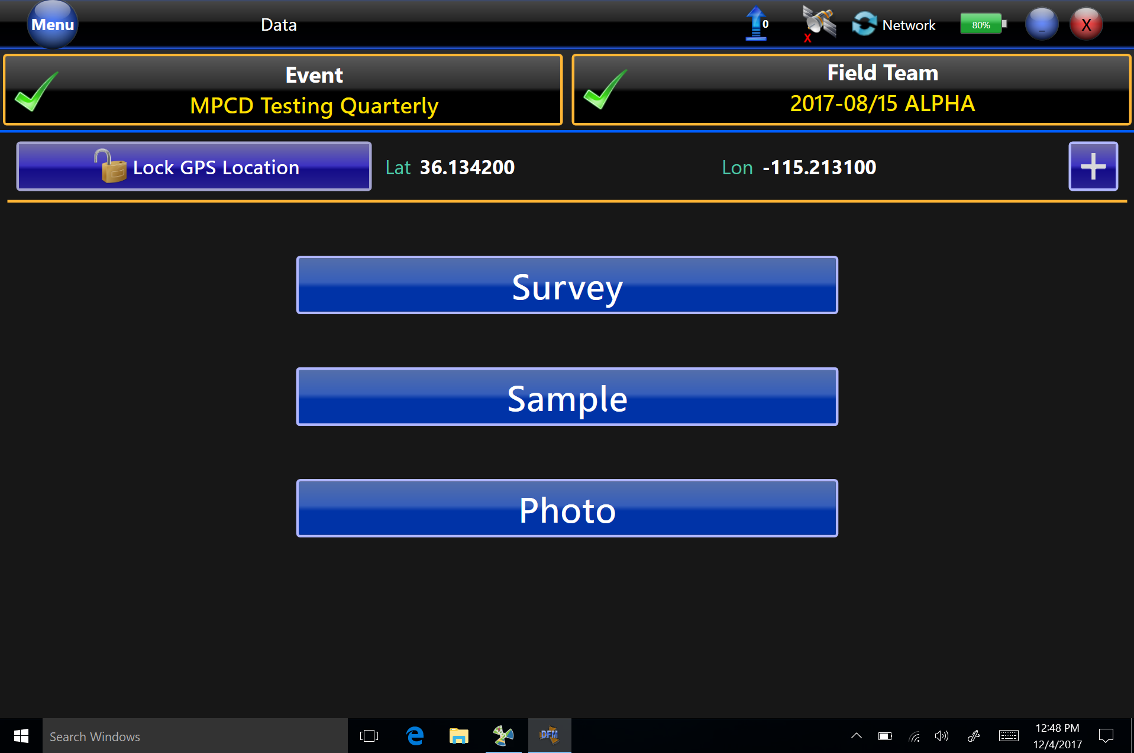
DFM – Digital Field Monitoring Program
Found on FRMAC Tablet
Notes:
The DFM software is what FRMAC field teams use to collect and transmit data to the RAMS database. Just as the RadResponder database has a RadResponder app, the DOE equivalent is true where the RAMS database uses DFM as the RAMS app. CMRT is available to transmit measurements, samples, and photos to the RAMS database. DFM is also used to connect the field teams with management through a chat feature. Field team instructions are sent to the tablet by management. Field teams are then able to see the locations where samples and measurements are requested on a map feature. Combining the map utility and the field team instructions allows the field teams enough information to complete their daily tasks.

Slide 19
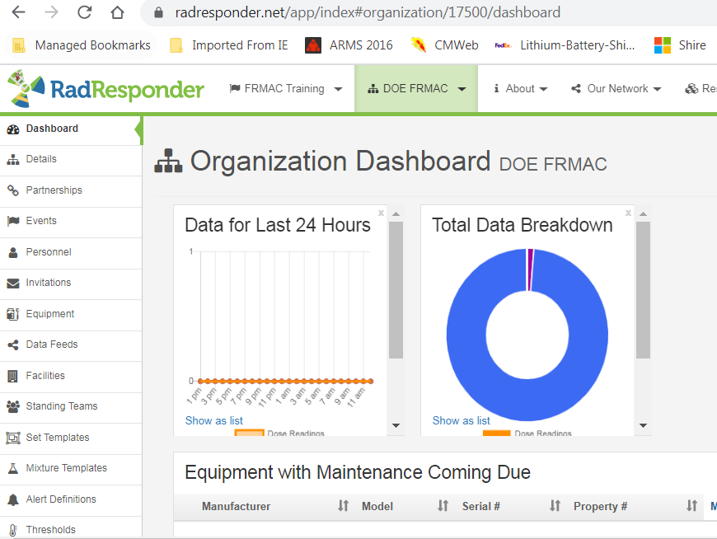
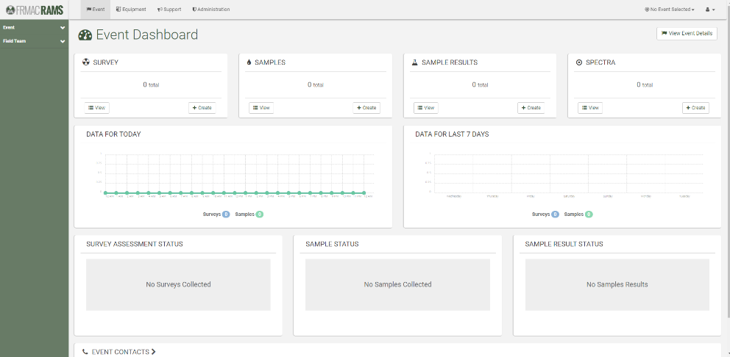
RAMS/RadResponder manages data…
Teams
  Contact info & locations
Instruments
Field measurements
Field samples
  Location & sample type
  Analysis Results
Photographs
Notes:
Currently, FRMAC collects data from both databases. Field teams can collect data with whatever system they are comfortable with or easier for them. The databases track a lot of data. The RAMS database is more of a pure database, where data is collected and stored with minimal visualization tools. RadResponder is a database and also contains visualization tools to see where data is on a map, status boards, and the ability to track responder locations. Again, FRMAC is transitioning to Rad Responder and will retire RAMS sometime in the future.

Slide 20
Documents and References

Slide 21
FRMAC Manuals
FRMAC divisions have manuals where processes and operational guidance is documented.
FRMAC divisions also have commonly used forms for the response (including Monitoring and Sampling forms and job aids).
Google: “FRMAC Manuals”
Additional information on FRMAC operations, methods, and procedures can also be found in the FRMAC manuals:
https://www.nnss.gov/pages/programs/FRMAC/FRMAC_DocumentsManuals.html
Notes:
Information contained in FRMAC manuals (cited below) may be valuable for reference purposes during an emergency. These manuals are available to the public on the Nevada National Security Site website:
https://www.nnss.gov/pages/programs/FRMAC/FRMAC_DocumentsManuals.html
FRMAC Operations Manual. This provides an overview of the operations and functions of the FRMAC during the emergency phase so that each participant can understand the individual tasks and their interface with the overall mission. The internal working operations are described from initial notification and the collection of data to the final distribution of data to the states(s) and the Coordinating Agency.
FRMAC Assessment Manual, Volumes I and II. The FRMAC Assessment Manual Volume I is the tool used to organize and guide activities of the FRMAC Assessment Division. This manual integrates many health physics tools and techniques used to make these assessments. The FRMAC Assessment Manual Volume II is a collection of pre-assessed scenarios. These pre-assessed scenarios contain default assessment parameters and techniques that could be applied to produce results that are consistent with the methodologies outlined in the FRMAC Assessment Manual Volume I.
FRMAC Monitoring and Sampling Manual, Volumes I and II. The purpose of Volume I is to detail the FRMAC Monitoring Division Operations during an emergency response. The manual describes the role and organization of the FRMAC Monitoring Division, deployment activities, and workflow development and implementation which includes default field team instructions. Volume II provides standard operating procedures (SOPs) for field radiation monitoring and sample collection activities that are performed by the FRMAC Monitoring and Sampling Division during a FRMAC response to a radiological emergency.
FRMAC Health and Safety Manual. The manual provides guidance for radiation safety, industrial hygiene, occupational safety, and, emergency medical care. The manual includes information on radiation exposure guidelines, personnel dosimetry, contamination control (including limits on contamination for release of equipment to uncontrolled areas), radioactive and hazardous waste packaging, and personal protective equipment.
FRMAC Laboratory Analysis. The FRMAC Laboratory Analysis Manual provides general guidance and some specific diagrams and forms to establish a common operating environment for FRMAC, and other, laboratory analysis personnel with regards to sample control and sample result data quality assurance. This manual is intended to provide enough guidance for stand-alone use without limiting FRMAC’s ability to integrate the work with other agencies and jurisdictions and laboratories.
The purpose of the FRMAC Fly Away Lab Manual is to provide guidance to Fly Away Laboratory (FAL) personnel responsible for the analysis of time sensitive radiological samples. The manual provides guidance on the instruments used, calibrations, and analysis.
The FRMAC Gamma Spectroscopist Knowledge Guide was developed as a training and reference manual for FRMAC gamma spectroscopists. The knowledge guide is geared towards applied HPGe gamma spectroscopy with an emphasis on examples. As such, the knowledge guide generally provides a limited but sufficient discussion of physics concepts.

Slide 22
Other Federal Manuals
U.S. EPA. PAG Manual: Protective Action Guides and Planning Guidance for Radiological Incidents, 2017
U.S. Food and Drug Administration. Accidental Radioactive Contamination of Human Food and Animal Feeds, August 13, 1998
U.S. NRC. RTM-96 Response Technical Manual, NUREG/BR-0150, Vol. 1, Rev. 4, March 1996
U.S. DoD. Nuclear Weapon Accident Response Procedures (NARP) Manual, DoD 3150.8-M, February 2005
Notes:
Obviously there are more federal manuals than can be listed in one slide…

Slide 23
If you have any questions about FRMAC, please contact:
Alvin Morris John Crapo
FRMAC Program Manager CM Program Manager
Alvin.Morris@nnsa.doe.gov John.Crapo@nnsa.doe.gov
702-794-1062 202-287-1035

Slide 24
Conclusion

Slide 25
Conclusion
Any questions about this or any other course module?
Thank you for participating!

